Slide 1
MMME2046 Dynamics: Control Lecture 5
Improving Transient and Steady-State Performance. Stability of Feedback Systems

Slide 2
Next week
8/3/2021
  The return of DB3!

Slide 3
Lecture Objectives:
Demonstrate how velocity feedback and PID controls can improve performance
Develop basic understanding of stability and behaviour in third and higher order systems
Introduce and use the Routh-Hurwitz stability criteria
MMME2046 Dynamics and Control Lecture 5

Slide 4

Summary Based on Case Studies
Hydraulic Position Control System: 1st order
Electro-Mechanical Position Control System: 2nd order
Steady-State Response/Error: Final Value Theorem
Transient Response: Poles (roots of the C.E.)
Result dependent upon type of input (step, ramp, etc.)

Slide 5
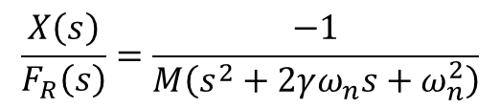
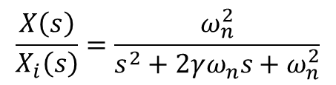
Last Week’s Example: Electro-Mechanical Position Control System
viscous
damping
lead
screw
mass
DC servo-
motor
f_{R}
servo-
amp
x (output)
+
position
transducer
V_{i}
-
input
voltage
It was shown that the transfer functions may be written as
$$\frac{X\left(s\right)}{X_{i}\left(s\right)}=\frac{ω_{n}^{2}}{s^{2}+2γω_{n}s+ω_{n}^{2}}$$
$$\frac{X\left(s\right)}{F_{R}\left(s\right)}=\frac{−1}{M\left(s^{2}+2γω_{n}s+ω_{n}^{2}\right)}$$
2nd order system

Slide 6
Electro-Mechanical Position Control System
This is an example of a feedback system with proportional control.
Position error, X_{i}-X
V_{i}-V_{x}
Control signal
F_{R}
V_{i}
−
1/K₄
+
K₄
K₀
+
X
−
The control signal is a constant gain times the position error
with K₀ = K₁K₂K₃ (collecting the gains of servo-amplifier, servo-motor and lead screw).
Q: Are there any other forms of control that can improve
transient and steady-state performance?
https://www.youtube.com/watch?v=7q4QDz1tcFw

Slide 7
a) Velocity Feedback
In addition to output feedback the rate of change of output is fed back.
In a position control system, this element will be the velocity, measured using a tachometer.
F_{R}
V_{i}
−
1/K₄
+
K₄
+
K₀
+
X
−
−
K_{v}s
The governing equation follows as:
velocity feedback ➔ viscous damping
The Velocity lag (F_{R} = 0) under ramp remains

Slide 8
b) Proportional and Derivative Control (P+D)
Proportional error is modified by adding to it a quantity proportional to the 1st derivative of error wrt time (i.e. the rate of change of error). Essentially then the D term is looking at the speed at which the actual results are approaching the desired. Often this is done electronically.
F_{R}
V_{i}
−
1/K₄
+
+
X
−
The governing equation follows as (check this):
Notes:
i) Damping increased without increasing power consumption.
ii) KT_{D}sX_{i}(s) term indicates that large overshoot is anticipated
and the transient response can be improved.

Slide 9
b) Proportional and Derivative Control (P+D)
Notes (continued):
iii) The steady-state error (F_{R} = 0) is independent of T_{D} (for a ramp check this):
iv) Derivative action tends to amplify ‘noise’ in the system:
V_{i}
V_{o}
in time domain
If the input signal is
the output is
Now, if
noise is amplified

Slide 10
Video Interlude
What happens when a car stops suddenly:
  https://www.youtube.com/watch?v=mnI-LiKCtuE
Automated collision prevention:
  https://www.youtube.com/watch?v=TJgUiZgX5rE
  What does the sensor need to know?
    Distance to object
    Rate of change
    Proportional – derivative control!

Slide 11
c) Proportional and Integral Control (P+I)
Proportional error is modified by adding an integral of error.
This can also be carried out electronically.
F_{R}
V_{i}
−
1/K₄
+
+
X
−
The governing equation follows as (check this):
The steady-state error (F_{R} = 0) under ramp is (check this):
0

Slide 12
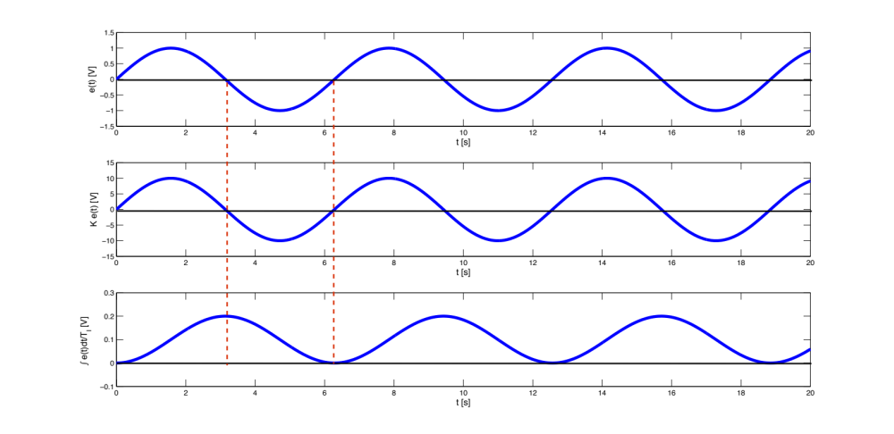
c) Proportional and Integral Control (P+I)
The integral action tends to destabilise the system: proportional action keeps track of sign changes, while integral action does not.
The effect is known as integral windup.

Slide 13
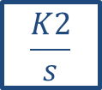




d) Proportional-Integral-Derivative Control (PID)
This the most common controller used in industry. To switch off an element, set gain to zero.
$$\frac{K2}{s}$$
+
+
+
$$K1$$
$$K3$$
$$G1$$
-
+
$K4$s
G1(s) is the open loop transfer function of the system
Tuning PID controllers is beyond this module’s scope. What are the possible drawbacks of using PID control?

Slide 14
Remote control
Simple example – remote operators for dockside container cranes
https://www.youtube.com/watch?v=tEk2v4RyFh4
How would you move to full automation?
  Actuators stay the same
  Sensors?
  Software?

Slide 15
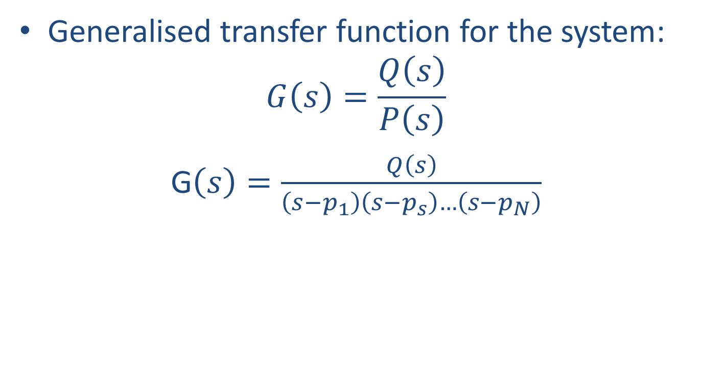
Transient response – Third and higher order systems
Generalised transfer function for the system:
$$G\left(s\right)=\frac{Q\left(s\right)}{P\left(s\right)}$$
G$\left(s\right)=\frac{Q\left(s\right)}{\left(s−p_{1}\right)\left(s−p_{s}\right)…\left(s−p_{N}\right)}$

Slide 16
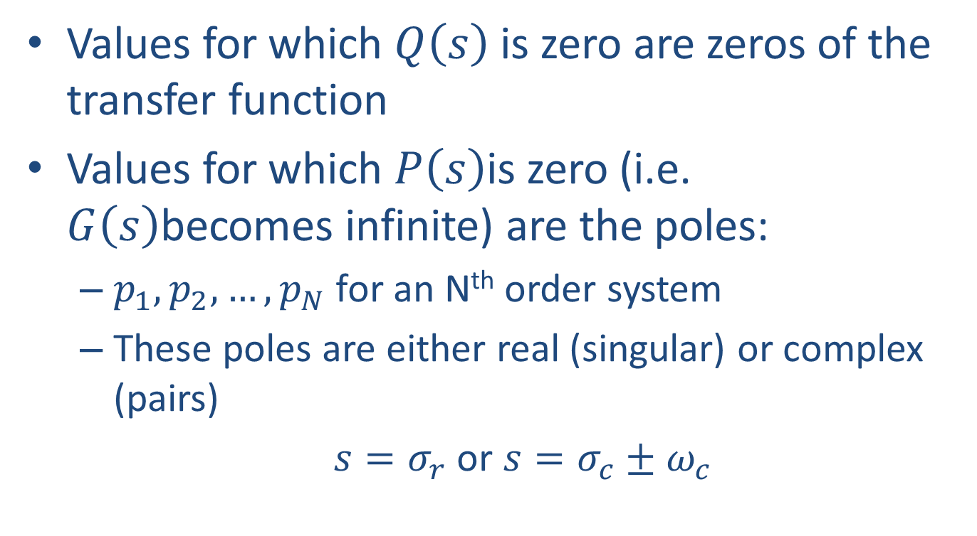
Transient Response – Higher order systems
Values for which $Q\left(s\right)$ is zero are zeros of the transfer function
Values for which $P\left(s\right)$is zero (i.e. $G\left(s\right)$becomes infinite) are the poles:
  $p_{1},p_{2},…,p_{N}$ for an N^{th} order system
  These poles are either real (singular) or complex (pairs)
  $s=σ_{r}$ or $s=σ_{c}±ω_{c}$

Slide 17
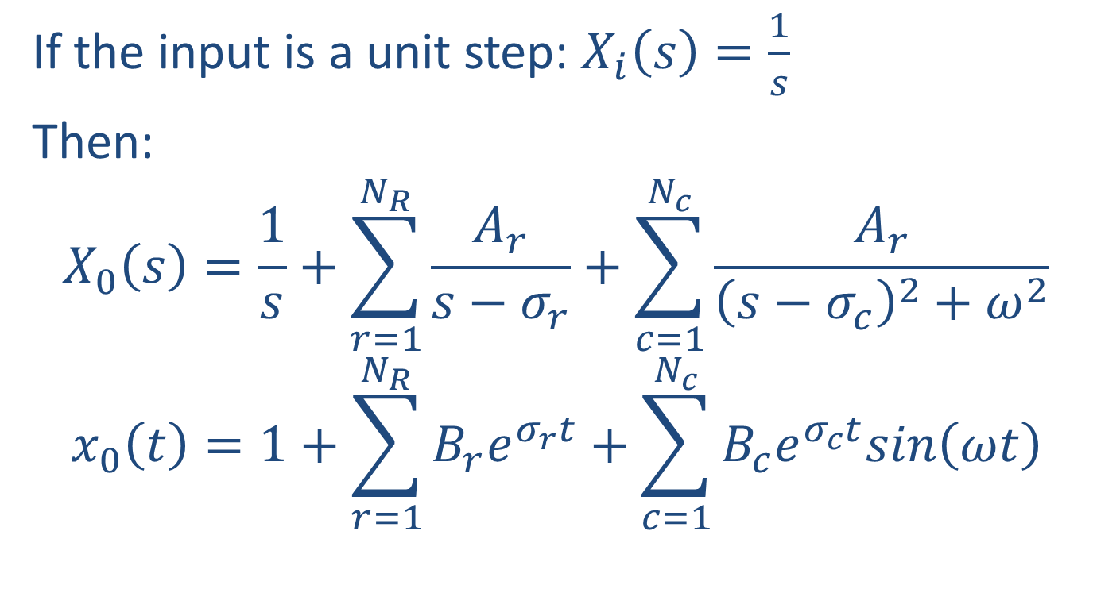
Transient Response – Higher order systems
If the input is a unit step: $X_{i}\left(s\right)=\frac{1}{s}$
Then:
$$X_{0}\left(s\right)=\frac{1}{s}+\sum_{r=1}^{N_{R}}{\frac{A_{r}}{s−σ_{r}}}+\sum_{c=1}^{N_{c}}{\frac{A_{r}}{{\left(s−σ_{c}\right)}^{2}+ω^{2}}}$$
$$x_{0}\left(t\right)=1+\sum_{r=1}^{N_{R}}{B_{r}e^{σ_{r}t}}+\sum_{c=1}^{N_{c}}{B_{c}e^{σ_{c}t}sin\left(ωt\right)}$$

Slide 18
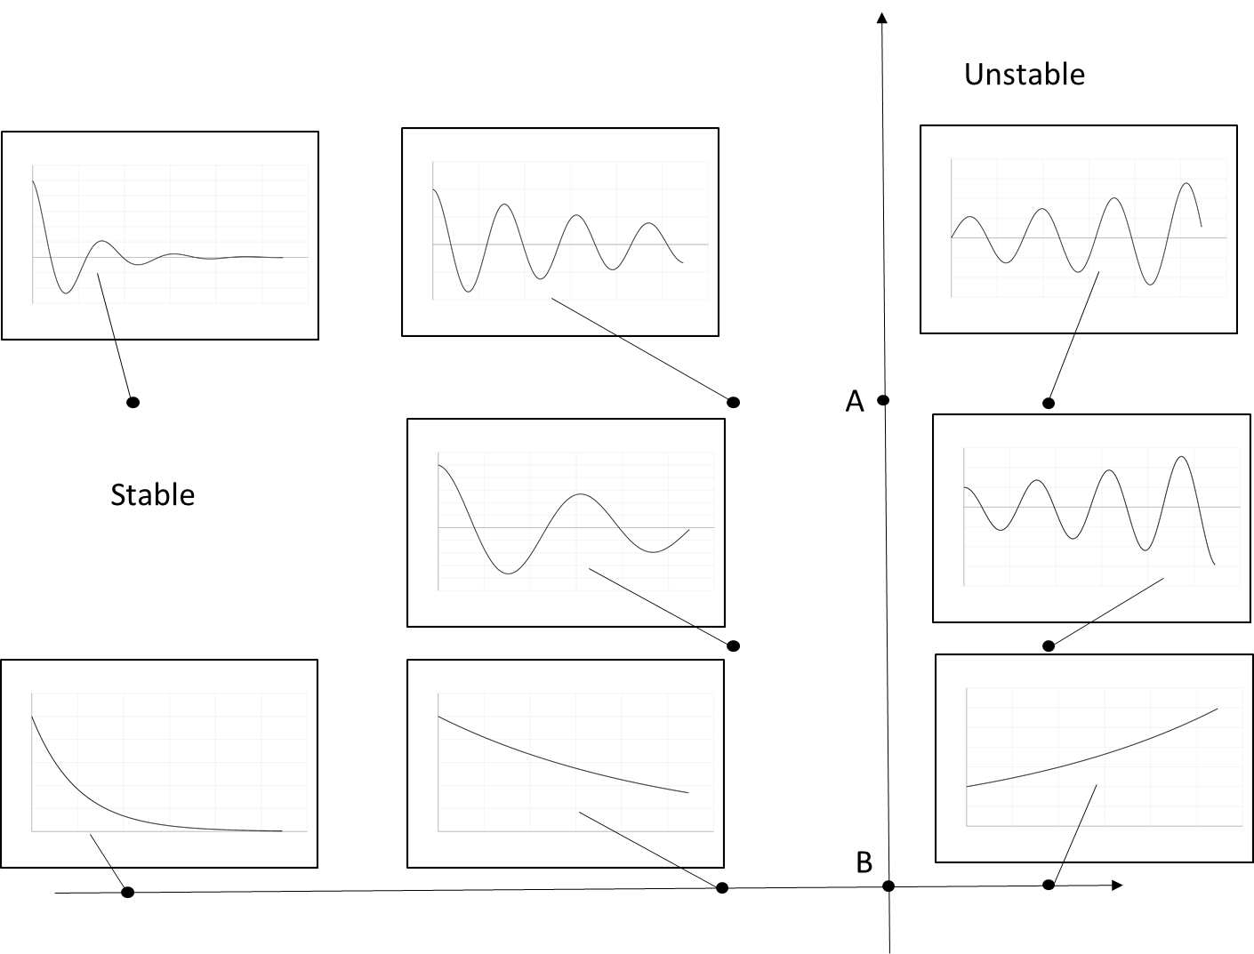

Slide 19
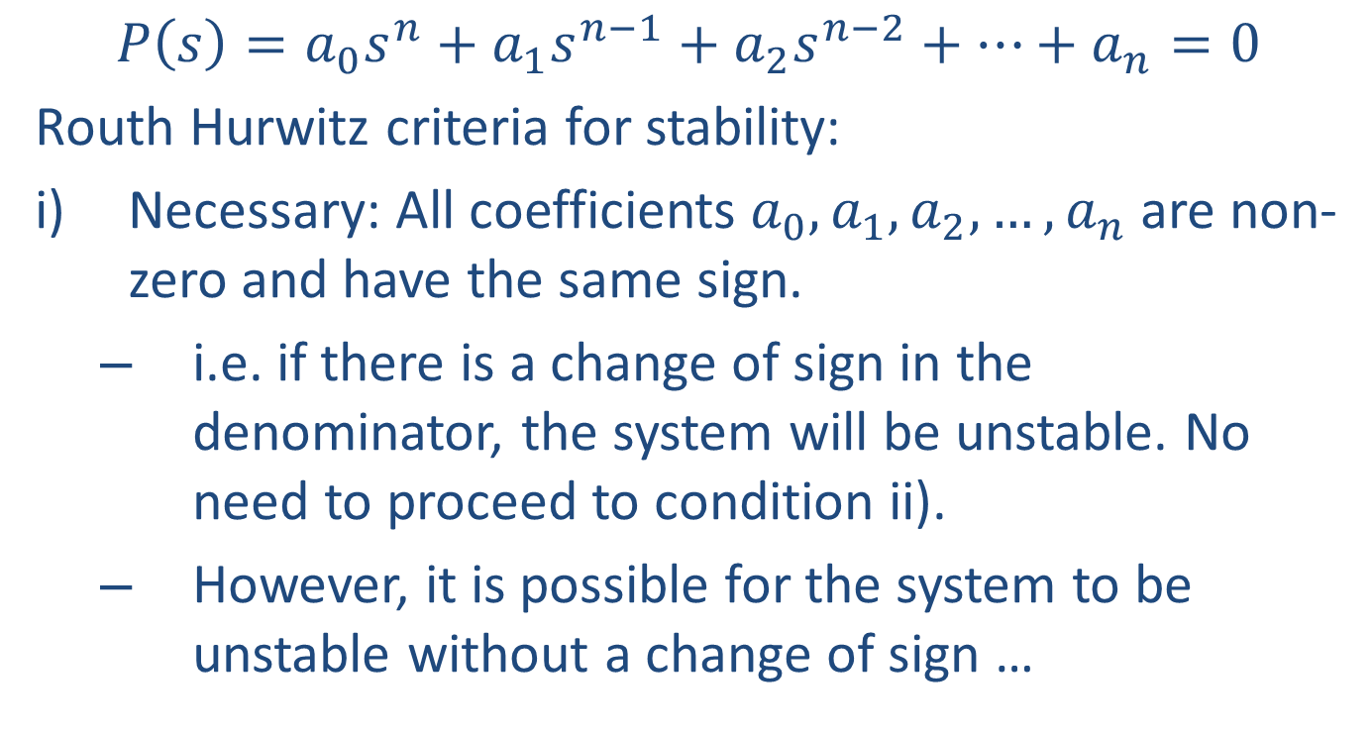
Routh-Hurwitz Stability Criteria
$$P\left(s\right)=a_{0}s^{n}+a_{1}s^{n−1}+a_{2}s^{n−2}+…+a_{n}=0$$
Routh Hurwitz criteria for stability:
Necessary: All coefficients $a_{0},a_{1},a_{2},…,a_{n}$ are non-zero and have the same sign.
  i.e. if there is a change of sign in the denominator, the system will be unstable. No need to proceed to condition ii).
  However, it is possible for the system to be unstable without a change of sign …

Slide 20
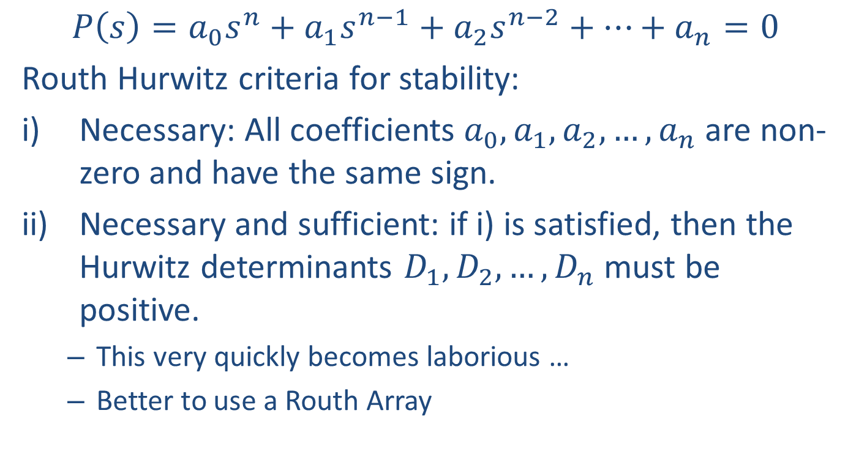
Routh-Hurwitz Stability Criteria
$$P\left(s\right)=a_{0}s^{n}+a_{1}s^{n−1}+a_{2}s^{n−2}+…+a_{n}=0$$
Routh Hurwitz criteria for stability:
Necessary: All coefficients $a_{0},a_{1},a_{2},…,a_{n}$ are non-zero and have the same sign.
Necessary and sufficient: if i) is satisfied, then the Hurwitz determinants $D_{1},D_{2},…,D_{n}$ must be positive.
  This very quickly becomes laborious …
  Better to use a Routh Array

Slide 21
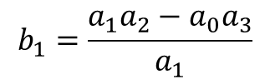
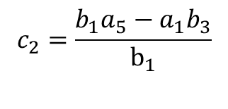
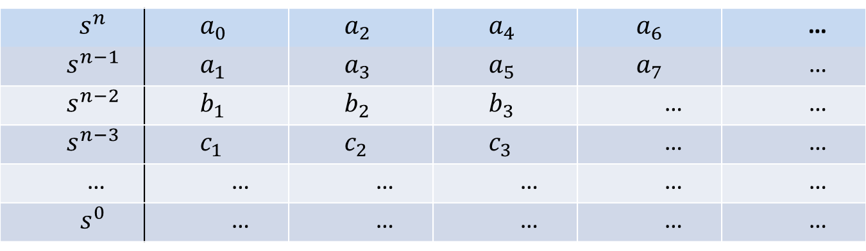
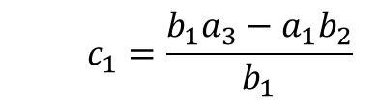
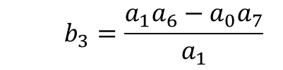
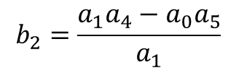
Routh-Hurwitz Stability Criteria (Routh Array)
$$s^{n}$$ | $$a_{0}$$ | $$a_{2}$$ | $$a_{4}$$ | $$a_{6}$$ | …
$$s^{n−1}$$ | $$a_{1}$$ | $$a_{3}$$ | $$a_{5}$$ | $$a_{7}$$ | …
$$s^{n−2}$$ | $$b_{1}$$ | $$b_{2}$$ | $$b_{3}$$ | … | …
$$s^{n−3}$$ | $$c_{1}$$ | $$c_{2}$$ | $$c_{3}$$ | … | …
… | … | … | … | … | …
$$s^{0}$$ | … | … | … | … | …
$$b_{1}=\frac{a_{1}a_{2}−a_{0}a_{3}}{a_{1}}$$
$$b_{2}=\frac{a_{1}a_{4}−a_{0}a_{5}}{a_{1}}$$
$$b_{3}=\frac{a_{1}a_{6}−a_{0}a_{7}}{a_{1}}$$
$$c_{1}=\frac{b_{1}a_{3}−a_{1}b_{2}}{b_{1}}$$
$$c_{2}=\frac{b_{1}a_{5}−a_{1}b_{3}}{b_{1}}$$

Slide 22
Routh-Hurwitz Stability Criteria
Using the Routh Array:
If there is a change of sign in the first column, there is a root on the real, positive side of the s-plane. For every change of sign, there is another positive root.
Thus, for the system to be stable, all values in the first column must be positive.
  There is an issue if there is a zero in the first column, or there is a complete row of zeros so that the array cannot be completed.
  Beyond the scope of MM2DYN!

