Slide 1
Dynamics and Control
Control Consolidation 3

Slide 2
General Introduction – Session 3
Second order systems and PID controllers – additional material
Routh Hurwitz – worked examples
Q&A

Slide 3
a) Velocity Feedback
F_{R}
V_{i}
−
1/K₄
+
K₄
+
K₀
+
X
−
−
K_{v}s
The governing equation follows as:
velocity feedback ➔ viscous damping
The Velocity lag (F_{R} = 0) under ramp remains

Slide 4
Velocity Feedback
Use block diagram manipulation:
Becomes:
F_{R}
V_{i}
−
1/K₄
+
K₄
+
K₀
+
X
−
−
K_{v}s
F_{R}
V_{i}
−
1/K₄
+
K₄
+
K₀
+
X
−
+
K_{v}s/K₄

Slide 5
Velocity Feedback
F_{R}
Becomes:
V_{i}
−
1/K₄
+
K₄
+
K₀
+
X
−
+
K_{v}s/K₄
F_{R}
V_{i}
−
1/K₄
+
K₄
+
K₀
+
X
−
1+K_{v}s/K₄

Slide 6
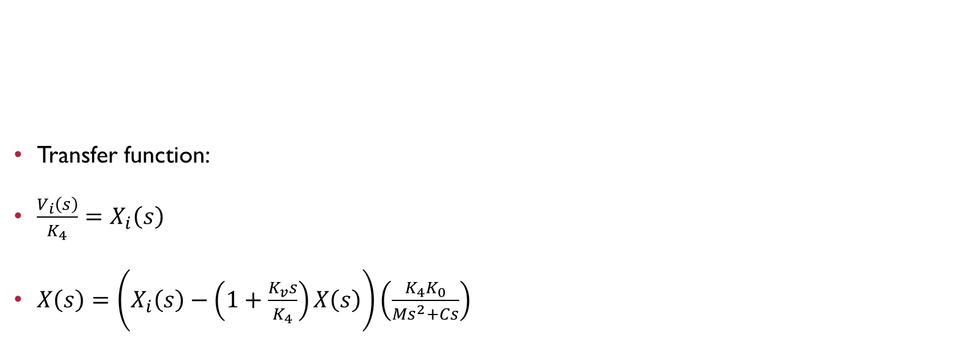
Velocity Feedback
F_{R}
Transfer function:
$\frac{V_{i}\left(s\right)}{K_{4}}=X_{i}\left(s\right)$
$X\left(s\right)=\left(X_{i}\left(s\right)−\left(1+\frac{K_{v}s}{K_{4}}\right)X\left(s\right)\right)\left(\frac{K_{4}K_{0}}{Ms^{2}+Cs}\right)$
V_{i}
−
1/K₄
+
K₄
+
K₀
+
X
−
1+K_{v}s/K₄

Slide 7
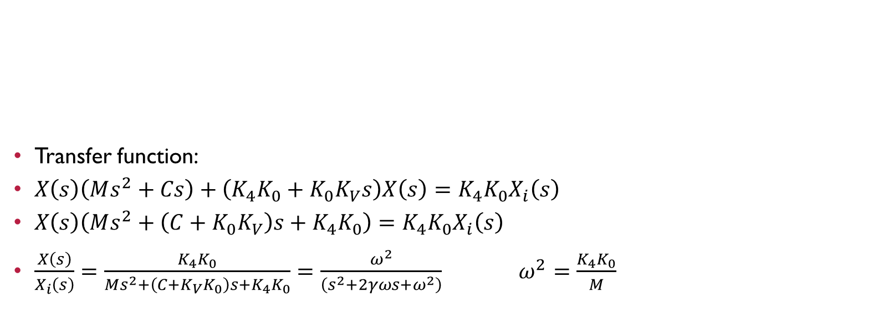
Velocity Feedback
F_{R}
Transfer function:
$X\left(s\right)\left(Ms^{2}+Cs\right)+\left(K_{4}K_{0}+K_{0}K_{V}s\right)X\left(s\right)=K_{4}K_{0}X_{i}\left(s\right)$
$X\left(s\right)\left(Ms^{2}+\left(C+K_{0}K_{V}\right)s+K_{4}K_{0}\right)=K_{4}K_{0}X_{i}\left(s\right)$
$\frac{X\left(s\right)}{X_{i}\left(s\right)}=\frac{K_{4}K_{0}}{Ms^{2}+\left(C+K_{V}K_{0}\right)s+K_{4}K_{0}}=\frac{ω^{2}}{\left(s^{2}+2γωs+ω^{2}\right)}$ $ω^{2}=\frac{K_{4}K_{0}}{M}$
V_{i}
−
1/K₄
+
K₄
+
K₀
+
X
−
1+K_{v}s/K₄

Slide 8
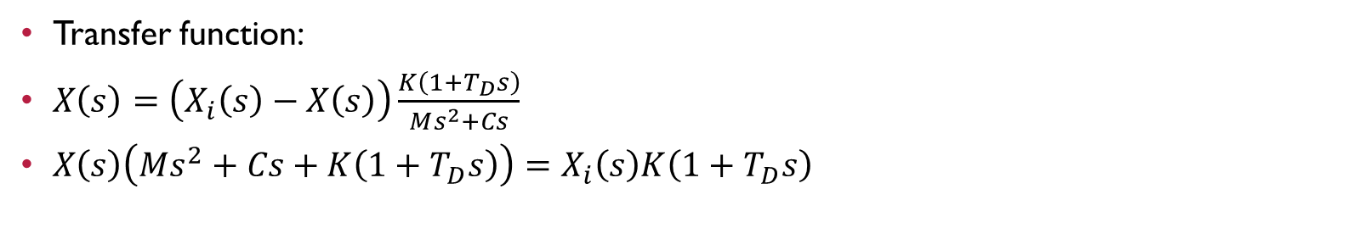
Proportional and Derivative Control (P+D)
F_{R}
V_{i}
−
1/K₄
+
+
X
−
Transfer function:
$X\left(s\right)=\left(X_{i}\left(s\right)−X\left(s\right)\right)\frac{K\left(1+T_{D}s\right)}{Ms^{2}+Cs}$
$X\left(s\right)\left(Ms^{2}+Cs+K\left(1+T_{D}s\right)\right)=X_{i}\left(s\right)K\left(1+T_{D}s\right)$
Notes:
i) Damping increased without increasing power consumption (why?)
ii) Overshoot is decreased
iii) Derivative control has no effect on steady state error.

Slide 9
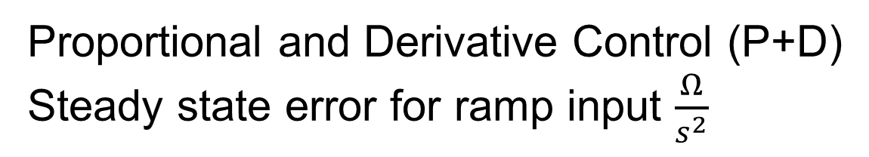
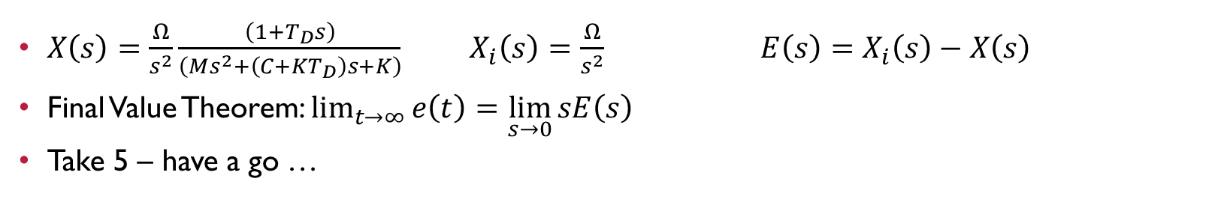
Proportional and Derivative Control (P+D)
Steady state error for ramp input $\frac{Ω}{s^{2}}$
X_{i}
+
X
−
$X\left(s\right)=\frac{Ω}{s^{2}}\frac{\left(1+T_{D}s\right)}{\left(Ms^{2}+\left(C+{KT}_{D}\right)s+K\right)}$ $X_{i}\left(s\right)=\frac{Ω}{s^{2}} E\left(s\right)=$ $X_{i}\left(s\right)−X\left(s\right)$
Final Value Theorem: $\lim_{t→∞}{e\left(t\right)=}$ $\lim_{s→0}{sE\left(s\right)}$
Take 5 – have a go …

Slide 10
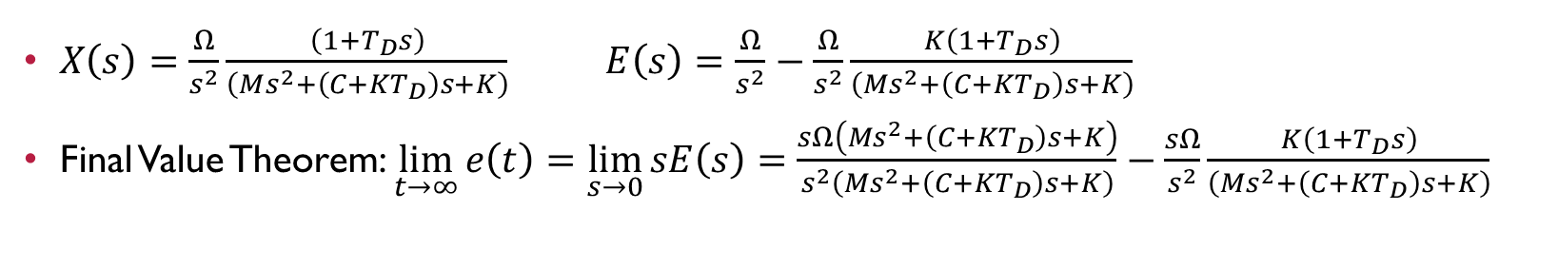
Proportional and Derivative Control (P+D)
Steady state error for ramp input $\frac{Ω}{s^{2}}$
X_{i}
+
X
−
$X\left(s\right)=\frac{Ω}{s^{2}}\frac{\left(1+T_{D}s\right)}{\left(Ms^{2}+\left(C+{KT}_{D}\right)s+K\right)}$ $E\left(s\right)=\frac{Ω}{s^{2}}−\frac{Ω}{s^{2}}\frac{K\left(1+T_{D}s\right)}{\left(Ms^{2}+\left(C+KT_{D}\right)s+K\right)}$
Final Value Theorem: $\lim_{t→∞}{e\left(t\right)=}$ $\lim_{s→0}{sE\left(s\right)}=$ $\frac{sΩ\left(Ms^{2}+\left(C+{KT}_{D}\right)s+K\right)}{s^{2}\left(Ms^{2}+\left(C+{KT}_{D}\right)s+K\right)}−\frac{sΩ}{s^{2}}\frac{K\left(1+T_{D}s\right)}{\left(Ms^{2}+\left(C+KT_{D}\right)s+K\right)}$
$\lim_{t→∞}{e\left(t\right)=}$ $\lim_{s→0}{sE\left(s\right)}=$ $\frac{sΩ}{s^{2}}\frac{\left(Ms^{2}+\left(C+KT_{D}\right)s+K\right)−K\left(1+T_{D}s\right)s}{\left(Ms^{2}+\left(C+{KT}_{D}\right)s+K\right)}=\frac{sΩ\left(Ms^{2}+Cs\right)}{s^{2}\left(Ms^{2}+\left(C+T_{D}\right)s+K\right)}$

Slide 11
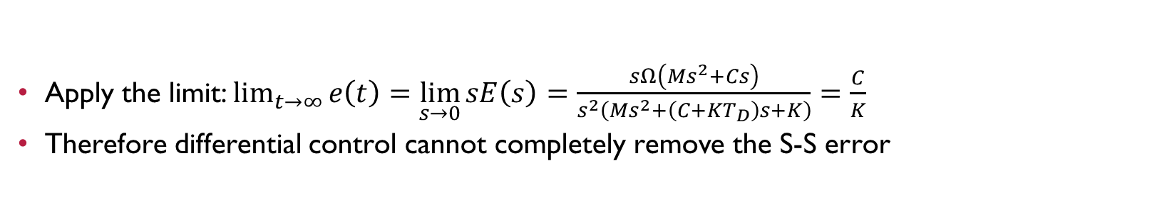
Proportional and Derivative Control (P+D)
Steady state error for ramp input $\frac{Ω}{s^{2}}$
X_{i}
+
X
−
$\lim_{t→∞}{e\left(t\right)=}$ $\lim_{s→0}{sE\left(s\right)}=$ $\frac{sΩ}{s^{2}}\frac{\left(Ms^{2}+\left(C+KT_{D}\right)s+K\right)−K\left(1+T_{D}s\right)s}{\left(Ms^{2}+\left(C+{KT}_{D}\right)s+K\right)}=\frac{sΩ\left(Ms^{2}+Cs\right)}{s^{2}\left(Ms^{2}+\left(C+T_{D}\right)s+K\right)}$
Apply the limit: $\lim_{t→∞}{e\left(t\right)=}$ $\lim_{s→0}{sE\left(s\right)}=$ $\frac{sΩ\left(Ms^{2}+Cs\right)}{s^{2}\left(Ms^{2}+\left(C+{KT}_{D}\right)s+K\right)}=\frac{C}{K}$
Therefore differential control cannot completely remove the S-S error

Slide 12
Proportional and Derivative Control (P+D)
iv) Derivative action tends to amplify ‘noise’ in the system:
V_{i}
V_{o}
in time domain
If the input signal is
the output is
Now, if
noise is amplified

Slide 13
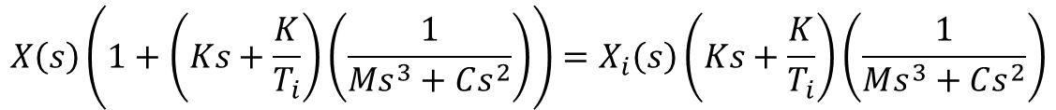
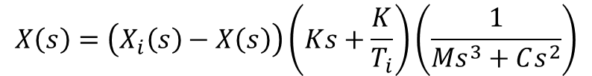
Proportional and Integral Control (P+I)
Proportional error is modified by adding an integral of error.
This can also be carried out electronically.
+
X_{i}
X
−
Governing equation:
$$X\left(s\right)=\left(X_{i}\left(s\right)−X\left(s\right)\right)\left(Ks+\frac{K}{T_{i}}\right)\left(\frac{1}{Ms^{3}+Cs^{2}}\right)$$
$$X\left(s\right)\left(1+\left(Ks+\frac{K}{T_{i}}\right)\left(\frac{1}{Ms^{3}+Cs^{2}}\right)\right)=X_{i}\left(s\right)\left(Ks+\frac{K}{T_{i}}\right)\left(\frac{1}{Ms^{3}+Cs^{2}}\right)$$

Slide 14
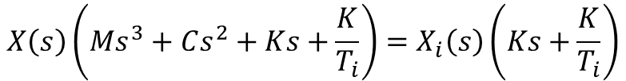
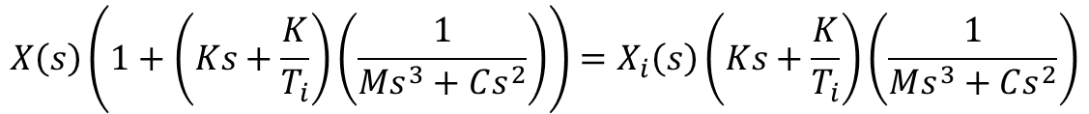
Proportional and Integral Control (P+I)
+
X_{i}
X
−
Governing equation:
$$X\left(s\right)\left(1+\left(Ks+\frac{K}{T_{i}}\right)\left(\frac{1}{Ms^{3}+Cs^{2}}\right)\right)=X_{i}\left(s\right)\left(Ks+\frac{K}{T_{i}}\right)\left(\frac{1}{Ms^{3}+Cs^{2}}\right)$$
$$X\left(s\right)\left(Ms^{3}+Cs^{2}+Ks+\frac{K}{T_{i}}\right)=X_{i}\left(s\right)\left(Ks+\frac{K}{T_{i}}\right)$$

Slide 15
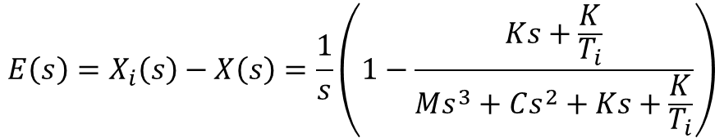
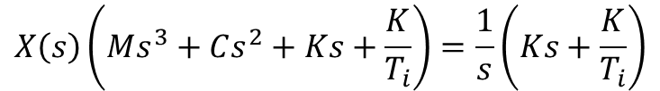
Proportional and Integral Control (P+I)
+
X_{i}
X
−
Step input:
$$X\left(s\right)\left(Ms^{3}+Cs^{2}+Ks+\frac{K}{T_{i}}\right)=\frac{1}{s}\left(Ks+\frac{K}{T_{i}}\right)$$
$$E\left(s\right)=X_{i}\left(s\right)−X\left(s\right)=\frac{1}{s}\left(1−\frac{Ks+\frac{K}{T_{i}}}{Ms^{3}+Cs^{2}+Ks+\frac{K}{T_{i}}}\right)$$

Slide 16
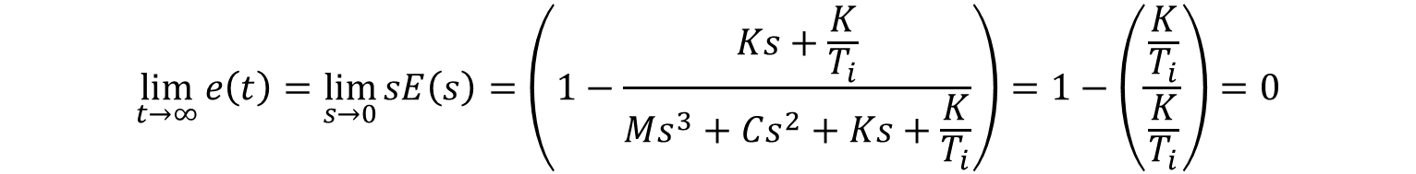
Proportional and Integral Control (P+I)
+
X_{i}
X
−
Final value Theorem for step input:
$$\lim_{t→∞}{e\left(t\right)}=\lim_{s→0}{sE\left(s\right)}=\left(1−\frac{Ks+\frac{K}{T_{i}}}{Ms^{3}+Cs^{2}+Ks+\frac{K}{T_{i}}}\right)=1−\left(\frac{\frac{K}{T_{i}}}{\frac{K}{T_{i}}}\right)=0$$

Slide 17
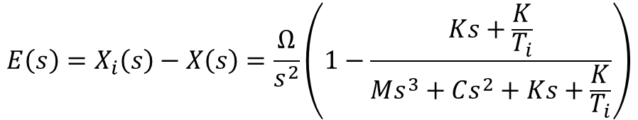
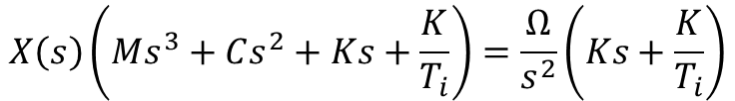
Proportional and Integral Control (P+I)
+
X_{i}
X
−
Ramp input:
$$X\left(s\right)\left(Ms^{3}+Cs^{2}+Ks+\frac{K}{T_{i}}\right)=\frac{Ω}{s^{2}}\left(Ks+\frac{K}{T_{i}}\right)$$
$$E\left(s\right)=X_{i}\left(s\right)−X\left(s\right)=\frac{Ω}{s^{2}}\left(1−\frac{Ks+\frac{K}{T_{i}}}{Ms^{3}+Cs^{2}+Ks+\frac{K}{T_{i}}}\right)$$

Slide 18
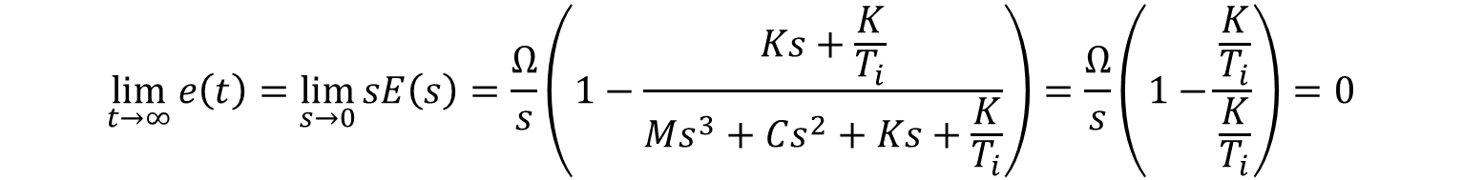
Proportional and Integral Control (P+I)
+
X_{i}
X
−
Final value Theorem for ramp input:
$$\lim_{t→∞}{e\left(t\right)}=\lim_{s→0}{sE\left(s\right)}=\frac{Ω}{s}\left(1−\frac{Ks+\frac{K}{T_{i}}}{Ms^{3}+Cs^{2}+Ks+\frac{K}{T_{i}}}\right)=\frac{Ω}{s}\left(1−\frac{\frac{K}{T_{i}}}{\frac{K}{T_{i}}}\right)=0$$

Slide 19
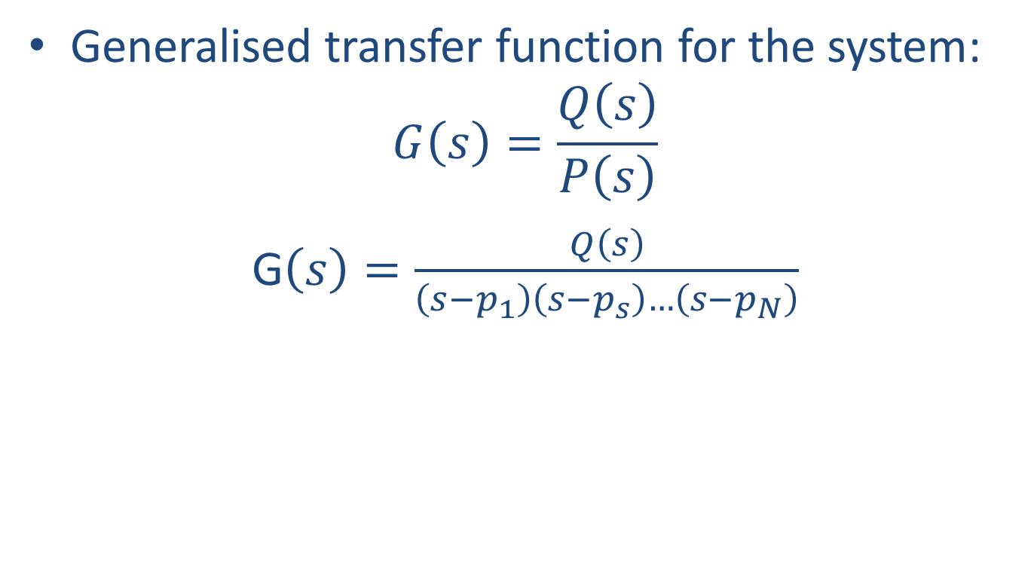
Transient response – Third and higher order systems
Generalised transfer function for the system:
$$G\left(s\right)=\frac{Q\left(s\right)}{P\left(s\right)}$$
G$\left(s\right)=\frac{Q\left(s\right)}{\left(s−p_{1}\right)\left(s−p_{s}\right)…\left(s−p_{N}\right)}$

Slide 20
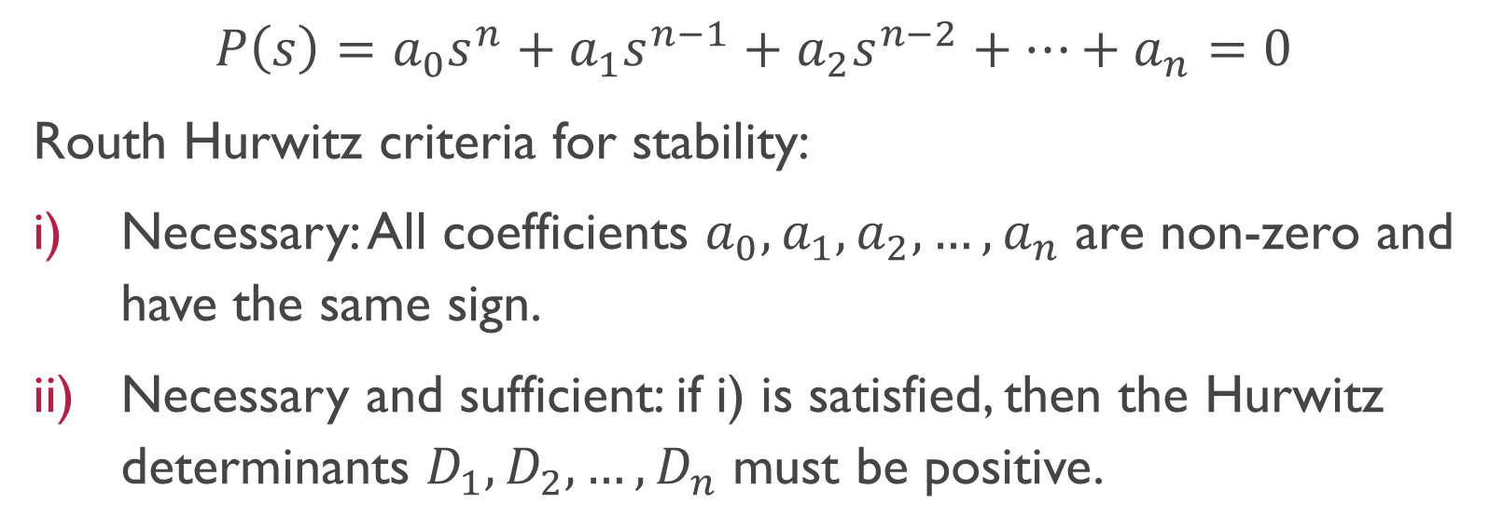
Routh-Hurwitz Stability Criteria
$$P\left(s\right)=a_{0}s^{n}+a_{1}s^{n−1}+a_{2}s^{n−2}+…+a_{n}=0$$
Routh Hurwitz criteria for stability:
Necessary: All coefficients $a_{0},a_{1},a_{2},…,a_{n}$ are non-zero and have the same sign.
Necessary and sufficient: if i) is satisfied, then the Hurwitz determinants $D_{1},D_{2},…,D_{n}$ must be positive.

Slide 21
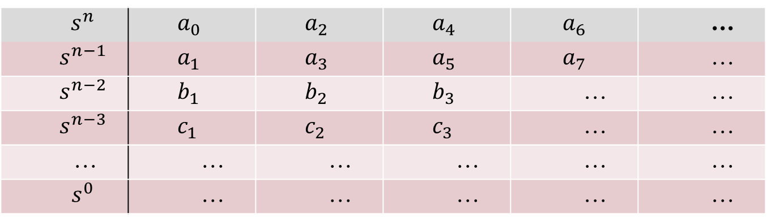
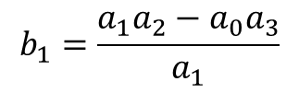
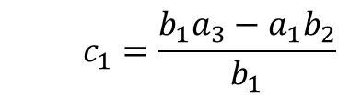
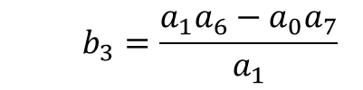
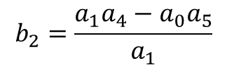
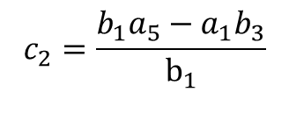
Routh-Hurwitz Stability Criteria (Routh Array)
$$s^{n}$$ | $$a_{0}$$ | $$a_{2}$$ | $$a_{4}$$ | $$a_{6}$$ | …
$$s^{n−1}$$ | $$a_{1}$$ | $$a_{3}$$ | $$a_{5}$$ | $$a_{7}$$ | …
$$s^{n−2}$$ | $$b_{1}$$ | $$b_{2}$$ | $$b_{3}$$ | … | …
$$s^{n−3}$$ | $$c_{1}$$ | $$c_{2}$$ | $$c_{3}$$ | … | …
… | … | … | … | … | …
$$s^{0}$$ | … | … | … | … | …
$$b_{1}=\frac{a_{1}a_{2}−a_{0}a_{3}}{a_{1}}$$
$$b_{2}=\frac{a_{1}a_{4}−a_{0}a_{5}}{a_{1}}$$
$$b_{3}=\frac{a_{1}a_{6}−a_{0}a_{7}}{a_{1}}$$
$$c_{1}=\frac{b_{1}a_{3}−a_{1}b_{2}}{b_{1}}$$
$$c_{2}=\frac{b_{1}a_{5}−a_{1}b_{3}}{b_{1}}$$

Slide 22
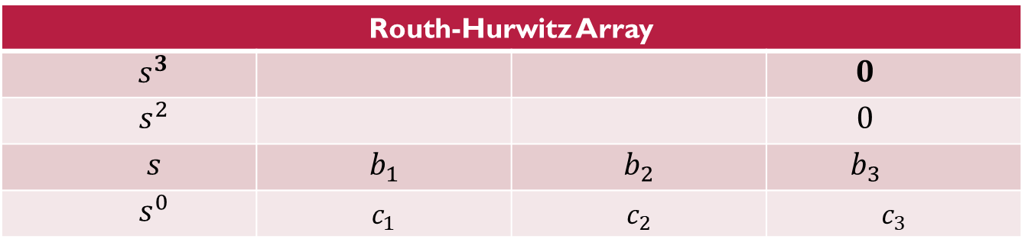
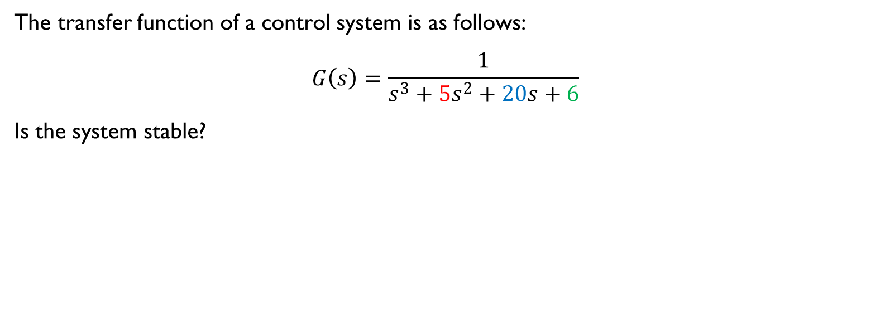
Example Sheet 5 Question 4
The transfer function of a control system is as follows:
$$G\left(s\right)=\frac{1}{s^{3}+5s^{2}+20s+6}$$
Is the system stable?
Routh-Hurwitz Array
$$s^{3}$$ |  |  | $$0$$
$$s^{2}$$ |  |  | $$0$$
$$s$$ | $$b_{1}$$ | $$b_{2}$$ | $$b_{3}$$
$$s^{0}$$ | $$c_{1}$$ | $$c_{2}$$ | $$c_{3}$$

Slide 23
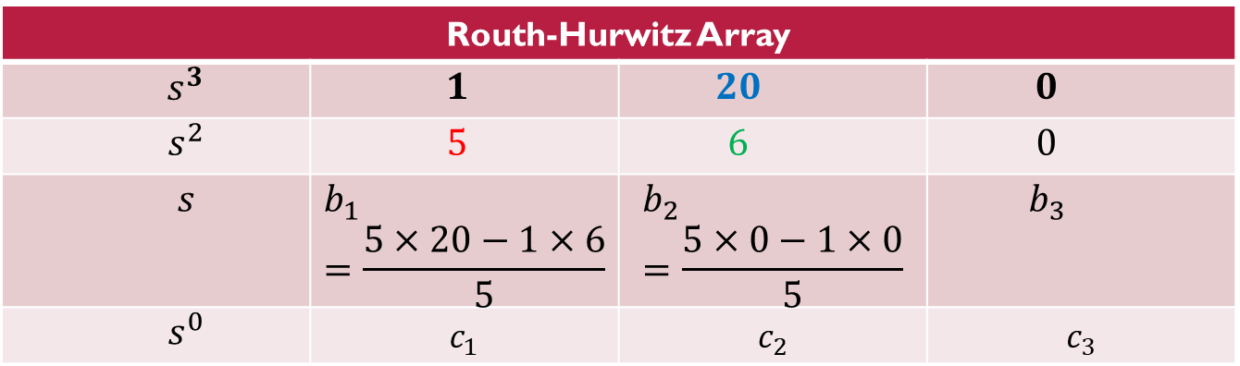
Example Sheet 5 Question 4
The transfer function of a control system is as follows:
$$G\left(s\right)=\frac{1}{s^{3}+5s^{2}+20s+6}$$
Is the system stable?
Routh-Hurwitz Array
$$s^{3}$$ | $$1$$ | $$20$$ | $$0$$
$$s^{2}$$ | $$5$$ | $$6$$ | $$0$$
$$s$$ | $$b_{1}=\frac{5×20−1×6}{5}$$ | $$b_{2}=\frac{5×0−1×0}{5}$$ | $$b_{3}$$
$$s^{0}$$ | $$c_{1}$$ | $$c_{2}$$ | $$c_{3}$$

Slide 24
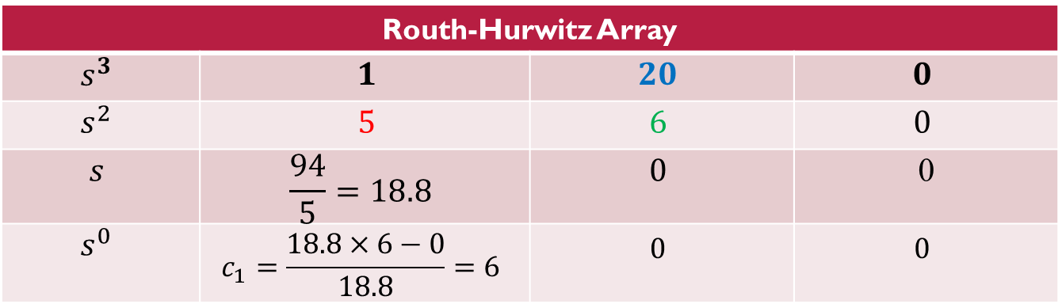
Example Sheet 5 Question 4
The transfer function of a control system is as follows:
$$G\left(s\right)=\frac{1}{s^{3}+5s^{2}+20s+6}$$
Is the system stable?
Routh-Hurwitz Array
$$s^{3}$$ | $$1$$ | $$20$$ | $$0$$
$$s^{2}$$ | $$5$$ | $$6$$ | $$0$$
$$s$$ | $$\frac{94}{5}=18.8$$ | $$0$$ | 0
$$s^{0}$$ | $$c_{1}=\frac{18.8×6−0}{18.8}=6$$ | $$0$$ | $$0$$

Slide 25
Example Sheet 5 Question 4
The transfer function of a control system is as follows:
$$G\left(s\right)=\frac{1}{s^{3}+5s^{2}+20s+6}$$
Is the system stable?
Routh-Hurwitz Array
$$s^{3}$$ | $$1$$ | $$20$$ | $$0$$
$$s^{2}$$ | $$5$$ | $$6$$ | $$0$$
$$s$$ | $$\frac{94}{5}=18.8$$ | $$0$$ | 0
$$s^{0}$$ | $$c_{1}=\frac{18.8×6−0}{18.8}=6$$ | $$0$$ | $$0$$

Slide 26
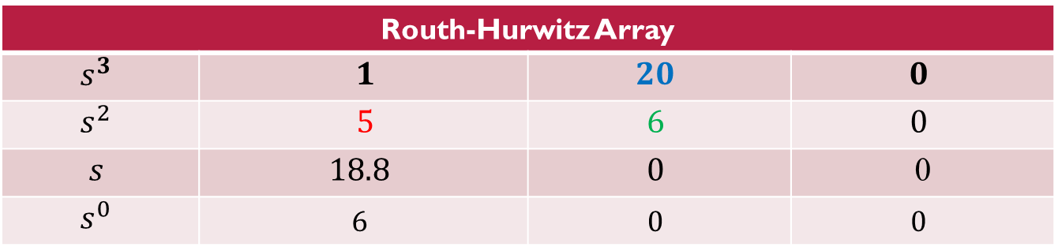
Example Sheet 5 Question 4
The transfer function of a control system is as follows:
$$G\left(s\right)=\frac{1}{s^{3}+5s^{2}+20s+6}$$
Is the system stable?
Routh-Hurwitz Array
$$s^{3}$$ | $$1$$ | $$20$$ | $$0$$
$$s^{2}$$ | $$5$$ | $$6$$ | $$0$$
$$s$$ | $$18.8$$ | $$0$$ | 0
$$s^{0}$$ | $$6$$ | $$0$$ | $$0$$
No change of sign in the first column: system is stable.

Slide 27
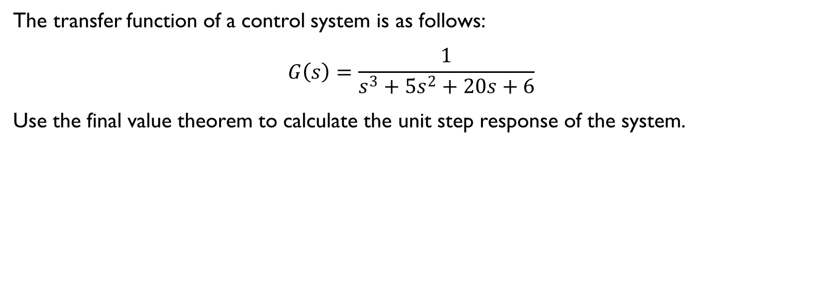
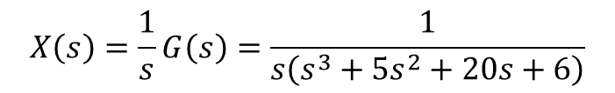
Example Sheet 5 Question 4
The transfer function of a control system is as follows:
$$G\left(s\right)=\frac{1}{s^{3}+5s^{2}+20s+6}$$
Use the final value theorem to calculate the unit step response of the system.
$$X\left(s\right)=\frac{1}{s}G\left(s\right)=\frac{1}{s\left(s^{3}+5s^{2}+20s+6\right)}$$
$$\lim_{t→∞}{x\left(t\right)}=\lim_{s→0}{sX\left(s\right)}=s\frac{1}{s}G\left(s\right)=\frac{1}{s^{3}+5s^{2}+20s+6}=\frac{1}{6}$$

Slide 28
Finis
Any questions?

