Slide 1
Thermodynamics 2
Introductory bit

Slide 2
Dr D.Giddings, Coates Building, C33, donald.giddings@nottingham.ac.uk
Properties of steam and gases – 2 lecture hours, 1 seminar hour
Refrigeration and air conditioning – 4 lecture hours, 2 seminar hours
Vapour power cycles – 3 lecture hours, 2 seminar hours
Reciprocating compressors – 3 lecture hours, 1 seminar hour
Combustion chemistry – 4 lecture hours, 2 seminar hours
Convective heat transfer correlations – 2 lecture hours, 1 seminar hour
Heat exchangers – 3 lecture hours, 2 seminar hours
Coursework on this topic

Slide 3
Topic 1: Properties of Steam, water, refrigerants and Gases
MMME2047
Thermodynamics

Slide 4
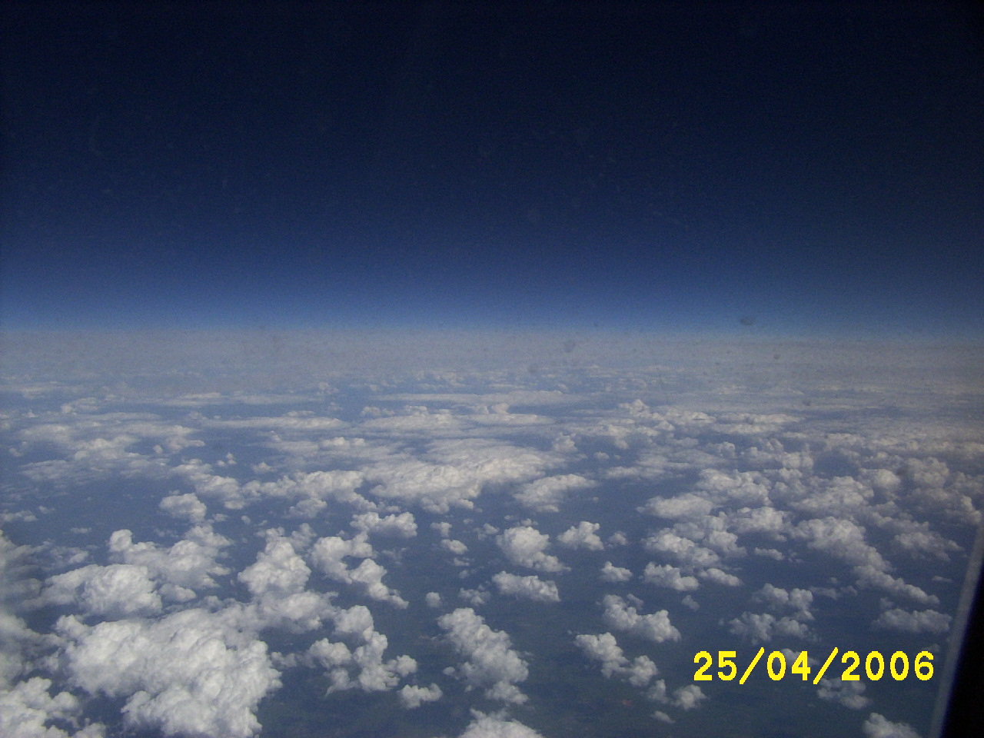
Fluid properties, learning objectives
Understand the concept of state, property, and phase;
understand the difference between thermodynamic and transport properties of fluids;
extract and use data from saturated water and steam tables sorted in order of temperature and pressure;
extract data from superheated steam tables;
Extract viscosity and conductivity and other properties of gases and liquids from tables;
use linear interpolation to extract data from the tables which is between the tabulated data points

Slide 5
Motivation
A working fluid can be used in a machine, previously met in TF1 and called a heat engine, because it produces work from heat.
Reciprocating steam engines were the most straightforward application initially; this would be a good point to watch the link on Moodle to a glass steam engine (image of link below). But the efficiency was generally poor.
Large steam turbines, with high efficiency are used now. A fly through video of a CGI steam turbine is found on the link on Moodle. We’ll be coming back to those.
In both cases, the energy of the steam decreases as it produces work to the devices connected outside of these work producing components of a system. The property changes of the steam are related directly to the energy out.
https://www.youtube.com/watch?v=73txXT21aZU&list=PLUXfvjXFn-cwgW73q93398k8l2ZLP4mh5
https://www.youtube.com/watch?v=SPg7hOxFItI

Slide 6
Important thermo language
State: condition of a fluid in a particular region, defined by properties
Property: a measurable, variable, characteristic of a fluid
System: a region of a fluid contained by real and/or virtual boundaries

Slide 7
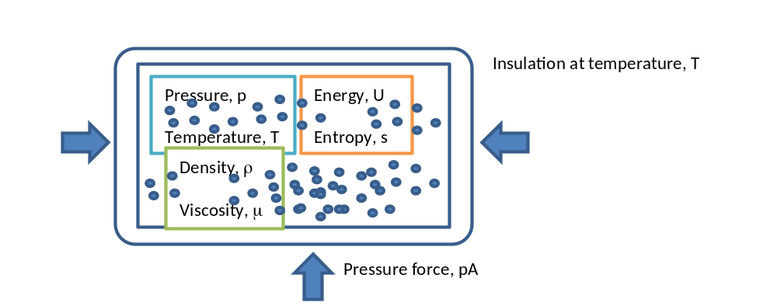
State and property and system
Boundary
Fluid inside boundary
Boundaries may be solid or fluid, constant volume or not;
Molecules respond to how excited they are (temperature) and how close together they are (pressure);
This state causes the fluid to express its other properties – quantities like how much energy it contains, how dense it is, how viscous, how chaotic the molecular motion is, and what phase it is in.

Slide 8
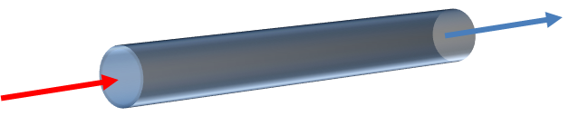
System
An open system is a component in a wider thermodynamic device
All systems in this course are open systems
Boundaries are a combination of solid and virtual defining a region of fluid
Change of properties reflects work and heat
A tube has solid cylinder walls but virtual end boundaries

Slide 9
Key terms
Extensive – quantity for entire mass extent, e.g. J
Intensive – quantity independent of extent, e.g. J⋅kg⁻¹
System – the extent of working fluid being considered, can be open (through-flow) or closed
Property – a measurable characteristic of a working fluid
  Transport property – to do with heat and mass transfer characteristics
  Thermodynamic property – to do with thermal response characteristics
Phase – the condition of a working fluid as either liquid or gas/vapour – see the video link on Moodle of vapour/liquid flow in a tube
https://www.youtube.com/watch?v=iFmaq_ZAccA&feature=youtu.be

Slide 10
Available data
Please acquire a booklet of data tables:
Rogers, GFC and Mayhew, YR, Thermodynamic and Transport Properties of Fluids, Fifth Edition, Blackwell.
Properties of most working fluids are available;
In particular common gases and liquids are published on line and in books;
Of particular interest to us are steam, air and the refrigerant R134a

Slide 11
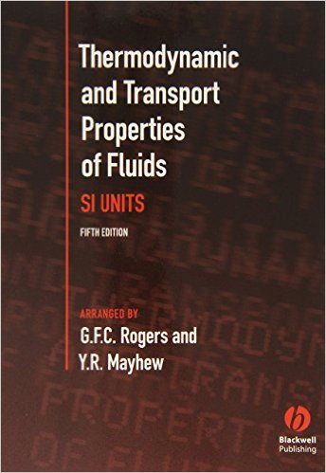
Available in university bookshop and Amazon
A copy of this booklet will be used in the exam so it is worth getting to know the book.

Slide 12
IAPWS
International Association for the Properties of Water and Steam have produced accurate data for industry and academia
http://iapws.org/
http://iapws.org/relguide/IF97-Rev.html
This information is given in tabulated form in the booklet of the previous slide
The complete interpolation formulae have been collected in graph form, but it is important to be able to interpolate from tables of data
In the same way, data is available for the other fluids with data in the booklet.

Slide 13
Things to know
Meaning of the terms used in this section
Attempt the short MCQ test on the Form below this in Moodle

