Slide 1
Dynamics and Control
Control Seminar 3

Slide 2
General Introduction – SEMINAR 3
Block diagram manipulation
2nd order systems

Slide 3
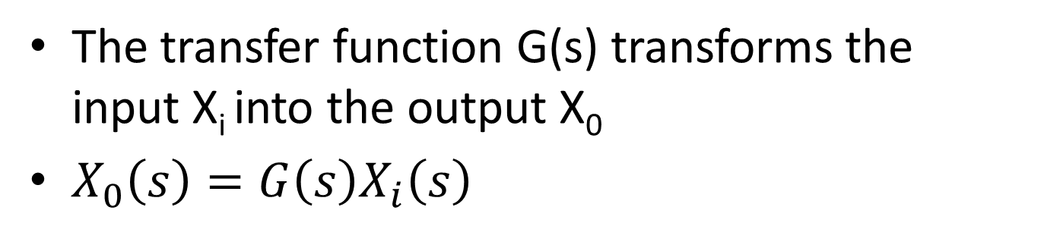
Block Diagrams Revisited
Systems engineers represent the components of the system as a series of blocks:
Recap:
X_{i}(s)
X_{o}(s)
G(s)
The transfer function G(s) transforms the input X_{i} into the output X₀
$X_{0}\left(s\right)=G\left(s\right)X_{i}\left(s\right)$
MMME2046 Dynamics and Control
Seminar 3

Slide 4
Block Diagram Manipulation: The rules
a) Elements in Series: Multiplication
X_{i}(s)
G₁(s)
G₂(s)
X_{o}(s)
X_{i}(s)
G₂G₁
X_{o}(s)
b) Elements in Parallel: Obey the summing junction (add/subtract)
G₁(s)
+
+
X_{o}(s)
X_{i}(s)
X_{o}(s)
X_{i}(s)
G₂(s)
G₁+G₂ - G₃
_
G₃(s)
MMME2046 Dynamics and Control
Seminar 3

Slide 5
c) Feedback (Closed loop) Transfer Function
X_{i}
+
X_{o}
X_{i}
X_{o}
G(s)
_
H(s)
d) Changing block positions:
X_{i}
X_{o}
X_{i}
+
X_{o}
+
G
H
G
1/H
_
_
H
X
Z
X
+
Z
+
G
G
_
_
Y
Y
G
MMME2046 Dynamics and Control
Seminar 3

Slide 6


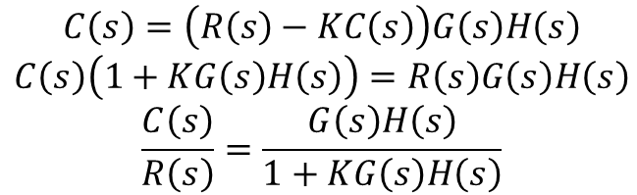














e) Dealing with disturbances
R(s) is the input
C(s) is the output
D(s) is a disturbance
N(s) is a (user controlled) compensation
$$D\left(s\right)$$
$$R\left(s\right)$$
$$+$$
$$G\left(s\right)$$
$$−$$
$$H\left(s\right)$$
$$C\left(s\right)$$
$$+$$
$$−$$
$$+$$
$$K$$
$$−$$
$$N\left(s\right)$$
Procedure:
  Each of the inputs has its own independent transfer function. For R(s):
$$R\left(s\right)$$
$$+$$
$$G\left(s\right)$$
$$H\left(s\right)$$
$$C\left(s\right)$$
$$C\left(s\right)=\left(R\left(s\right)−KC\left(s\right)\right)G\left(s\right)H\left(s\right)$$
$$C\left(s\right)\left(1+KG\left(s\right)H\left(s\right)\right)=R\left(s\right)G\left(s\right)H\left(s\right)$$
$$\frac{C\left(s\right)}{R\left(s\right)}=\frac{G\left(s\right)H\left(s\right)}{1+KG\left(s\right)H\left(s\right)}$$
$$−$$
$$K$$
MMME2046 Dynamics and Control
Seminar 3

Slide 7
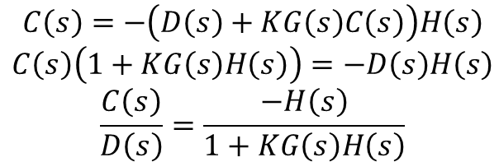




e) Dealing with disturbances
R(s) is the input
C(s) is the output
D(s) is a disturbance
N(s) is a (user controlled) compensation
$$D\left(s\right)$$
$$R\left(s\right)$$
$$+$$
$$G\left(s\right)$$
$$−$$
$$H\left(s\right)$$
$$C\left(s\right)$$
$$+$$
$$−$$
$$+$$
$$K$$
$$−$$
$$N\left(s\right)$$
Procedure:
  For D(s):
$$D\left(s\right)$$
$$−$$
$$H\left(s\right)$$
$$C\left(s\right)$$
$$C\left(s\right)=−\left(D\left(s\right)+KG\left(s\right)C\left(s\right)\right)H\left(s\right)$$
$$C\left(s\right)\left(1+KG\left(s\right)H\left(s\right)\right)=−D\left(s\right)H\left(s\right)$$
$$\frac{C\left(s\right)}{D\left(s\right)}=\frac{−H\left(s\right)}{1+KG\left(s\right)H\left(s\right)}$$
$$−$$
$$KG\left(s\right)$$
MMME2046 Dynamics and Control
Seminar 3

Slide 8

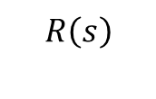

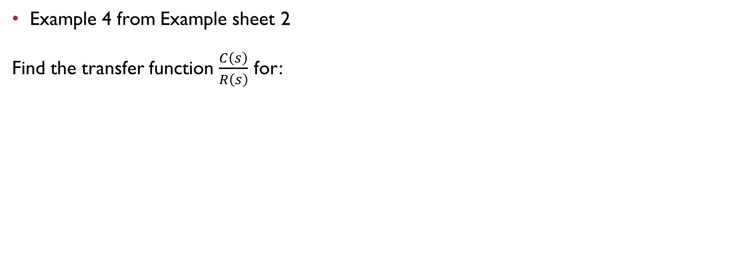
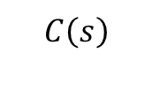
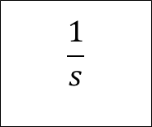
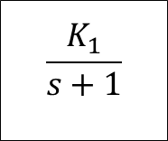

Block Diagram Manipulation
4.
Example 4 from Example sheet 2
Find the transfer function $\frac{C\left(s\right)}{R\left(s\right)}$ for:
$$R\left(s\right)$$
$$\frac{K_{1}}{s+1}$$
$$\frac{1}{s}$$
$$C\left(s\right)$$
$$+$$
$$+$$
$$K_{2}$$
$$+$$
$$+$$

Slide 9


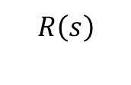
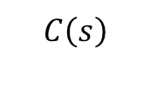


Block Diagram Manipulation
4.
Step 1: resolve inner feedback loop:
$$R\left(s\right)$$
$$\frac{K_{1}}{s+1}$$
$$\frac{1}{s}$$
$$C\left(s\right)$$
$$+$$
$$+$$
$$+$$
$$+$$
$${sK}_{2}$$

Slide 10
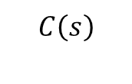
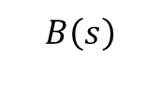
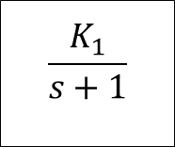
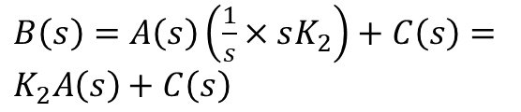

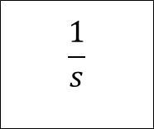
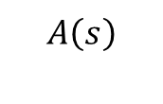
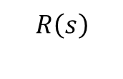
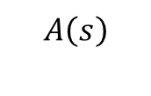

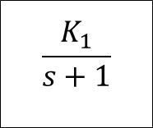
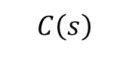

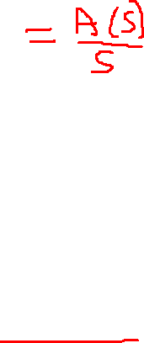
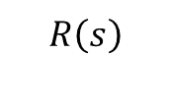
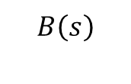
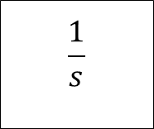


CHECK
4.
Step 1: resolve inner feedback loop:
$$R\left(s\right)$$
$$\frac{K_{1}}{s+1}$$
$$A\left(s\right)$$
$$\frac{1}{s}$$
$$C\left(s\right)$$
$$+$$
$$+$$
$$B\left(s\right)=K_{2}A\left(s\right)+C\left(s\right)$$
$$K_{2}$$
$$+$$
$$B\left(s\right)$$
$$+$$
$$R\left(s\right)$$
$$\frac{K_{1}}{s+1}$$
$$A\left(s\right)$$
$$\frac{1}{s}$$
$$C\left(s\right)$$
$$+$$
$$+$$
$B\left(s\right)=A\left(s\right)\left(\frac{1}{s}×sK_{2}\right)+C\left(s\right)=$ $K_{2}A\left(s\right)+C\left(s\right)$
$$B\left(s\right)$$
$$+$$
$$+$$
$${sK}_{2}$$

Slide 11
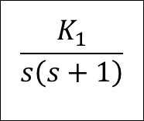
Block Diagram Manipulation
4.
Step 2: Combine forward transfer functions:
$$R\left(s\right)$$
$$\frac{K_{1}}{s\left(s+1\right)}$$
$$C\left(s\right)$$
$$+$$
$$+$$
$$+$$
$$+$$
$${sK}_{2}$$

Slide 12


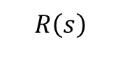
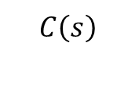
Block Diagram Manipulation
4.
Step 3: Combine feedback transfer functions:
$$R\left(s\right)$$
$$\frac{K_{1}}{s\left(s+1\right)}$$
$$C\left(s\right)$$
$$+$$
$$+$$
$${1+sK}_{2}$$

Slide 13
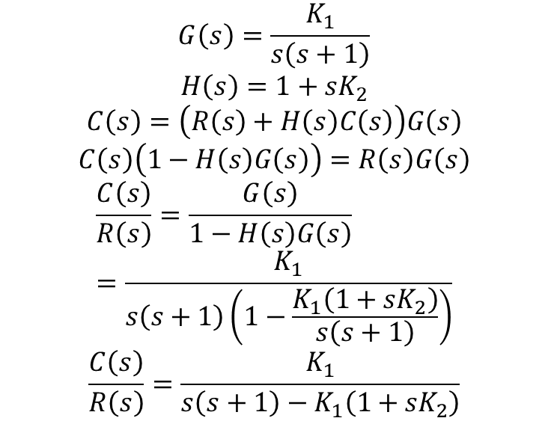
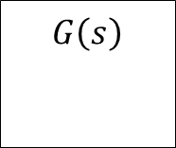

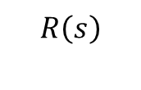
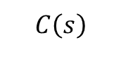
Block Diagram Manipulation
4.
Step 4: Resolve:
$$G\left(s\right)=\frac{K_{1}}{s\left(s+1\right)}$$
$$H\left(s\right)={1+sK}_{2}$$
$$C\left(s\right)=\left(R\left(s\right)+H\left(s\right)C\left(s\right)\right)G\left(s\right)$$
$$C\left(s\right)\left(1−H\left(s\right)G\left(s\right)\right)=R\left(s\right)G\left(s\right)$$
$$\frac{C\left(s\right)}{R\left(s\right)}=\frac{G\left(s\right)}{1−H\left(s\right)G\left(s\right)}=\frac{K_{1}}{s\left(s+1\right)\left(1−\frac{K_{1}\left({1+sK}_{2}\right)}{s\left(s+1\right)}\right)}$$
$$\frac{C\left(s\right)}{R\left(s\right)}=\frac{K_{1}}{s\left(s+1\right)−K_{1}\left({1+sK}_{2}\right)}$$
$$R\left(s\right)$$
$$G\left(s\right)$$
$$C\left(s\right)$$
$$+$$
$$+$$
$$H\left(s\right)$$

Slide 14



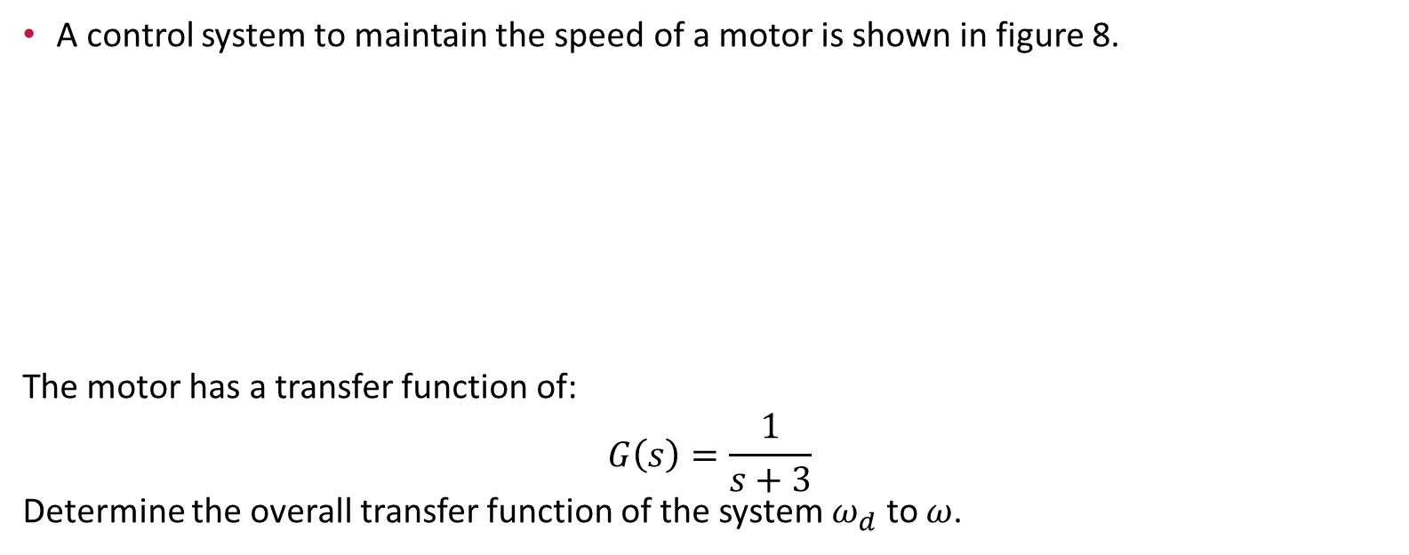






Example Sheet 2 Question 8
A control system to maintain the speed of a motor is shown in figure 8.
The motor has a transfer function of:
$$G\left(s\right)=\frac{1}{s+3}$$
Determine the overall transfer function of the system $ω_{d}$ to $ω$.
$$D\left(s\right)$$
Speed
$$ω_{d}\left(s\right)$$
$$+$$
$$−$$
$$ω\left(s\right)$$
$$\frac{K}{s}$$
$$G\left(s\right)$$
$$−$$
$$+$$
Tachometer
$$K_{1}$$

Slide 15



STEP 1: Eliminate the disturbance and combine forward Transfer functions
Speed
$$ω_{d}\left(s\right)$$
$$+$$
$$\frac{KG\left(s\right)}{s}$$
$$ω\left(s\right)$$
$$−$$
$$K_{1}$$

Slide 16
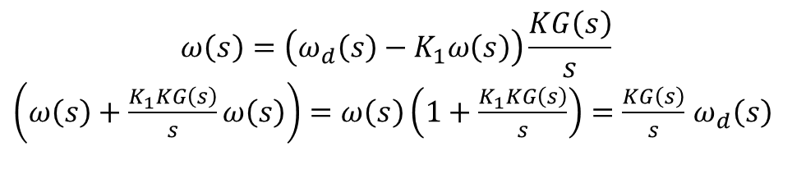
STEP 2: Resolve the feedback loop
Speed
$$ω_{d}\left(s\right)$$
$$+$$
$$\frac{KG\left(s\right)}{s}$$
$$ω\left(s\right)$$
$$−$$
$$K_{1}$$
$$ω\left(s\right)=\left(ω_{d}\left(s\right)−K_{1}ω\left(s\right)\right)\frac{KG\left(s\right)}{s}$$
$\left(ω\left(s\right)+\frac{K_{1}KG\left(s\right)}{s}ω\left(s\right)\right)=ω\left(s\right)\left(1+\frac{K_{1}KG\left(s\right)}{s}\right)=\frac{KG\left(s\right)}{s}$ $ω_{d}\left(s\right)$

Slide 17
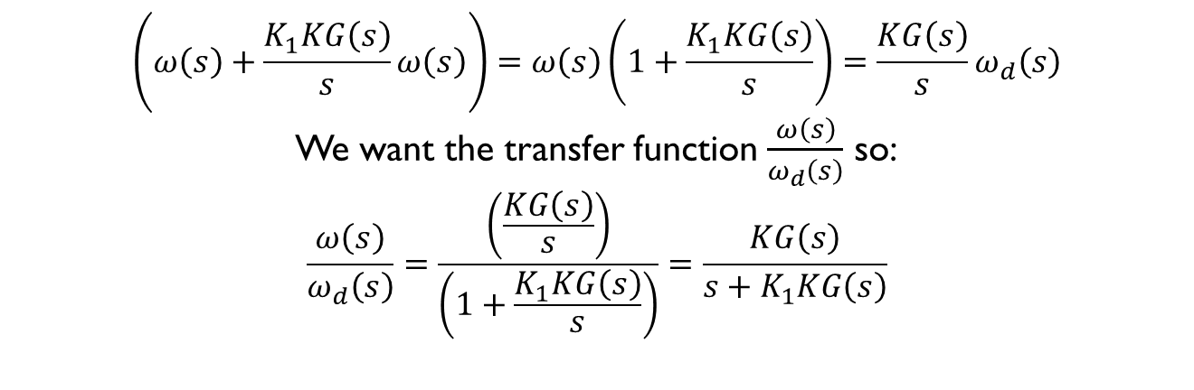
STEP 2: Resolve the feedback loop
Continued …
$$\left(ω\left(s\right)+\frac{K_{1}KG\left(s\right)}{s}ω\left(s\right)\right)=ω\left(s\right)\left(1+\frac{K_{1}KG\left(s\right)}{s}\right)=\frac{KG\left(s\right)}{s}ω_{d}\left(s\right)$$
We want the transfer function $\frac{ω\left(s\right)}{ω_{d}\left(s\right)}$ so:
$$\frac{ω\left(s\right)}{ω_{d}\left(s\right)}=\frac{\left(\frac{KG\left(s\right)}{s}\right)}{\left(1+\frac{K_{1}KG\left(s\right)}{s}\right)}=\frac{KG\left(s\right)}{s+K_{1}KG\left(s\right)}$$

Slide 18
2nd Order Control Systems
1st order systems are
  Reliable
  Non-oscillatory
  Slower than 2nd order
Hydraulics are slow and heavy
First there was Claudia, now there is Melissa:
  https://www.youtube.com/watch?v=JWyl9RnKOIQ
MMME2046 Dynamics and Control
Seminar 3

Slide 19
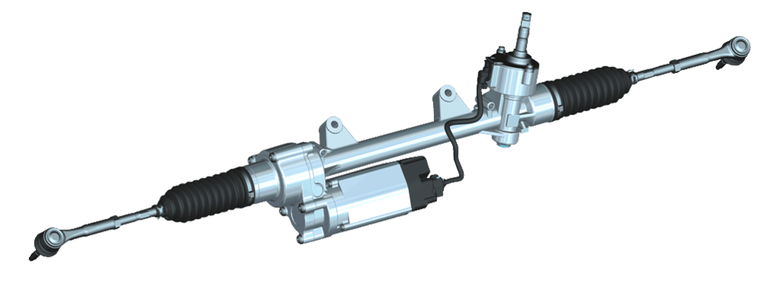
2nd Order Control Systems
Some examples – electro-mechanical position control
  Power steering
  n-degree of freedom robots
  …
Image courtesy of Bosch AG
MMME2046 Dynamics and Control
Seminar 3

Slide 20
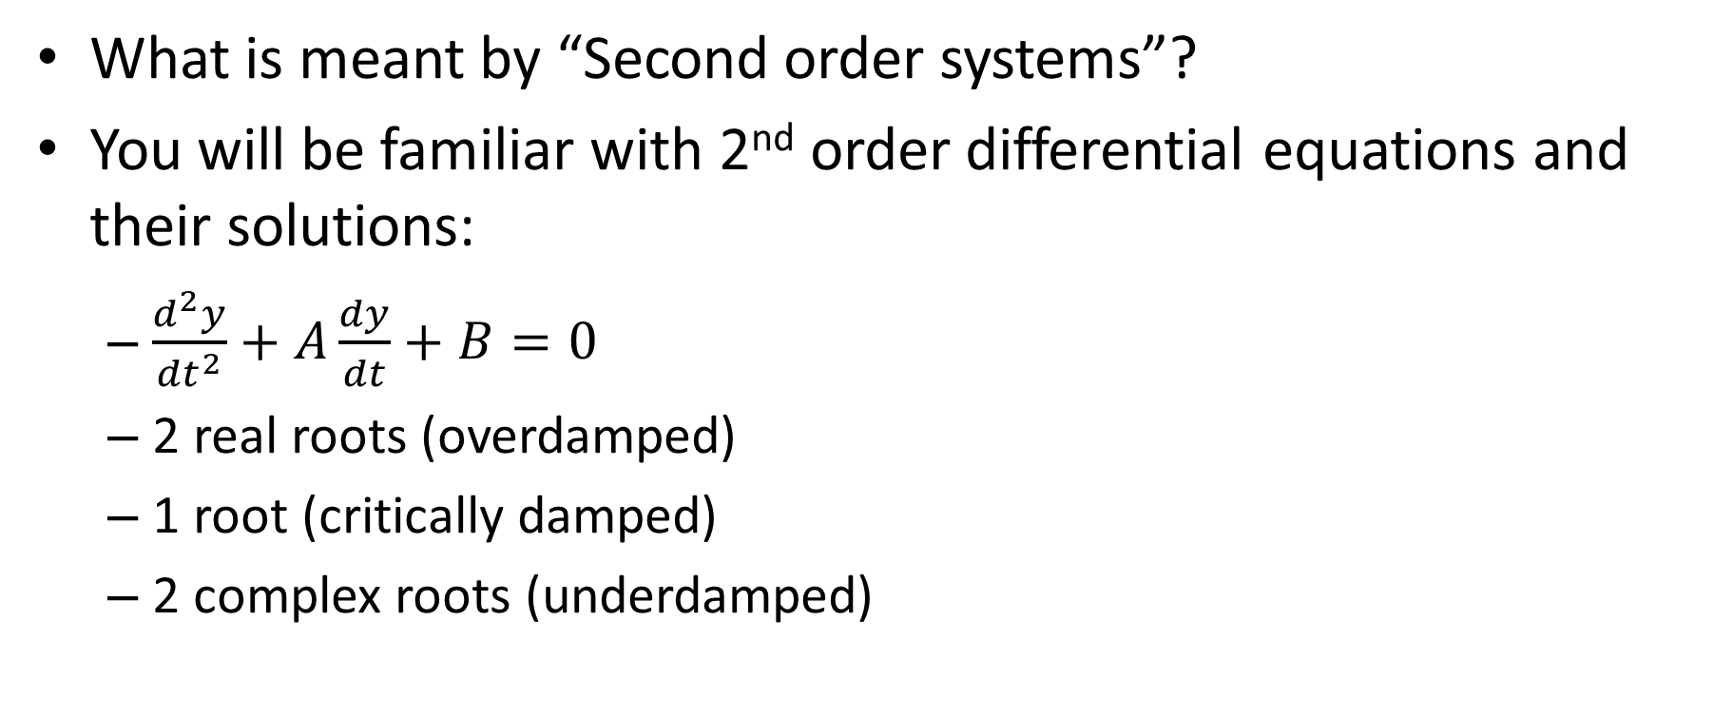
2nd Order Control Systems
What is meant by “Second order systems”?
You will be familiar with 2nd order differential equations and their solutions:
  $\frac{d^{2}y}{{dt}^{2}}+A\frac{dy}{dt}+B=0$
  2 real roots (overdamped)
  1 root (critically damped)
  2 complex roots (underdamped)
MMME2046 Dynamics and Control
Seminar 3

Slide 21
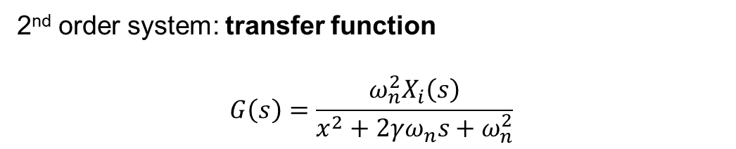
Example: Electro-Mechanical Position Control System
viscous
damping
lead
screw
mass
DC servo-
motor
f_{R}
servo-
amp
x (output)
+
position
transducer
V_{i}
-
input
voltage
2nd order system: transfer function
$$G\left(s\right)=\frac{ω_{n}^{2}X_{i}\left(s\right)}{x^{2}+2γω_{n}s+ω_{n}^{2}}$$
MMME2046 Dynamics and Control
Seminar 3

Slide 22
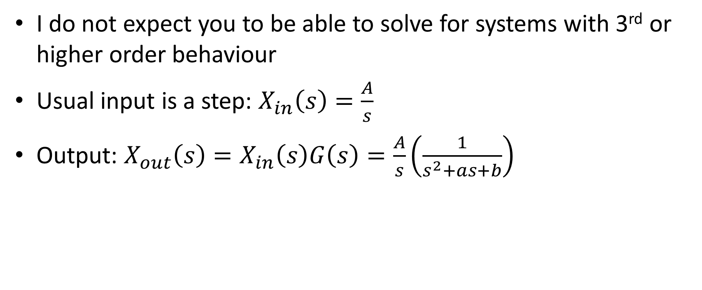
2nd order system: time domain solution
I do not expect you to be able to solve for systems with 3rd or higher order behaviour
Usual input is a step: $X_{in}\left(s\right)=\frac{A}{s}$
Output: $X_{out}\left(s\right)=X_{in}\left(s\right)G\left(s\right)=\frac{A}{s}\left(\frac{1}{s^{2}+as+b}\right)$

Slide 23
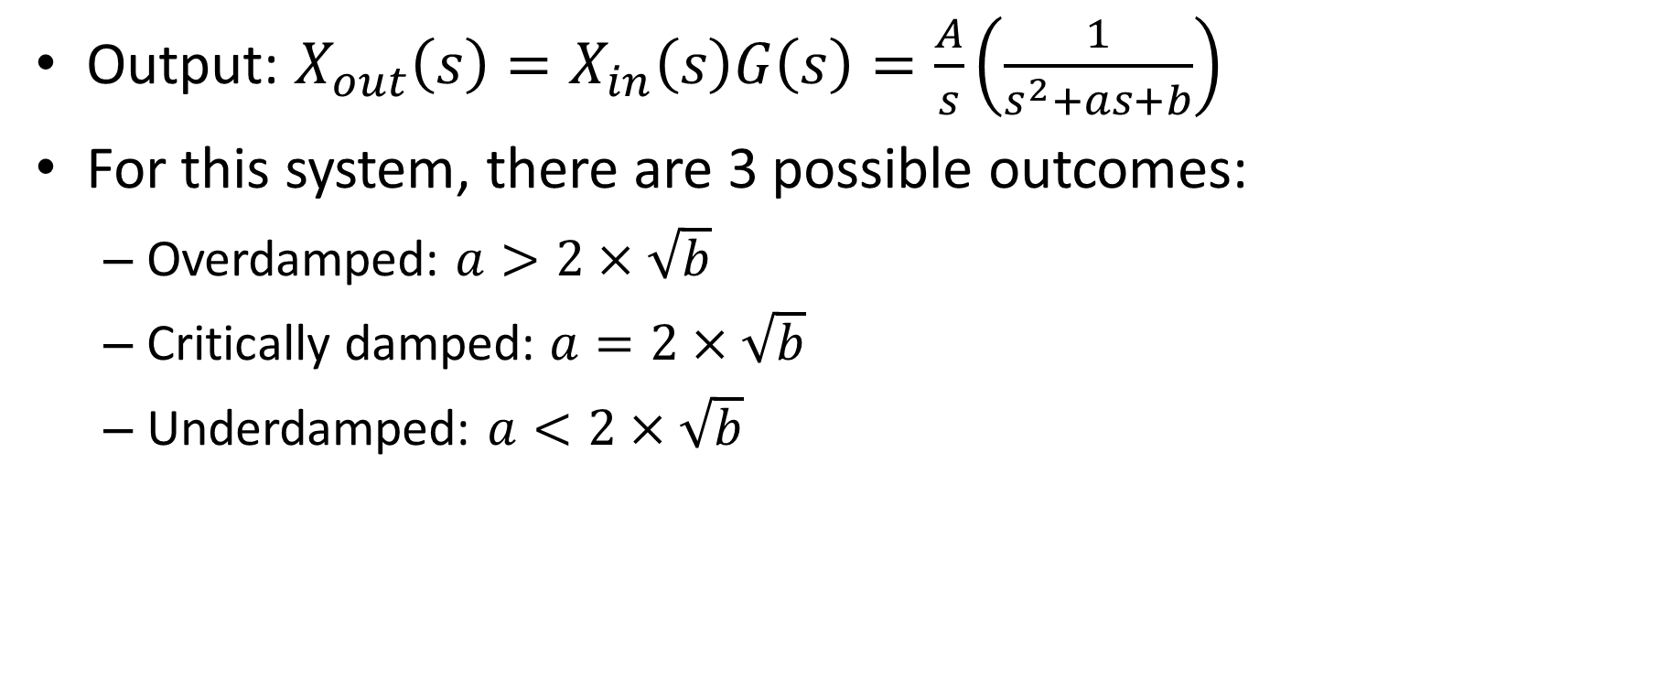
2nd order system: time domain solution
Output: $X_{out}\left(s\right)=X_{in}\left(s\right)G\left(s\right)=\frac{A}{s}\left(\frac{1}{s^{2}+as+b}\right)$
For this system, there are 3 possible outcomes:
  Overdamped: $a>2×\sqrt{b}$
  Critically damped: $a=2×\sqrt{b}$
  Underdamped: $a<2×\sqrt{b}$

Slide 24
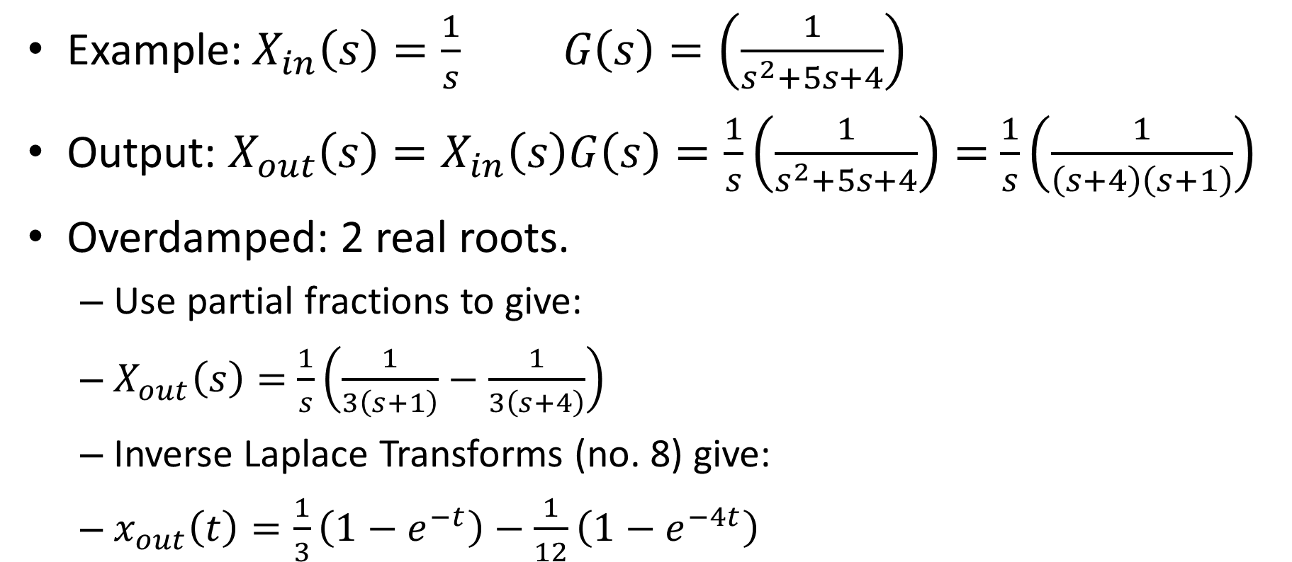
2nd order system: time domain solution
Example: $X_{in}\left(s\right)=\frac{1}{s} G\left(s\right)=\left(\frac{1}{s^{2}+5s+4}\right)$
Output: $X_{out}\left(s\right)=X_{in}\left(s\right)G\left(s\right)=\frac{1}{s}\left(\frac{1}{s^{2}+5s+4}\right)=$ $\frac{1}{s}\left(\frac{1}{\left(s+4\right)\left(s+1\right)}\right)$
Overdamped: 2 real roots.
  Use partial fractions to give:
  $X_{out}\left(s\right)=$ $\frac{1}{s}\left(\frac{1}{3\left(s+1\right)}−\frac{1}{3\left(s+4\right)}\right)$
  Inverse Laplace Transforms (no. 8) give:
  $x_{out}\left(t\right)=\frac{1}{3}\left(1−e^{−t}\right)−\frac{1}{12}\left(1−e^{−4t}\right)$

Slide 25
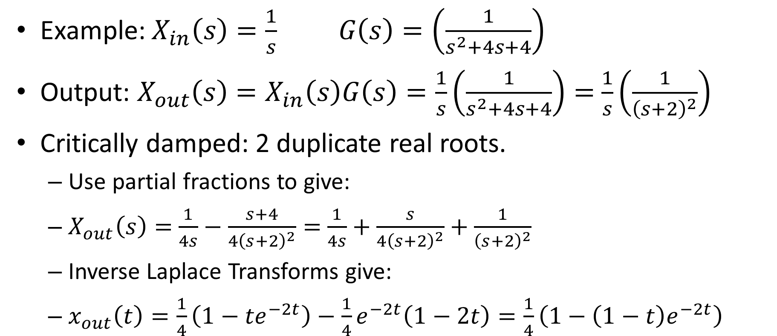
2nd order system: time domain solution
Example: $X_{in}\left(s\right)=\frac{1}{s} G\left(s\right)=\left(\frac{1}{s^{2}+4s+4}\right)$
Output: $X_{out}\left(s\right)=X_{in}\left(s\right)G\left(s\right)=\frac{1}{s}\left(\frac{1}{s^{2}+4s+4}\right)=$ $\frac{1}{s}\left(\frac{1}{{\left(s+2\right)}^{2}}\right)$
Critically damped: 2 duplicate real roots.
  Use partial fractions to give:
  $X_{out}\left(s\right)=$ $\frac{1}{4s}−\frac{s+4}{{4\left(s+2\right)}^{2}}=$ $\frac{1}{4s}+\frac{s}{{4\left(s+2\right)}^{2}}+\frac{1}{{\left(s+2\right)}^{2}}$
  Inverse Laplace Transforms give:
  $x_{out}\left(t\right)=\frac{1}{4}\left(1−{te}^{−2t}\right)−\frac{1}{4}e^{−2t}\left(1−2t\right)=\frac{1}{4}\left(1−\left(1−t\right)e^{−2t}\right)$

Slide 26
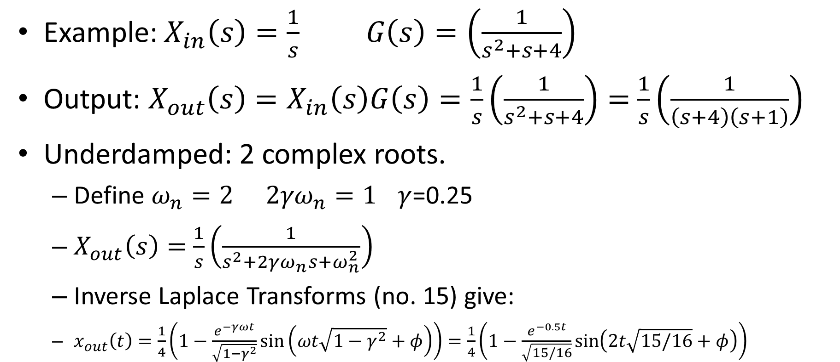
2nd order system: time domain solution
Example: $X_{in}\left(s\right)=\frac{1}{s} G\left(s\right)=\left(\frac{1}{s^{2}+s+4}\right)$
Output: $X_{out}\left(s\right)=X_{in}\left(s\right)G\left(s\right)=\frac{1}{s}\left(\frac{1}{s^{2}+s+4}\right)=$ $\frac{1}{s}\left(\frac{1}{\left(s+4\right)\left(s+1\right)}\right)$
Underdamped: 2 complex roots.
  Define $ω_{n}=2$ ${2γω}_{n}=1$ $γ$=0.25
  $X_{out}\left(s\right)=$ $\frac{1}{s}\left(\frac{1}{s^{2}+{2γω}_{n}s+ω_{n}^{2}}\right)$
  Inverse Laplace Transforms (no. 15) give:
  $x_{out}\left(t\right)=\frac{1}{4}\left(1−\frac{e^{−γωt}}{\sqrt{1−γ^{2}}}\sin\left(ωt\sqrt{1−γ^{2}}+φ\right)\right)=\frac{1}{4}\left(1−\frac{e^{−0.5t}}{\sqrt{15/16}}\sin\left(2t\sqrt{15/16}+φ\right)\right)$

Slide 27
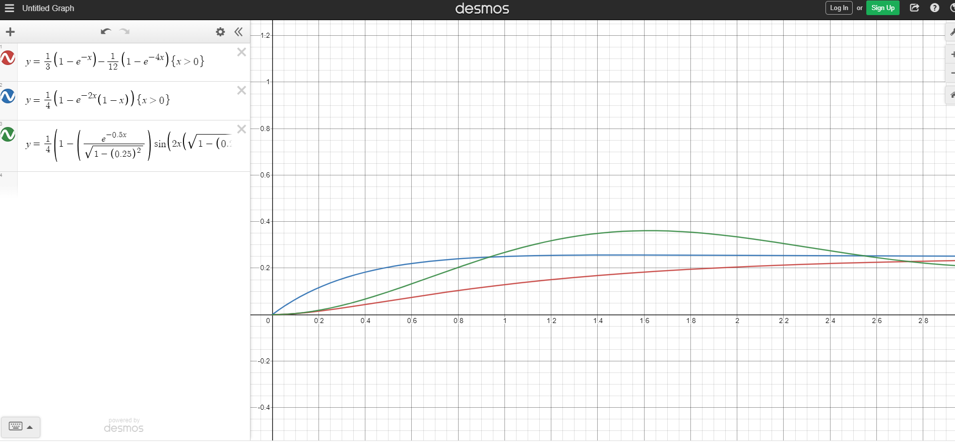

Slide 28
The End?
Any questions?

