Slide 1
Dynamics and Control
Control Seminar 1

Slide 2
General RECAP – Session 1
Why do we need control systems?
Why is it important to be able to predict how a system behaves?

Slide 3
Lecture recap:
Why do we model control?
  Understanding behaviour of controlled systems
  Tuning for optimum performance (speed, efficiency, rapid response)
  Preventing out-of control behaviour (resonance, oscillation, run-away)

Slide 4
Method of operation for centrifugal governor
Angular velocity of governor shaft is proportional to engine rpm
Steam supply from boiler
As speed increases, flymasses rise and operate linkage
Control valve adjusts supply of steam to engine as linkage is moved by governor
Drive from engine to governor
Engine
Video: https://www.youtube.com/watch?v=OG1AiaNTT6s

Slide 5
Systems and block diagrams
Open-Loop system
Closed-Loop (feedback) system
Input
Plant or process
Output
Input
(desired result)
Plant and controller
Output
(controlled)

Slide 6


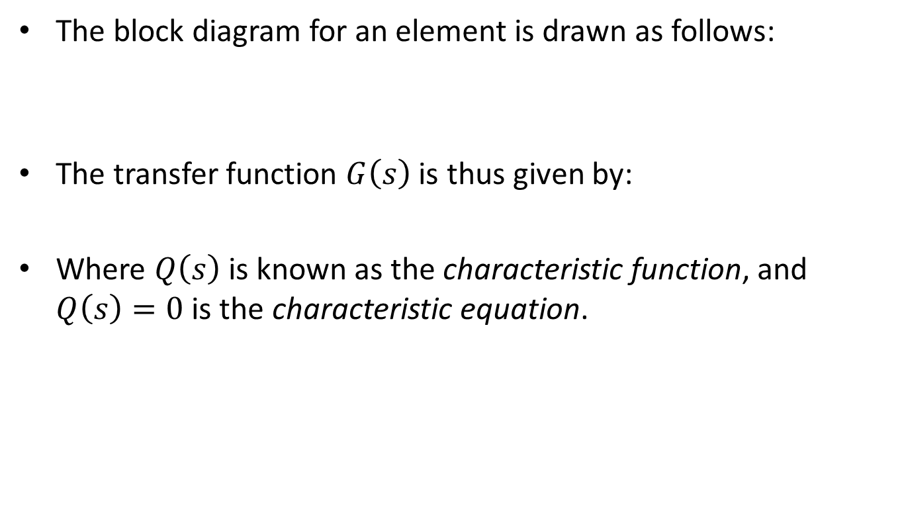



Representation of control systems
The block diagram for an element is drawn as follows:
The transfer function $G\left(s\right)$ is thus given by:
Where $Q\left(s\right)$ is known as the characteristic function, and $Q\left(s\right)=0$ is the characteristic equation.
$$X_{i}\left(s\right)$$
$$X_{o}\left(s\right)$$
$$G\left(s\right)$$
$X_{o}\left(s\right)=G\left(s\right)$ $X_{i}\left(s\right)$
$G\left(s\right)$= $\frac{X_{o}\left(s\right)}{X_{i}\left(s\right) }=\frac{P\left(s\right)}{Q\left(s\right) }$

Slide 7
Representation of Control Systems
A typical system has a block diagram of the following form
Disturbance
Disturbance Elements
error
Input Elements
+
Controller
+
+
Plant or Process
Input
_
Output
Feedback Elements
Each box will then contain the transfer function of the element contained in the box.

Slide 8
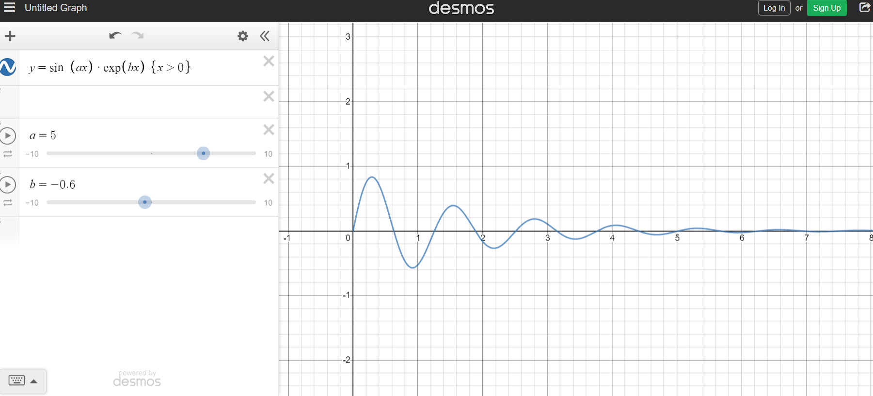
Laplace Transforms
All based on the insight that any time dependent function can be written as
$$x\left(t\right)=Ae^{αt}×e^{jωt}=Ae^{\left(α+jω\right)t}=Ae^{st}$$
https://www.youtube.com/watch?v=n2y7n6jw5d0
https://www.youtube.com/watch?v=3gjJDuCAEQQ

Slide 9



Laplace Transforms
Differentiate: multiply by s:
$$ℒ\left[\frac{dx}{dt}\right]=sX\left(s\right)$$
$$ℒ\left[\frac{d^{2}x}{{dt}^{2}}\right]=s^{2}X\left(s\right)$$
Integrate: divide by s:
$$ℒ\left[\int{x\left(t\right)dt}\right]=\frac{1}{s}X\left(s\right)$$
https://www.youtube.com/watch?v=n2y7n6jw5d0
https://www.youtube.com/watch?v=3gjJDuCAEQQ

Slide 10



Laplace Transforms: Linear functions
i) Addition and Subtraction (superposition applies)
$$l\left[f_{1}\left(t\right)±f_{2}\left(t\right)\right]=F_{1}\left(s\right)±F_{2}\left(s\right)$$
ii) Multiplication by a constant
$$l\left[Kf\left(t\right)\right]=KF\left(s\right)$$
iii) Final Value Theorem
$$\lim_{t→∞}{f\left(t\right)}⁡=\lim_{s→0}{sF\left(s\right)}$$
This theorem is only valid if the final value is finite and constant.
A table of Laplace transform pairs will be provided (also at the exam).
MMME2046 Dynamics and Control Lecture 1

Slide 11
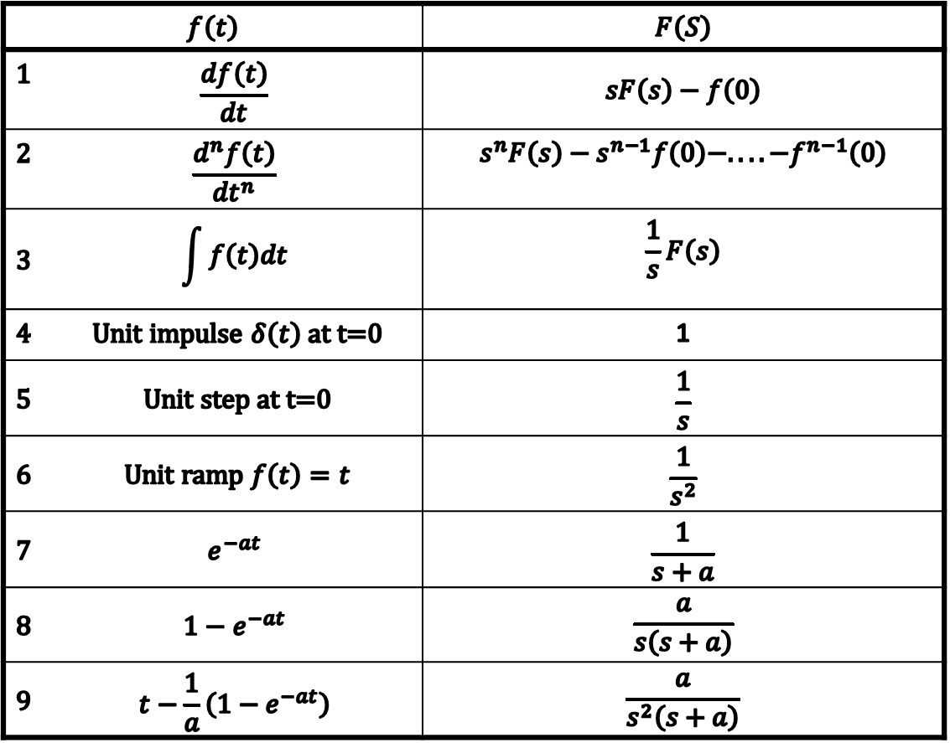

Table of Laplace Transforms
$$f\left(t\right)$$ |  | $$F\left(S\right)$$
1 | $$\frac{df\left(t\right)}{dt}$$ | $$sF\left(s\right)−f\left(0\right)$$
2 | $$\frac{d^{n}f\left(t\right)}{{dt}^{n}}$$ | $$s^{n}F\left(s\right)−s^{n−1}f\left(0\right)−....−f^{n−1}\left(0\right)$$
3 | $$\int{f\left(t\right)dt}$$ | $$\frac{1}{s}F\left(s\right)$$
4 | Unit impulse $δ\left(t\right)$ at t=0 | 1
5 | Unit step at t=0 | $$\frac{1}{s}$$
6 | Unit ramp $f\left(t\right)=t$ | $$\frac{1}{s^{2}}$$
7 | $$e^{−at}$$ | $$\frac{1}{s+a}$$
8 | $${1−e}^{−at}$$ | $$\frac{a}{s\left(s+a\right)}$$
9 | $$t−\frac{1}{a}\left(1−e^{−at}\right)$$ | $$\frac{a}{s^{2}\left(s+a\right)}$$

Slide 12
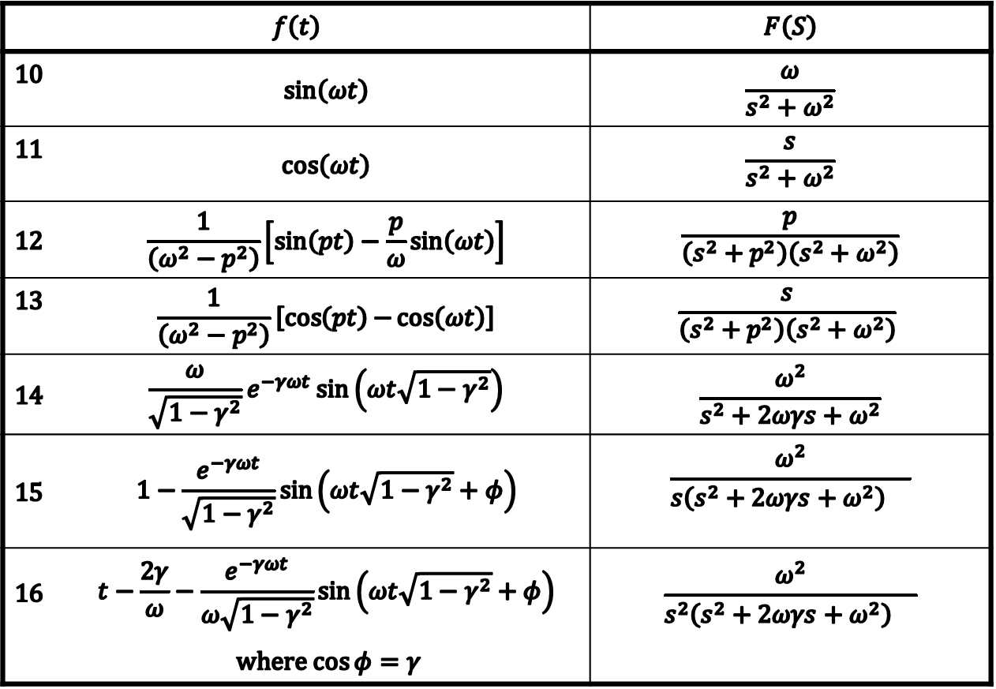
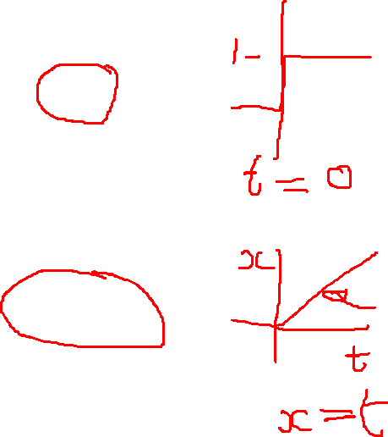
Table of Laplace Transforms (continued)
$$f\left(t\right)$$ |  | $$F\left(S\right)$$
10 | $$\sin\left(ωt\right)$$ | $$\frac{ω}{s^{2}+ω^{2}}$$
11 | $$\cos\left(ωt\right)$$ | $$\frac{s}{s^{2}+ω^{2}}$$
12 | $$\frac{1}{\left(ω^{2}−p^{2}\right)}\left[\sin\left(pt\right)−\frac{p}{ω}\sin\left(ωt\right)\right]$$ | $$\frac{p}{\left(s^{2}+p^{2}\right)\left(s^{2}+ω^{2}\right)}$$
13 | $$\frac{1}{\left(ω^{2}−p^{2}\right)}\left[\cos\left(pt\right){−}\cos\left(ωt\right)\right]$$ | $$\frac{s}{\left(s^{2}+p^{2}\right)\left(s^{2}+ω^{2}\right)}$$
14 | $$\frac{ω}{\sqrt{1−γ^{2}}}e^{−γωt}\sin\left(ωt\sqrt{1−γ^{2}}\right)$$ | $$\frac{ω^{2}}{s^{2}+2ωγs+ω^{2}}$$
15 | $$1−\frac{e^{−γωt}}{\sqrt{1−γ^{2}}}\sin\left(ωt\sqrt{1−γ^{2}}+φ\right)$$ | $$\frac{ω^{2}}{{s\left(s^{2}+2ωγs+ω^{2}\right) }^{}}$$
16 | $$t−\frac{2γ}{ω}−\frac{e^{−γωt}}{ω\sqrt{1−γ^{2}}}\sin\left(ωt\sqrt{1−γ^{2}}+φ\right)$$ | $$\frac{ω^{2}}{{s^{2}\left(s^{2}+2ωγs+ω^{2}\right) }^{}}$$
 | where $\cos{φ=γ}$
This Table will be provided in the exam handout.

Slide 13
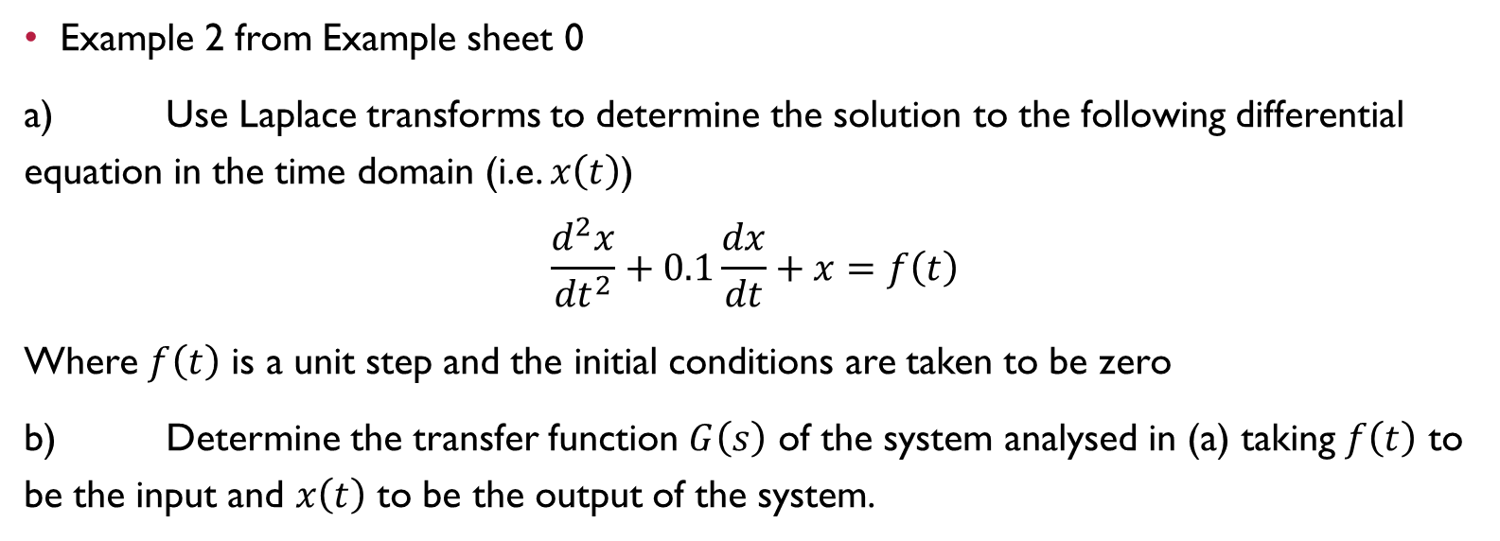
lapLace Transforms Revision
Example 2 from Example sheet 0
a) Use Laplace transforms to determine the solution to the following differential equation in the time domain (i.e. $x\left(t\right)$)
$$\frac{d^{2}x}{{dt}^{2}}+0.1\frac{dx}{dt}+x=f\left(t\right)$$
Where $f\left(t\right)$ is a unit step and the initial conditions are taken to be zero
b) Determine the transfer function $G\left(s\right)$ of the system analysed in (a) taking $f\left(t\right)$ to be the input and $x\left(t\right)$ to be the output of the system.

Slide 14
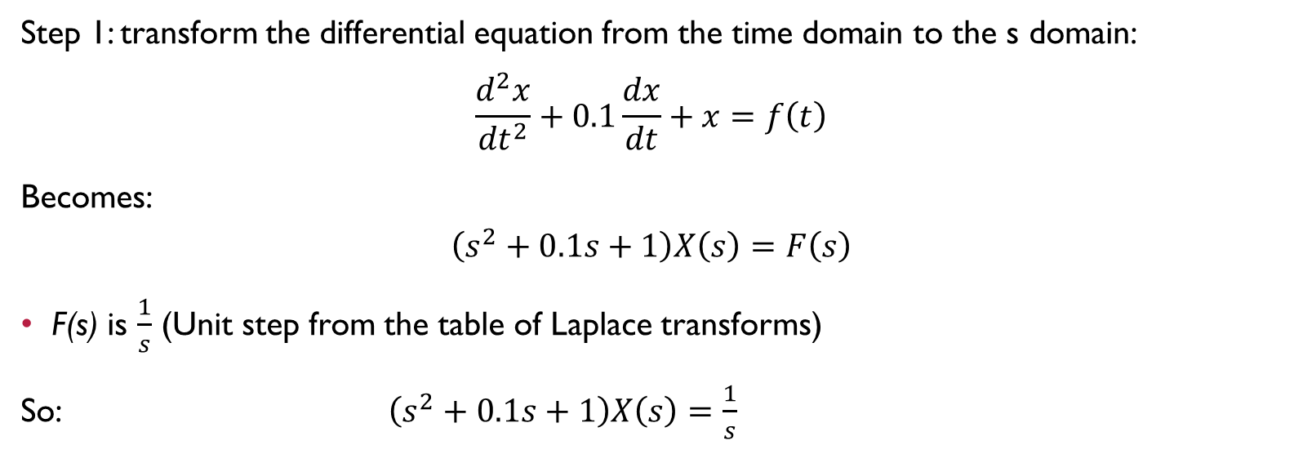
Part (a)
Step 1: transform the differential equation from the time domain to the s domain:
$$\frac{d^{2}x}{{dt}^{2}}+0.1\frac{dx}{dt}+x=f\left(t\right)$$
Becomes:
$$\left(s^{2}+0.1s+1\right)X\left(s\right)=F\left(s\right)$$
F(s) is $\frac{1}{s}$ (Unit step from the table of Laplace transforms)
So: $\left(s^{2}+0.1s+1\right)X\left(s\right)=\frac{1}{s}$

Slide 15
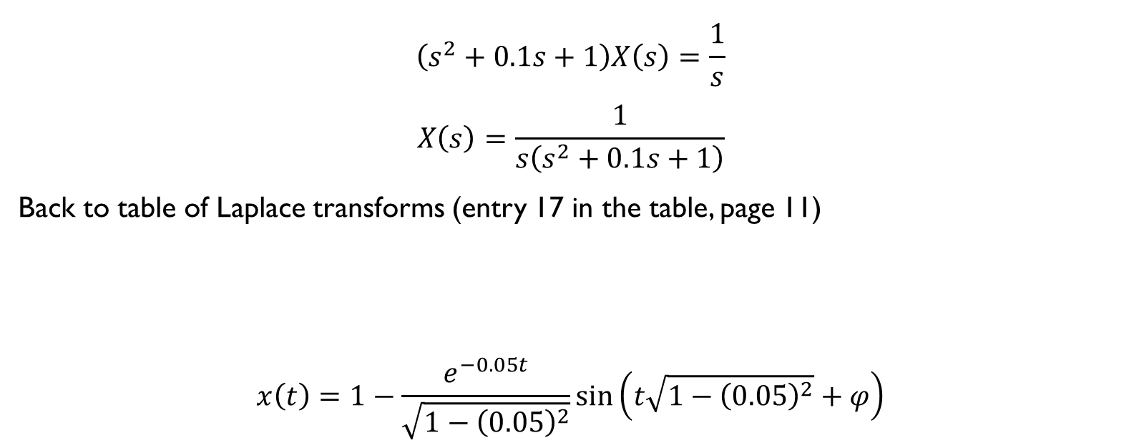

Part (a)
$$\left(s^{2}+0.1s+1\right)X\left(s\right)=\frac{1}{s}$$
$$X\left(s\right)=\frac{1}{s\left(s^{2}+0.1s+1\right)}$$
Back to table of Laplace transforms (entry 17 in the table, page 11)
$$x\left(t\right)=1−\frac{e^{−0.05t}}{\sqrt{1−{\left(0.05\right)}^{2}}}\sin\left(t\sqrt{1−{\left(0.05\right)}^{2}}+φ\right)$$
$$1−\frac{e^{−γωt}}{\sqrt{1−γ^{2}}}\sin\left(ωt\sqrt{1−γ^{2}}+φ\right)$$ | $$\frac{ω^{2}}{s\left(s^{2}+2γωs+ω^{2}\right)}$$
$$φ=\cos^{−1}{γ}$$

Slide 16

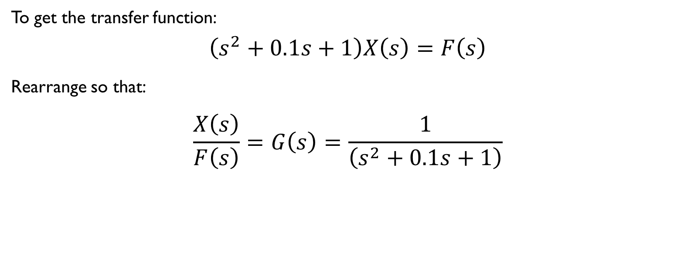


Part (B)
To get the transfer function:
$$\left(s^{2}+0.1s+1\right)X\left(s\right)=F\left(s\right)$$
Rearrange so that:
$$\frac{X\left(s\right)}{F\left(s\right)}=G\left(s\right)=\frac{1}{\left(s^{2}+0.1s+1\right)}$$
$$F\left(s\right)$$
$$X\left(s\right)$$
$$G\left(s\right)$$

Slide 17
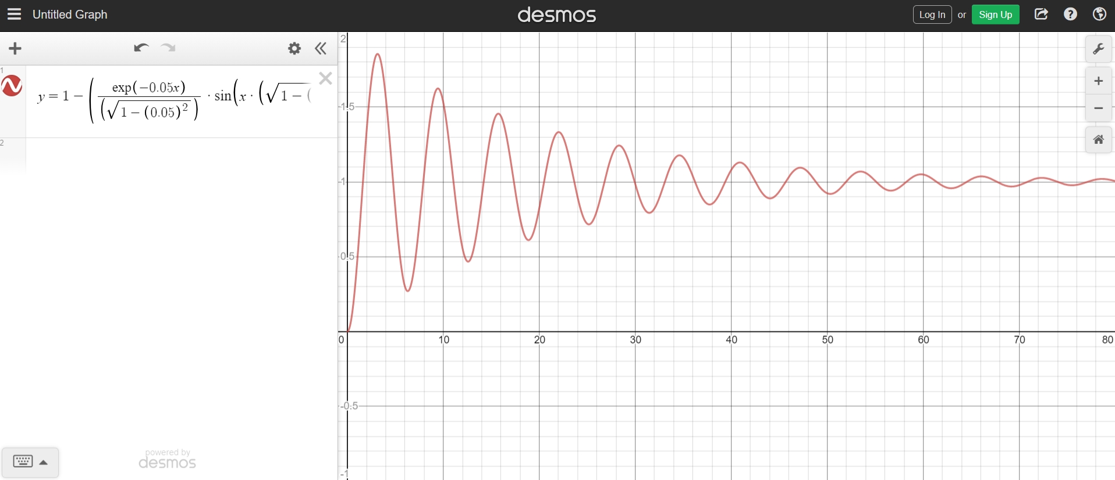
And this is the system response:

Slide 18
Modelling of Simple Components
Lever Systems
Rotor with Viscous Drag
Mass-Spring-Damper System (Exercise)
Hydraulic Ram

Slide 19
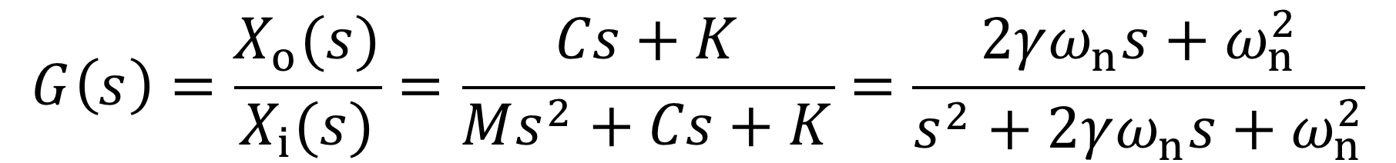

d) Spring-Mass-Damper System
x_{i}
x_{o}
K
M
C
Exercise: Noting that the input to the above system is a displacement, show that the transfer function for the system is given by
where

Slide 20
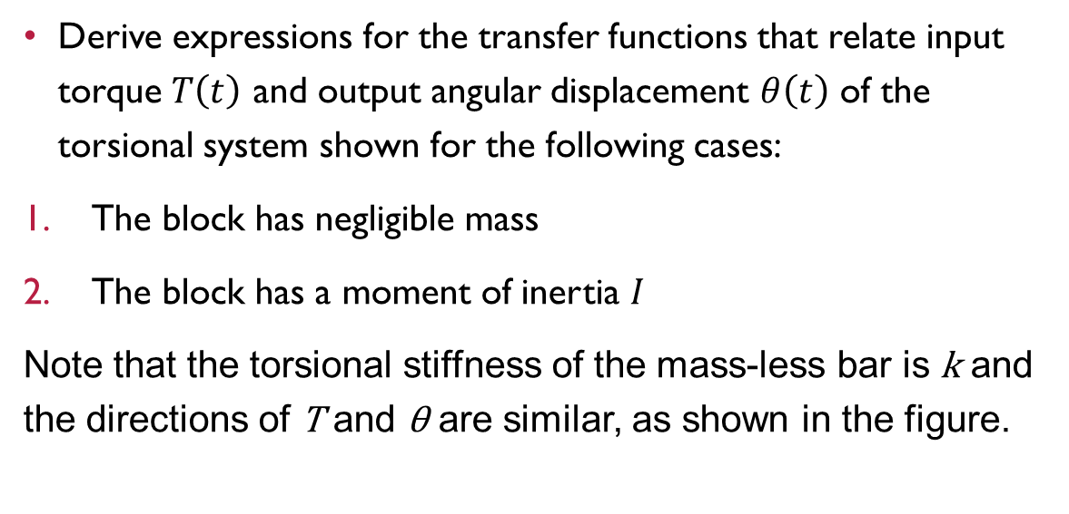
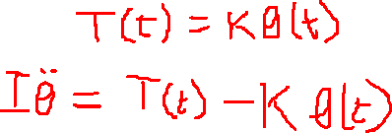
How to – Example Sheet 1, no. 2
Derive expressions for the transfer functions that relate input torque $T\left(t\right)$ and output angular displacement $θ\left(t\right)$ of the torsional system shown for the following cases:
The block has negligible mass
The block has a moment of inertia $I$
Note that the torsional stiffness of the mass-less bar is k and the directions of T and θ are similar, as shown in the figure.
Clamp
θ
T

Slide 21
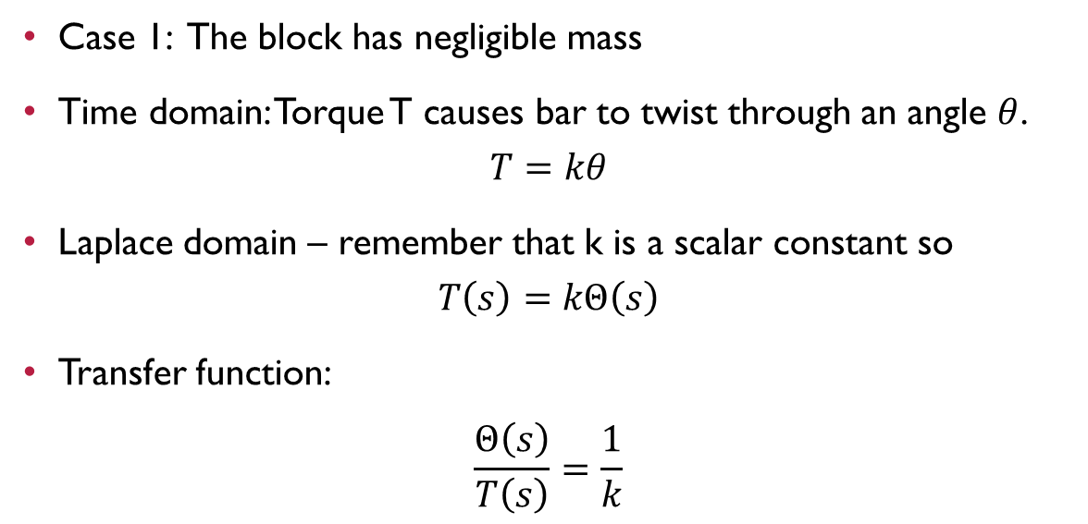
Always think about the physics!
Case 1: The block has negligible mass
Time domain: Torque T causes bar to twist through an angle $θ$.
$$T=kθ$$
Laplace domain – remember that k is a scalar constant so
$$T\left(s\right)=kΘ\left(s\right)$$
Transfer function:
$$\frac{Θ\left(s\right)}{T\left(s\right)}=\frac{1}{k}$$
Clamp
θ
T

Slide 22
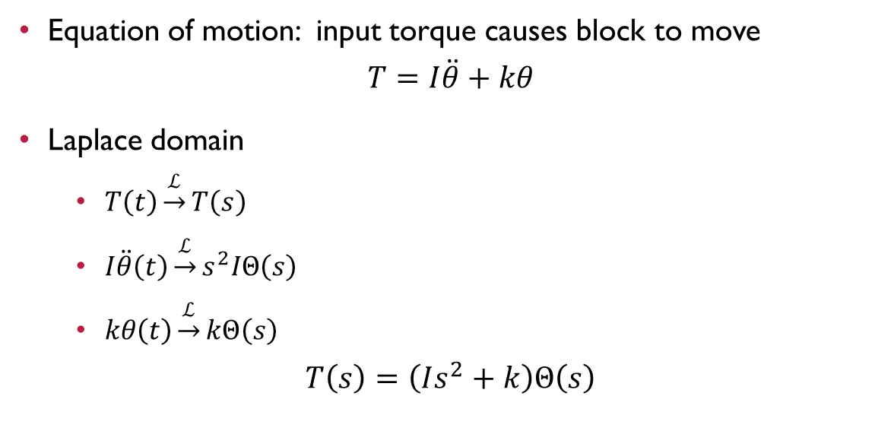
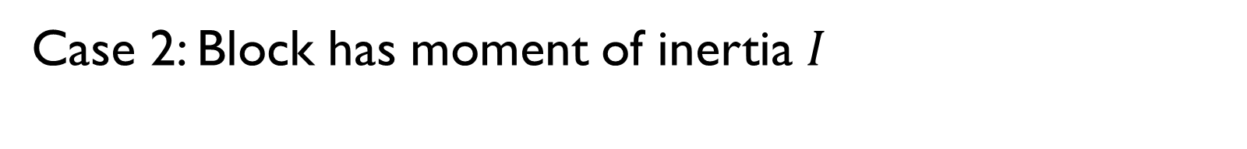
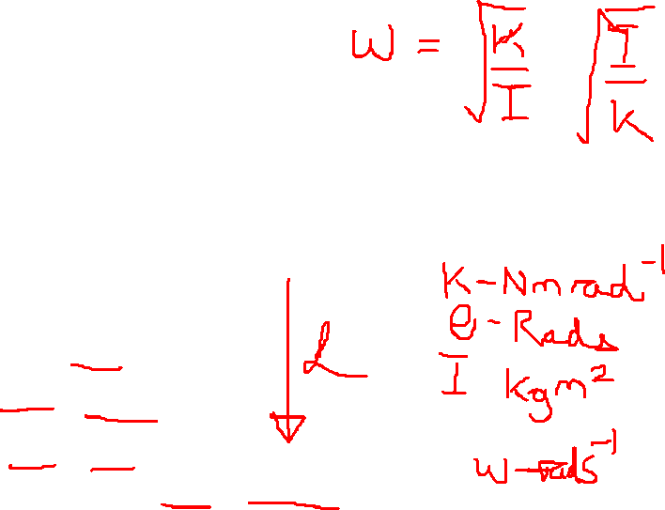
Case 2: Block has moment of inertia $I$
Equation of motion: input torque causes block to move
$$T=I\ddot{θ}+kθ$$
Laplace domain
  $T\left(t\right)\underset{→}{ℒ}T\left(s\right)$
  $I\ddot{θ}\left(t\right)\underset{→}{ℒ}s^{2}IΘ\left(s\right)$
  $kθ\left(t\right)\underset{→}{ℒ}kΘ\left(s\right)$
$$T\left(s\right)=\left(Is^{2}+k\right)Θ\left(s\right)$$
Clamp
θ
T

Slide 23
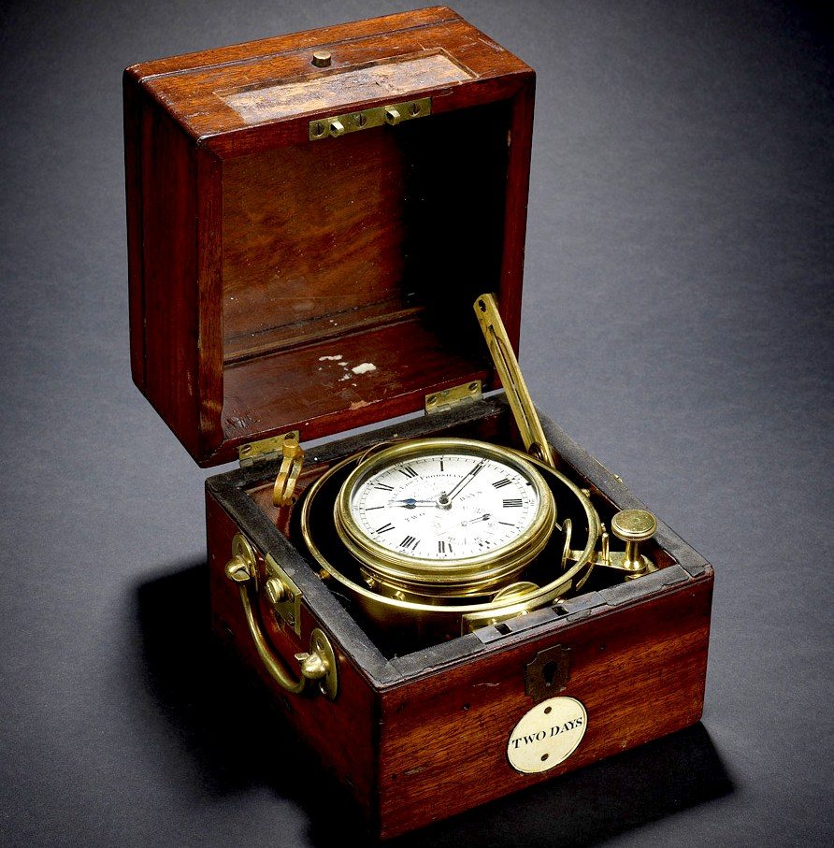
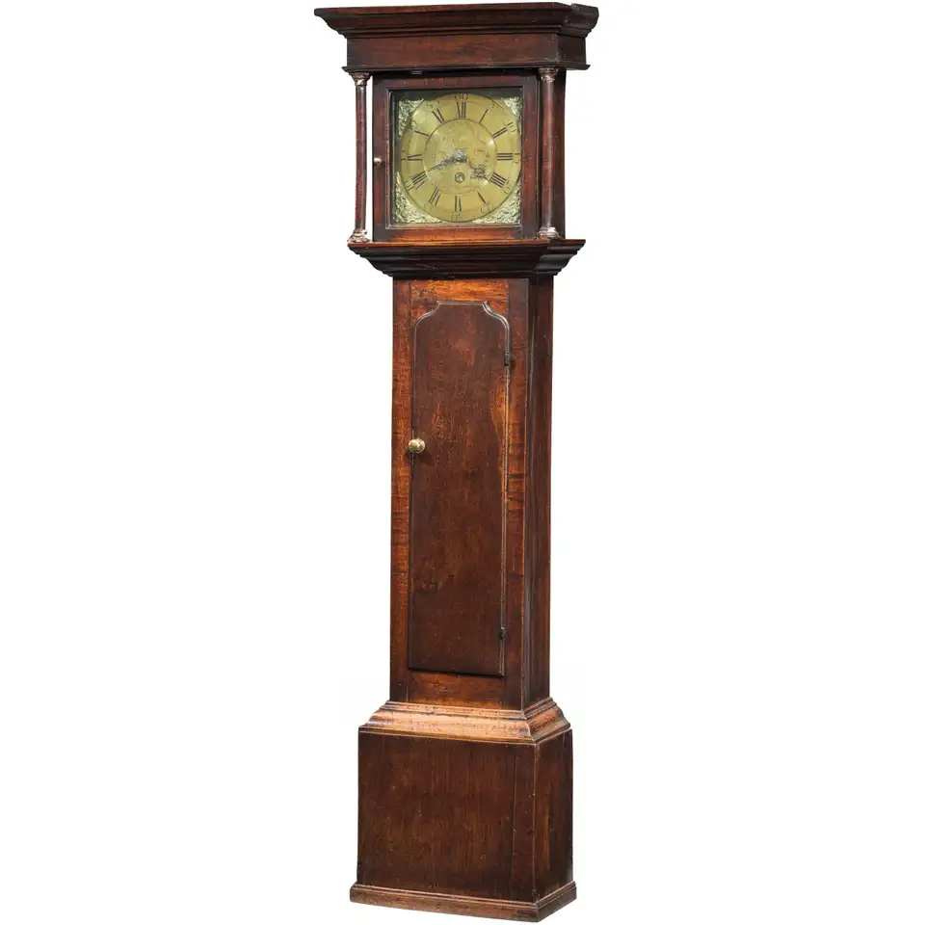
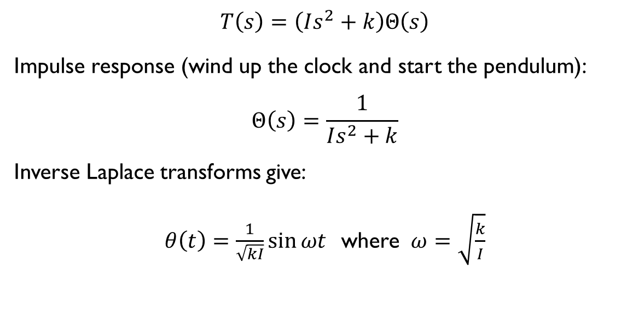
Bonus: What does this mean?
$$T\left(s\right)=\left(Is^{2}+k\right)Θ\left(s\right)$$
Impulse response (wind up the clock and start the pendulum):
$$Θ\left(s\right)=\frac{1}{Is^{2}+k}$$
Inverse Laplace transforms give:
$θ\left(t\right)=\frac{1}{\sqrt{kI}}sin{ωt}$ where $ω=\sqrt{\frac{k}{I}}$

Slide 24
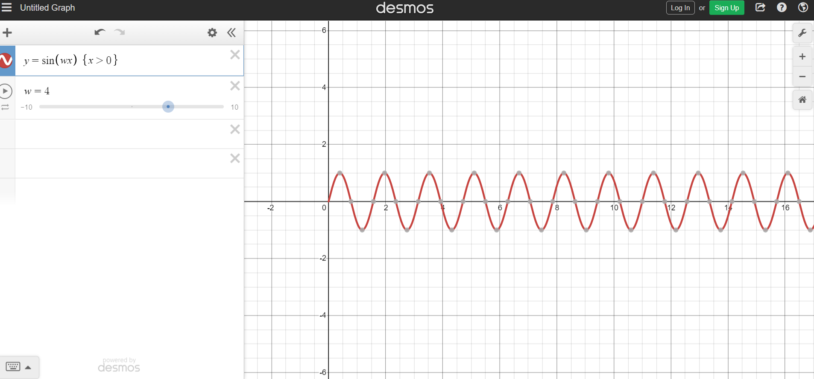
Bonus: What does this mean?
Harrison’s chronometer – rotary pendulum not affected by the motion of the ship – solved the longitude problem.
My ancestors made these things (Ritchie of Methven)

Slide 25
How to – Example Sheet 1, no. 2
Derive expressions for the transfer functions that relate input torque $T\left(t\right)$ and output angular displacement $θ\left(t\right)$ of the torsional system shown for the following cases:
The block has negligible mass
The block has a moment of inertia $I$
Note that the torsional stiffness of the mass-less bar is k and the directions of T and θ are similar, as shown in the figure.
Clamp
θ
T

Slide 26
Important Take-AWAYS
Laplace transforms make solving differential equations much more straightforward.
Control modelling is about stability: the denominator of the transfer function tells you a lot about the system behaviour (more later)

