Slide 1
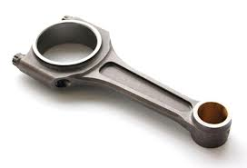
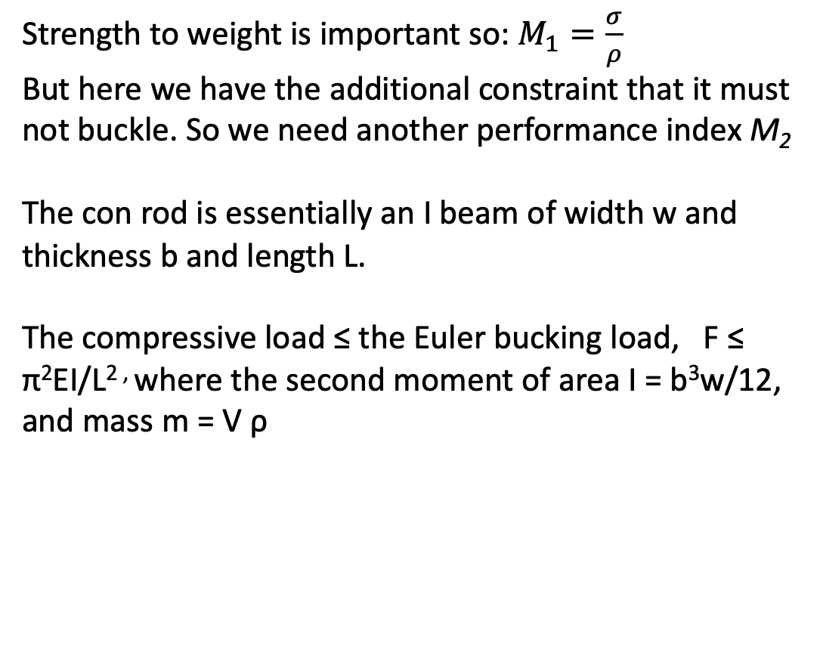
Con Rod
Function: Connecting rod in a reciprocating engine
Objectives: Connects piston to crankshaft, must be as light as possible, thus minimise mass, while maintaining mechanical performance in terms of strength and resisting bucking.
Constraints: Sufficient specific strength over billions of cycles ( high cycle fatigue strength), must withstand elastic buckling, must be mass produced, low production costs
Free variable: Choice of material, cross section
Strength to weight is important so: $M_{1}=\frac{σ}{ρ}$
But here we have the additional constraint that it must not buckle. So we need another performance index M₂
The con rod is essentially an I beam of width w and thickness b and length L.
The compressive load ≤ the Euler bucking load, F ≤ π²EI/L^{2 ,} where the second moment of area I = b³w/12, and mass m = V ρ

Slide 2
Con Rod
If we assume a shape constant such that the width of the con rod is related to its thickness such that b = α w
Then
I = α³w⁴/12
And
m = αw²Lρ
Rearranging
w² = m/(αLρ)
Therefore
I = α m²/(L²ρ² 12)
Euler bucking occurs when
F = π²EI/L²
F = π²Eα m²/(L⁴ρ² 12)
m² = F L⁴ρ² 12/(π²Eα)
Therefore m² is proportional to ρ²/E for a set length L.

Slide 3
Con Rod
But we want to minimise mass ( i.e. 1/m) so:
Merit index for bucking: M₂ = (E^{1/2}/ρ)
This merit index is commonly used for bucking problems such as pillars, table legs…
Taking logs then
log M₂ = log E^{1/2} – log ρ
Thus
log E = 2log ρ + 2log M₂
Which is the form y = mx + c
Therefore plot log E versus log ρ and lines with slope 2 will have the same merit index for buckling.

Slide 4
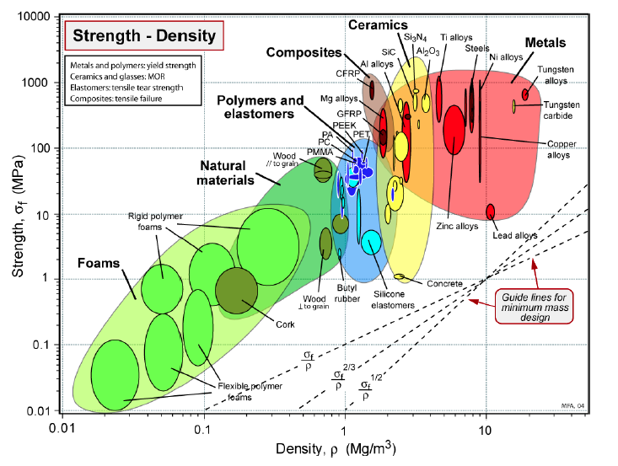
Materials Selection

Slide 5
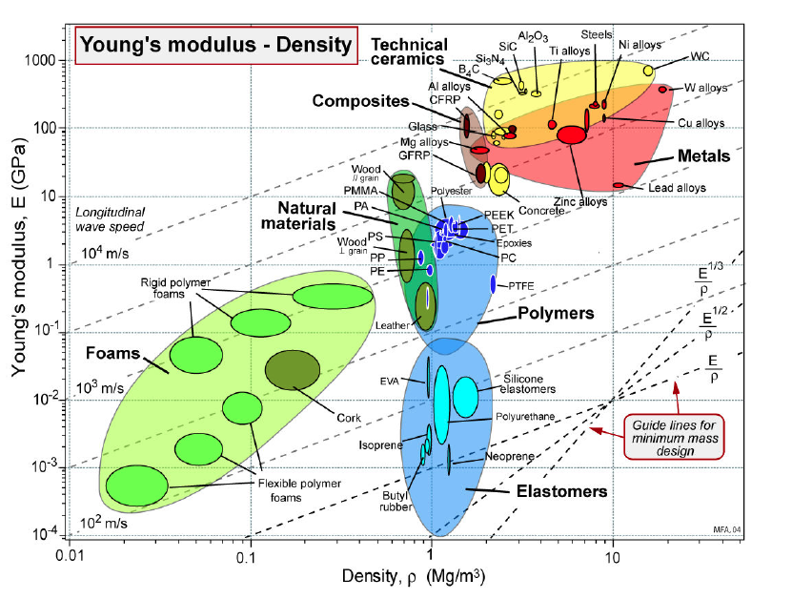
Materials Selection

Slide 6
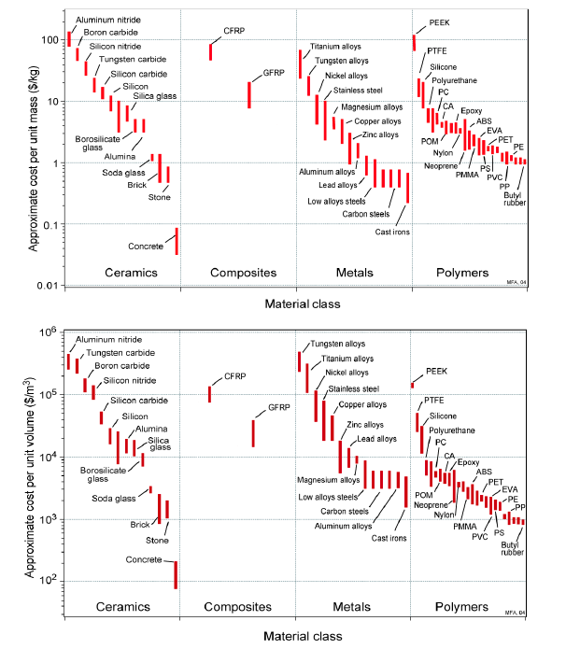


Slide 7
Light Alloy selection
Based on strength to weight index M₁ = (σ_{f}/ρ) then
Aluminium, Magnesium and titanium alloys are promising
Based on buckling resistance M₂ = (E^{1/2}/ρ) then
Magnesium best followed by aluminium, both outperform the Titanium alloys
Based on raw material cost
Titanium alloys are significantly more expensive to produce ( and to manufacture due to high temperature processing in an inert atmosphere)
Magnesium is more expensive but has better overall performance
Based on manufacturing
Again Titanium too expensive for mass production, low cost engines, due to being processed at high temperatures Tm = 1668˚C and in an inert atmosphere.
Like Al alloys, Mg alloys have limited ductility at room temperature and have to be wrought at elevated temperatures
Processing of Mg alloys is further complicated by its reactivity and corrosion in air.

Slide 8
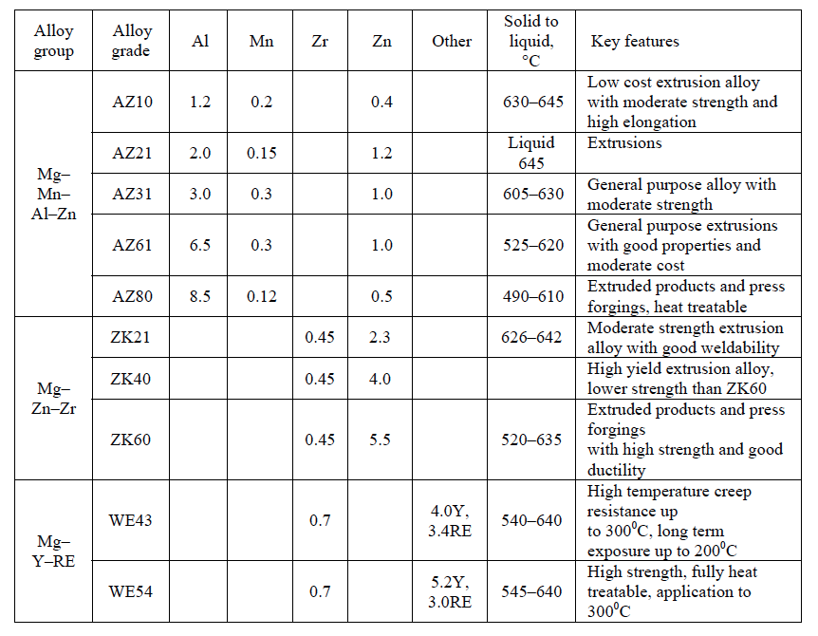
structure - properties - processing
Typical wrought Magnesium alloys

Slide 9
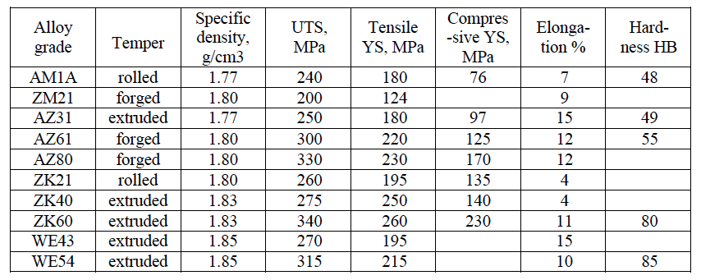
structure - properties - processing
Typical properties at room temperature of some of the wrought Magnesium Alloys

Slide 10
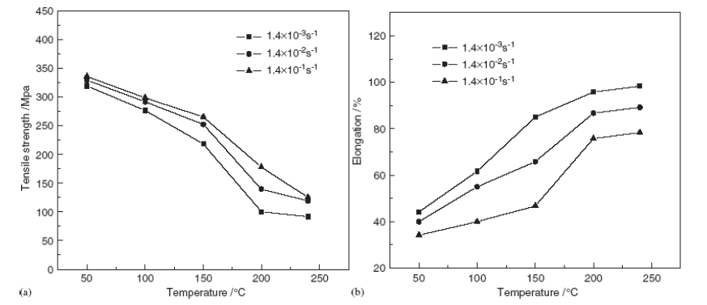
structure - properties - processing
The influence of strain rate and temperature on strength and ductility for an AZ31 alloy showing why wrought Mg alloys tend to be processed above 100˚C, typically in the range 175 – 350 ˚C

Slide 11
structure - properties - processing
AZ alloys Mg(Al-Mn-Zn)have the better ductility at room temperature and as we have seen on previous slide at temperatures from 175 - 350˚C.
However this means limited to applications below 150˚C otherwise suffers from creep

Slide 12
structure - properties - processing
The elemental additions in AZ Mg alloys are:
Aluminium (Al) improves castability, it also provides solid solution strengthening and age hardening at relatively low T (<120°C)
Manganese (Mn) controls any Fe content by forming FeMn compounds and increases creep resistance and improves corrosion resistance
Zinc (Zn) improves casting by decreasing viscosity allowing greater fluidicity. Zn also provides age( precipitation) hardening, is a weak grain refiner but increases brittleness
Silicon(Si) increases creep resistance and is a weak grain refiner but at the cost of poorer corrosion resistance

Slide 13
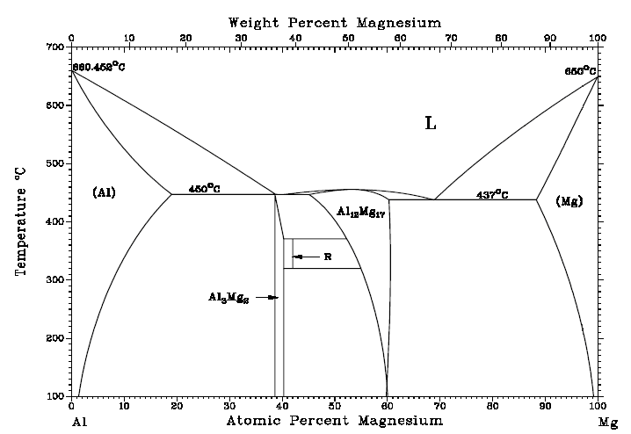
structure - properties - processing
β α + β α

Slide 14
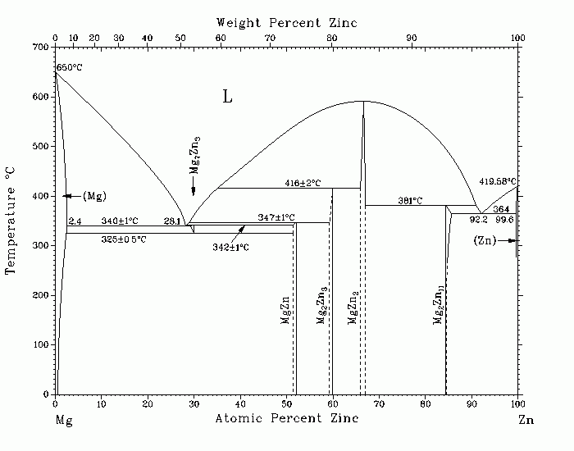
structure - properties - processing
α

Slide 15
structure - properties - processing
Mg has a HCP crystal structure and like other metals with HCP there is limited ductility at room temperature and therefore tends to be worked at elevated temperatures
Solid Solution Strengthening
In the above slide elements such as Al and Zn have significant solid solubility into the Mg HCP matrix. Unfortunately the effect on strengthening is very modest thus Mg alloys are often aged.
Age hardening
Thus improved strengthening is by age (precipitation) hardening

Slide 16
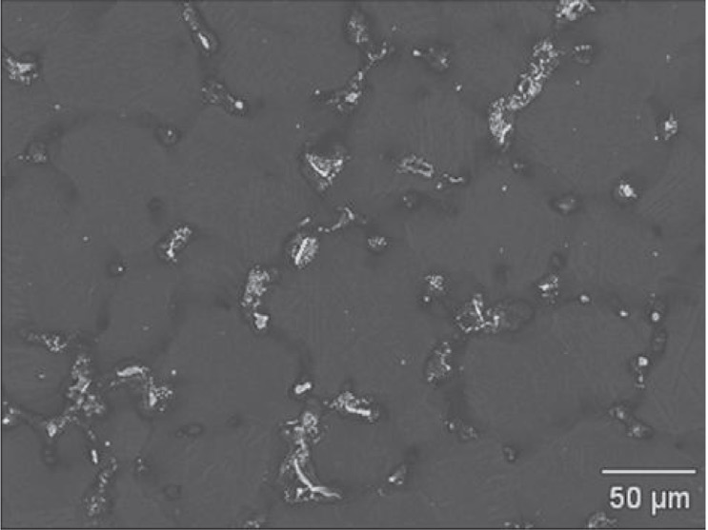
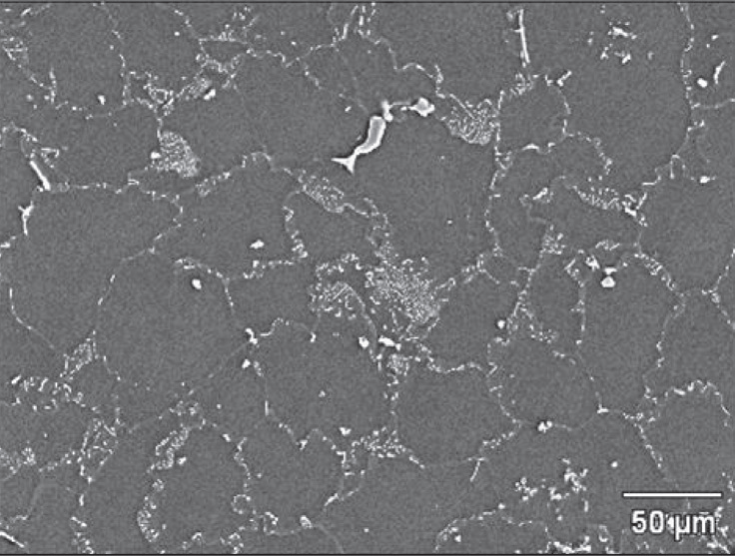
structure - properties - processing
β-Mg₁₇Al₁₂
β-Mg₁₇Al₁₂
α-Mg
α-Mg
As-cast AZ31
As-cast AZ61
Both alloys consist of primary α-Mg matrix and β-Mg₁₇Al₁₂ second phase Precipitate phase in the form of a network at grain boundaries.
The coarse β-Mg₁₇Al₁₂ phase is prone to break, and cracks tend to propagate along them during room temperature deformation process
At elevated temperature (> 350-420 °C) most precipitate dissolve in the matrix
Reference: M.L. Olguín-González, D. Hernández-Silva, M.A. García-Bernal, V.M. Sauce-Rangel, Materials Science and Engineering: A, Volume 597, 12 March 2014, pp82-88 ,
Notes:
Reference: M.L. Olguín-González, D. Hernández-Silva, M.A. García-Bernal, V.M. Sauce-Rangel, Materials Science and Engineering: A, Volume 597, 12 March 2014, Pages 82-88 ,

Slide 17
structure - properties - processing
AZ series such as AZ61 suffers from loss of strength and creep if operated at elevated temperatures above 150˚C.
The WE series based on Mg-RE-Zr has a greater creep resistance and good mechanical properties at both room temperature and elevated temperatures and is generally rated for use up to 300˚C.
Typical rare earths (RE) used to improve yield strength and creep resistance are Dysprosium, Yttrium and Gadolinium. Other additions include Scandium, Calcium, Cerium and Manganese. Mn helps with fatigue resistance.
The addition of RE and Zr combined with the higher processing temperatures make WE alloys more expensive.

Slide 18
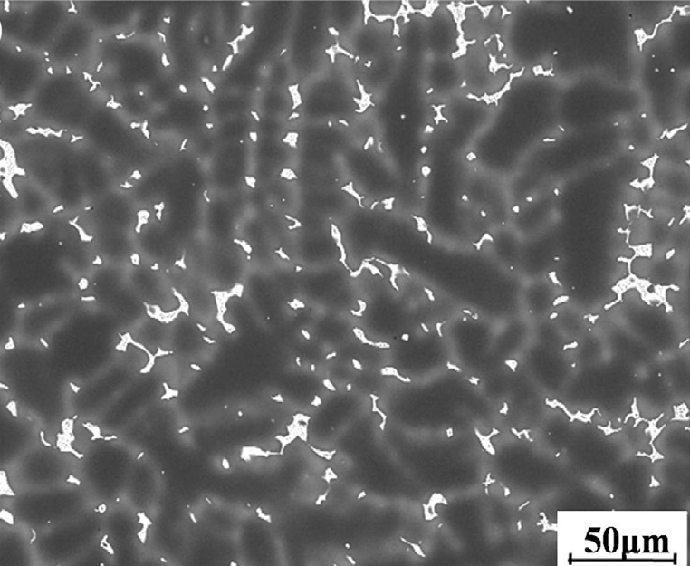
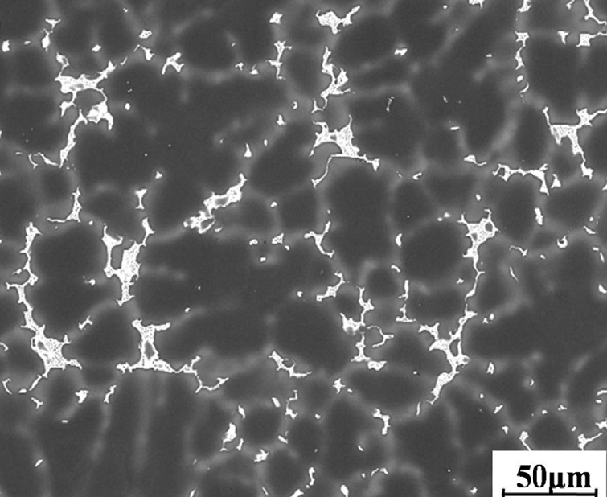
structure - properties - processing
Mg-5%Y-4%RE (WE54) without Zr
Mg-5%Y-4%RE (WE54) with 0.45wt% Zr
α-Mg matrix, Y and Nd intermetallic eutectic phase along the grain boundaries and brighter isolated cuboidal intermetallic Mg-RE phases
High processing temperature: around 750 °C
Tensile strength increased with the addition of Zr
Ref: Jilin Li, Rongshi Chen, Yuequn Ma, Wei Ke, Journal of Magnesium and Alloys, Volume 1, Issue 4, December 2013, Pages 346-351
Notes:
Ref: Jilin Li, Rongshi Chen, Yuequn Ma, Wei Ke, Journal of Magnesium and Alloys, Volume 1, Issue 4, December 2013, Pages 346-351

Slide 19
structure - properties - processing
A big drawback to Mg alloys is their poor resistance to corrosion. Mg alloys suffer from crevice corrosion, intergranular corrosion, pitting, stress corrosion cracking and corrosion fatigue.
Exposure to air above 150˚C leads to large scale oxidation and therefore processing at elevated temperatures has to be done in inert atmospheres
Mg alloys react readily with moisture to form Magnesium hydroxide layers
Mg (s) + 2 H₂O (l) → Mg(OH)₂ (s) + H₂ (g)

Slide 20
So be careful
Burning VW engine LINK
Mg firefighter LINK

