Slide 1
External environment
It is not just the internal environment of the PE gas pipes but the external environment such as exposure to UV radiation before burying and oxidative degradation are important considerations that influence the material properties of strength, stiffness, creep resistance and toughness which are also influenced by the processing of the pipe during manufacture and fusing joints.
Therefore for Materials in Design we must consider the materials structure – property – processing relationships

Slide 2
Design against Failure in Service
In this section we will consider important failure modes of polymers and check suitability for PE for operation. In particular design against:
Creep
Creep Rupture
Environmental Stress Cracking (ESC)

Slide 3
Design against Creep
NOTE: Creep implies time dependent strain not permanent strain. When a creep load is removed then the polymer may slowly recover its shape provided it had not been strained to yield point or a mechanism of failure has started.
Therefore creep in polymers is different from creep in metals where metals experience permanent strain.

Slide 4
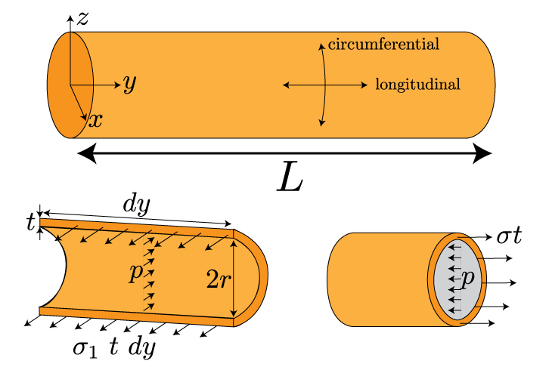

Design against Creep
For the gas pipes it is expected that they will experience a static stress.
The principal stresses are hoop, longitudinal and radial
which for a thin walled pressure vessel are
Where P is the pressure inside the vessel, R is the mean radius and t is the wall thickness
Since
Where υ is Poisson ratio
Note we have used a thin wall approximation for the principle stresses which holds provided R/t > 20. In this module for simplicity we will still use the approximation even though the gas pipes have R/t ~ 5.
Notes:
Creep is a time-dependent deformation of a material while under an applied load that is below its yield strength.
Note we have used a thin wall approximation for the principle stresses which holds provided R/t > 20. In this module for simplicity we will still use the approximation even though the gas pipes have R/t ~ 5.
Radial stress is very smaller than hoop and longitudinal stress and can be neglected (in varies from –P on the inside surface to 0 at the outer surface).
Stresses derivation: https://www.youtube.com/watch?v=Ja03J1RQ3Hw

Slide 5


Design against Creep
The Gas pipe needs to last 50 years! In that time new fittings need to fit within tolerance despite any creep. This is set at 3% hoop strain in 50 years.
We need to allow for the viscoeleastic behaviour so we define Creep Compliance J(t) as:
So the strain in a uniaxial tension creep experiment is:
While the strain for a material that creeps under hoop stress is:
Similarly
Notes:
The creep compliance is the rate at which strain increases at a constant applied stress

Slide 6
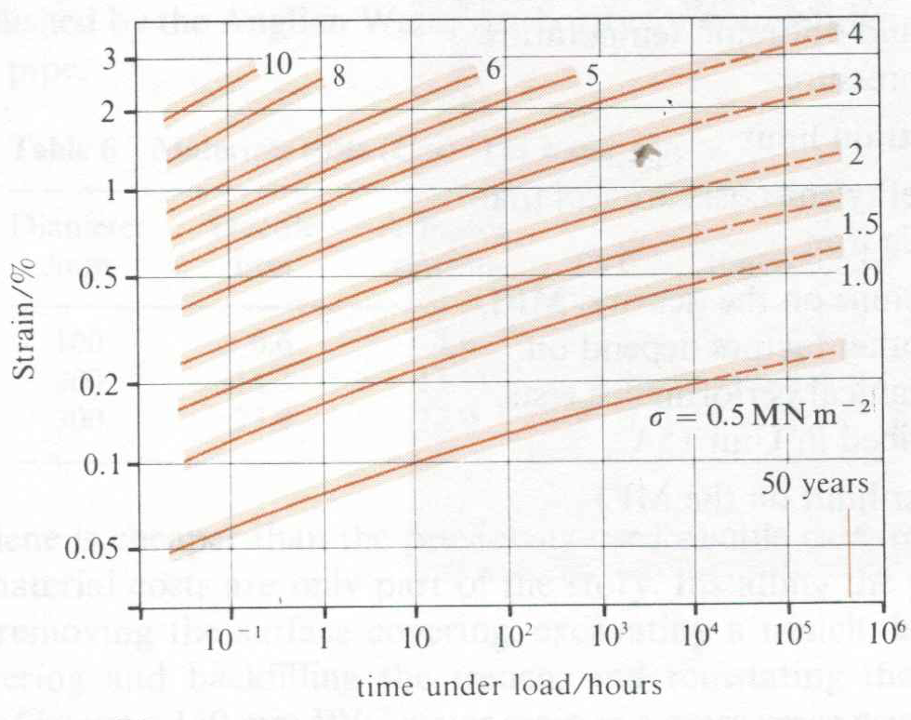
PQ4 Polymer Question 4
Use the equation for creep hoop strain, convert to creep tensile strain and use the graph below to calculate the maximum internal gas pressure in a pipe of R/t =5 with a Poisson ratio of 0.4 to reach 3% hoop strain in 50 years.
Graph: MDPE creep strain /time curves for MDPE test samples under tensile load
Notes:
Non linear after 0.5%
Creep compliemce with time – give an example showing creep complience

Slide 7
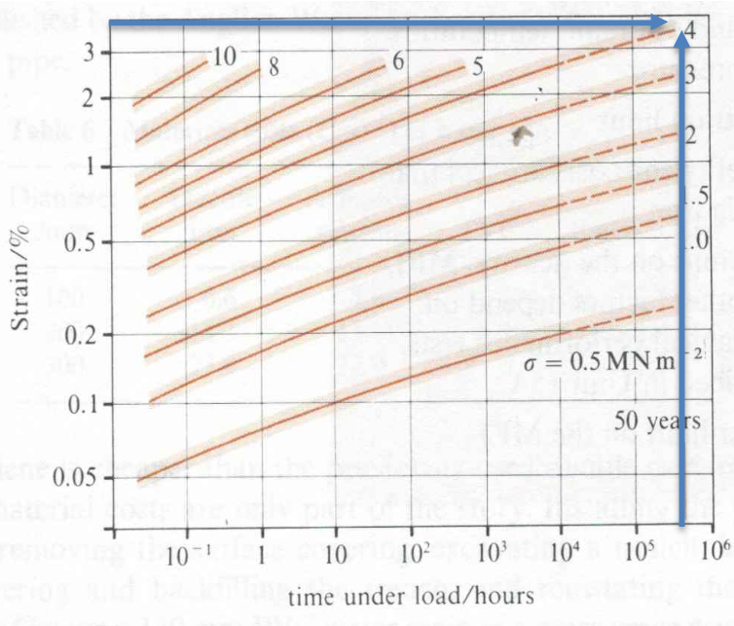
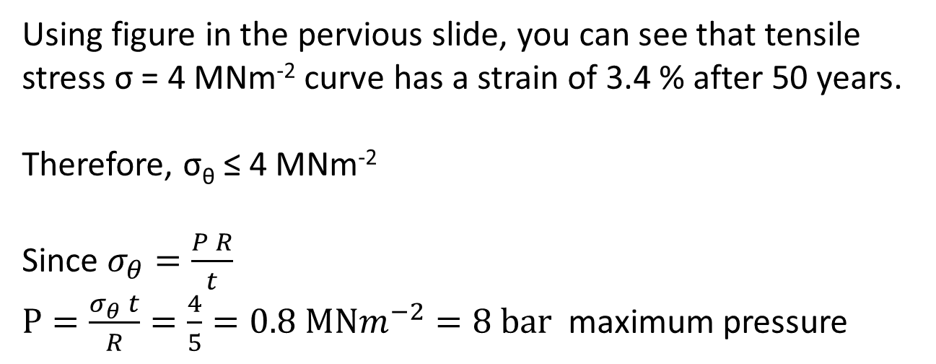
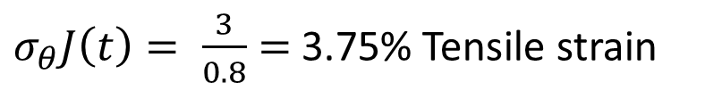

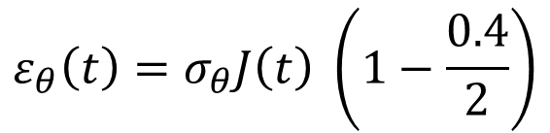
Answer PQ4
$$ε_{θ}\left(t\right)=σ_{θ}J\left(t\right) \left(1−\frac{0.4}{2}\right)$$
$$ε_{θ}\left(t\right)=0.8 σ_{θ}J\left(t\right)$$
$σ_{θ}J\left(t\right)= \frac{3}{0.8}=$3.75% Tensile strain
Using figure in the pervious slide, you can see that tensile stress σ = 4 MNm⁻² curve has a strain of 3.4 % after 50 years.
Therefore, σ_{θ} ≤ 4 MNm⁻²
Since $σ_{θ}=\frac{P R}{t}$
$P=\frac{σ_{θ} t}{R}=\frac{4}{5}=0.8 MNm^{−2}=8 bar$ maximum pressure

Slide 8
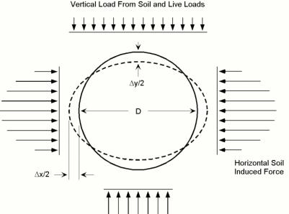
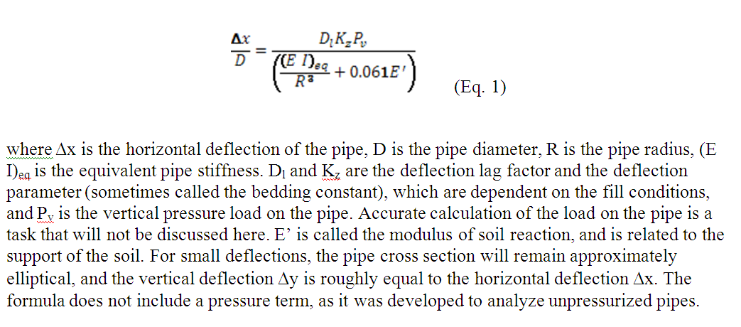
Design against Creep
Soil Loading in flexible buried pipes
Buried flexible pipes have underestimated load-carrying capacity due to the pressure induced at the sides of the pipe as they deform horizontally outward under vertical loading. The interaction between the pipe and the soil packing leads to the empirical Iowa Formula*
You do not need to know this equation ☺
Calculations based on MDPE with R/t = 5 and typical soil loads predict less than 0.5% diameter change after 50 years
(*Spangler, M.G., “The Structural Design of Flexible Pipe Culverts,” Bulletin 153. Iowa State College, Ames, Iowa, 1941.)

Slide 9
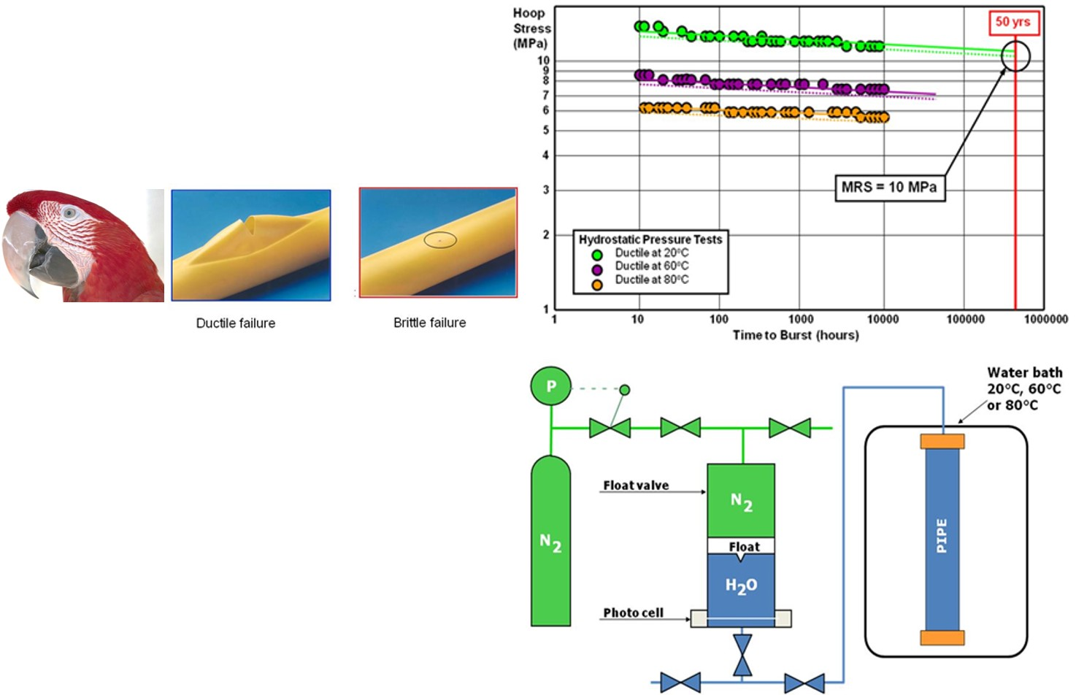
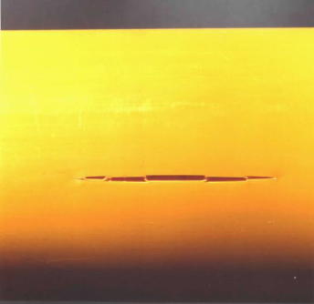
Design against Creep Rupture
PE 80 and 100 are ISO standards for a HDPE pipe. Minimum strength of 8 and 10 MPa after 50 years.
Hydrostatic pressure tests. Internal pressures give hoop stresses that cause failures from 10 to 9000 hours.
A minimum of 30 data points (ISO 9080).
PE pipe materials are tested at 20, 60 and 80˚C .
LINK
Notes:
Creep rupture testing is similar to creep testing except that the stresses are higher than those used in a creep testing. Stress rupture tests are used to determine the time necessary to reach failure so stress rupture testing is always done until failure.
Why is the shape and direction of the ductile creep rupture the way it is? Followed hoop stress - parrot beak fracture
Ductile failure results in yielding and reflects a material’s tendency to undergo large-scale, irreversible ‘plastic’ deformation when under stress.
Brittle failure is typically slit-type fracture that lie parallel to the pipe’s extrusion direction. Circumferential hoop stress in the pipe wall is the driving force for crack opening.
80 and 100 bar

Slide 10
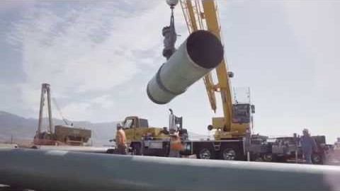
Design against Creep Rupture
LINK
https://www.youtube.com/watch?v=lRFWeTRAcCU&app=desktop
Notes:
Why is the shape and direction of the ductile creep rupture the way it is? Followed hoop stress - parrot beak fracture
Ductile failure results in yielding and reflects a material’s tendency to undergo large-scale, irreversible ‘plastic’ deformation when under stress.
Brittle failure is typically slit-type fracture that lie parallel to the pipe’s extrusion direction. Circumferential hoop stress in the pipe wall is the driving force for crack opening.
80 and 100 bar

Slide 11
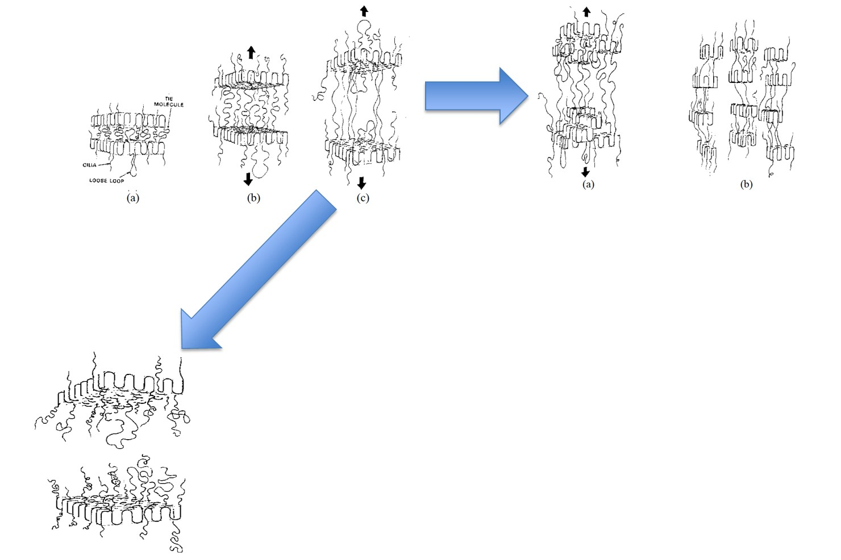
Ductile vs Brittle
Initial deformation of PE
Ductile Failure: Under tensile load the interlamellar ties stretch until the ties can be pulled out no further. The lamellae break up into small crystals. The tie molecules hold the lamellae blocks together, critical for ductile-type behaviour.
Brittle failure: Occurs by applying low stress over long period, the interlamellar ties have time to disentangle from each other and from the lamellae. At the failure point, the remaining interlamellar ties are not enough to hold the crystalline lamellae together, leading to a sudden break of the material. Break surfaces are usually smooth because the lamellae remain intact.
Notes:
Ductile failure: At low stress, the load is carried by the crystalline phase until the load increased enough to break the lamella into small crystals leading to necking effect. With continued deformation, the amorphous phase of PE starts to “strain harden,” and this is observed as an increase in load until the material breaks.
Brittle failure: brittle failure occurs when the material experiences low stress over a long period. Because of the long period to failure, the interlamellar links have time to disentangle from one another and from the lamellae as the lamellae are being pulled apart. At the failure point, the remaining interlamellar
links are few and cannot hold together the crystalline lamellae, leading to a sudden break of the material with the lamellae staying intact. Because the lamellae remain intact, smooth break surfaces are usually observed in brittle fracture of PE.

Slide 12
Design against ESC
Environmental stress cracking (ESC) - failure at room temperature due to continuously acting external and/or internal stresses in the presence of surface active substances (stress cracking agents)
Typical stress cracking agents - alcohols, soaps, dyes, agents containing moisture.
ESC - interaction of the polymer with certain chemicals. It is not a chemical reaction between the polymer and the active environment.
The stress cracking agents do not cause any chemical degradation of the polymer but they accelerate the process of macroscopic brittle-crack formation.
All liquids that are absorbed by a polymer in a short period may be a severe stress cracking agents.
Notes:
Environmental stress cracking is the formation of cracks in a product when exposed to chemicals due to external/ internal stress.

Slide 13
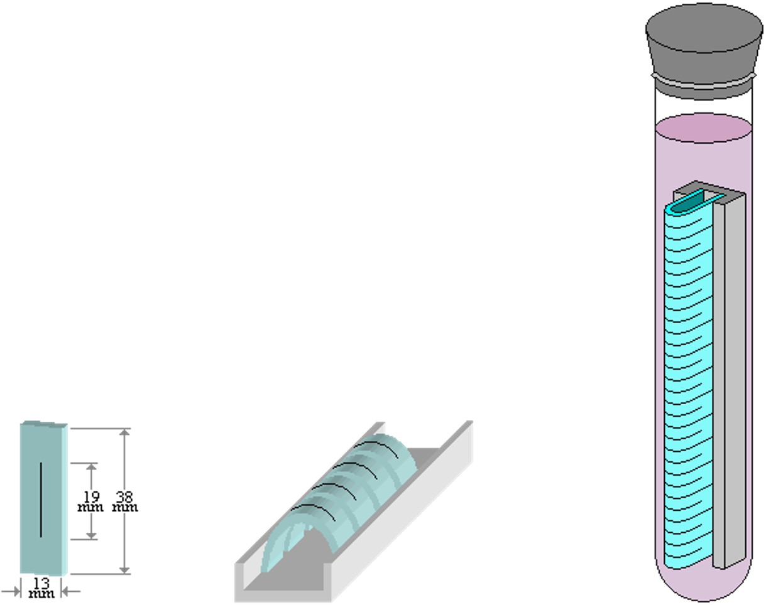
Design against ESC
Environmental Stress-Cracking Resistance (ESCR) – (ASTM D1693) which is the number of hours that 50% of the specimens tested exhibit stress cracks.
Test samples are notched then bent and placed in a holding clamp.
The clamp and specimens are then immersed in a specified reagent in a constant-temperature bath. Multiple test specimens are tested at one time.
Notes:
Environmental stress cracking is an example of material degradation by the simultaneous action of two degradants: stresses (external and internal) and chemical effect.

Slide 14

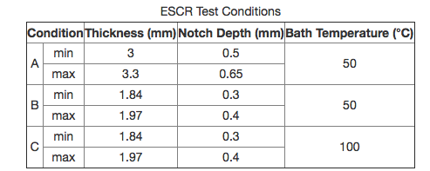
Design against ESC
Specimens are inspected periodically for failure.
Cracks generally develop at the notch, perpendicular to the notch, and run to the edge of the specimen.
Any cracks represent failure, not just cracks that reach the edge of the specimen.
Cracks sometimes appear beneath the surface and are visible as surface depressions.
If a depression develops into a surface crack the time at which the depression was noted is taken as the time of failure.
Condition A is PE densities 0.910 - 0.925 g/cm³. Condition B densities greater than 0.925 g/cm³. Condition C accelerated testing high ESCR materials.

Slide 15
Design against ESC
Stress Cracking Agents
Liquids with weak hydrogen bonding - organic liquids such as aromatic hydrocarbons, halogenated hydrocarbons, ethers, ketones, aldehydes, esters, and nitrogen and sulphur containing compounds.
Liquids with strong hydrogen bonds and Aliphatic hydrocarbons, for example water and alcohols, are less aggressive agents.
Solvents include petroleum ether, carbon tetrachloride, toluene, acetone, ethanol and chloroform.
Liquids close to their boiling point and low viscosity are more aggressive agents.
Notes:
ethers - oxygen atom connected to two alkyl or aryl groups
Aromatic compounds contain an aromatic-ring configuration of atoms, such as benzene whereas aliphatic compounds do not.[1] Aliphatic compounds can be saturated, like hexane, or unsaturated, like hexene.

Slide 16
Design against ESC
How long?
Transition to brittle behaviour is accelerated to shorter times by
  increasing temperature,
  cyclic loading,
  dilatational stress, stress concentrations
Localized concentration of the stress due to local geometrical features
  notches,
  voids,
  inclusions
Craze (fine cracks on the surface) initiation is accelerated by stress fields with high dilatational stress and retarded under hydrostatic pressure
Notes:
dilatational stress is the stress that acts to change the volume of the material only

Slide 17
Other CASE STUDIES
We have looked in detail why a particular polymer is selected for a low pressure gas distributions and the relevant structure-properties- processing inter -relationships.
We will now explore Materials in Design for
polymers in four other applications:
Acetabular cup – hip replacement
Snap on lids/clips – Deflection limited design
Seals – leak tight seals for containers
Elastic hinges – finger
Notes:
Light box examples?
Different Tg examples?

Slide 18
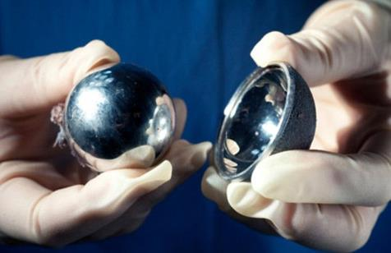
Acetabular cup- hip replacement
Metal-on-metal total hip replacements showed a much higher failure rate than other options which was linked with their high wear rates.
6.1% of metal-on-metal hips had failed within five years, while only 1.6% of metal-on-polymer had failed within the same period.
What is the problem……
Smith et al., Lancet 2012; 379: 1199–204
Notes:
They analysed the National Joint Registry of England and Wales for primary hip replacements (402 051 cases, of which 31 171 were stemmed metal-on-metal) undertaken between 2003 and 2011. “Experts are calling for controversial metal-on-metal hip implants to be banned in 2012.

Slide 19
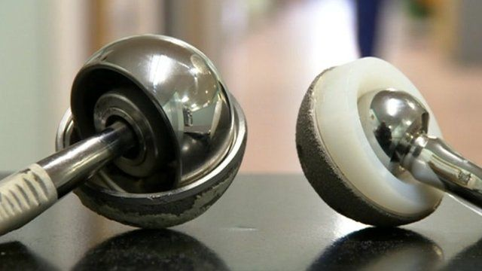
Acetabular cup- hip replacement
Function: Acetabular cup for hip replacement
Objective: delivering low wear rate
Constraints: must be physically and mechanically stable under physiological conditions, able to sterilised, does not leach-out harmful materials….
Free variable: choice of material.
Notes:
They analysed the National Joint Registry of England and Wales for primary hip replacements (402 051 cases, of which 31 171 were stemmed metal-on-metal) undertaken between 2003 and 2011. “Experts are calling for controversial metal-on-metal hip implants to be banned in 2012.

Slide 20
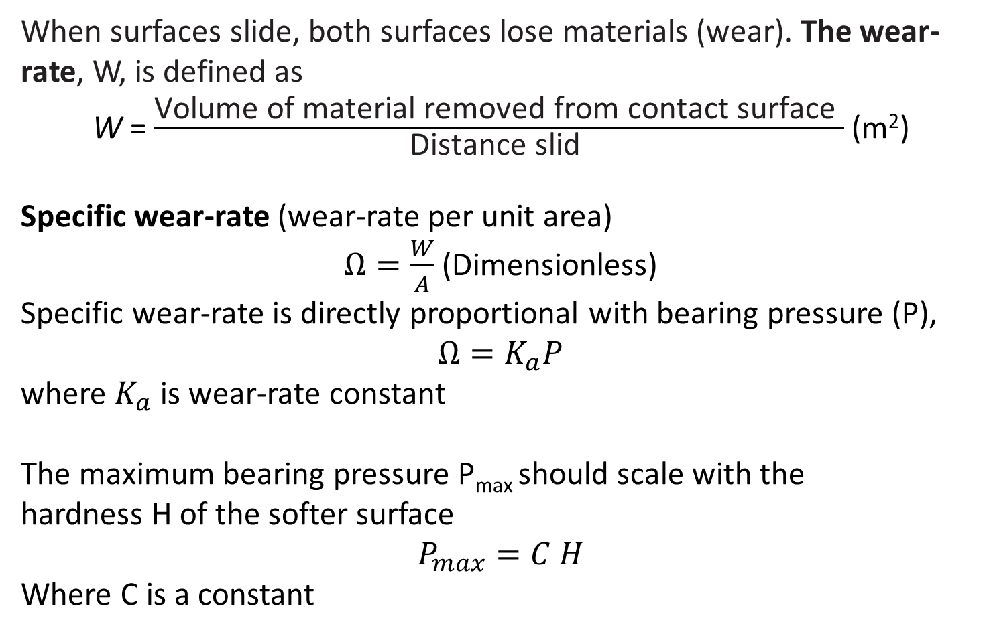
Low Wear rate materials
When surfaces slide, both surfaces lose materials (wear). The wear-rate, W, is defined as
W = $\frac{\text{Volume} \text{of} \text{material} \text{removed} \text{from} \text{contact} \text{surface} }{\text{Distance} \text{slid} }$ (m²)
Specific wear-rate (wear-rate per unit area)
$Ω=\frac{W}{A}$ (Dimensionless)
Specific wear-rate is directly proportional with bearing pressure (P),
$Ω=K_{a}P$
where $K_{a}$ is wear-rate constant
The maximum bearing pressure P_{max} should scale with the
hardness H of the softer surface
$$P_{max}=C H$$
Where C is a constant

Slide 21
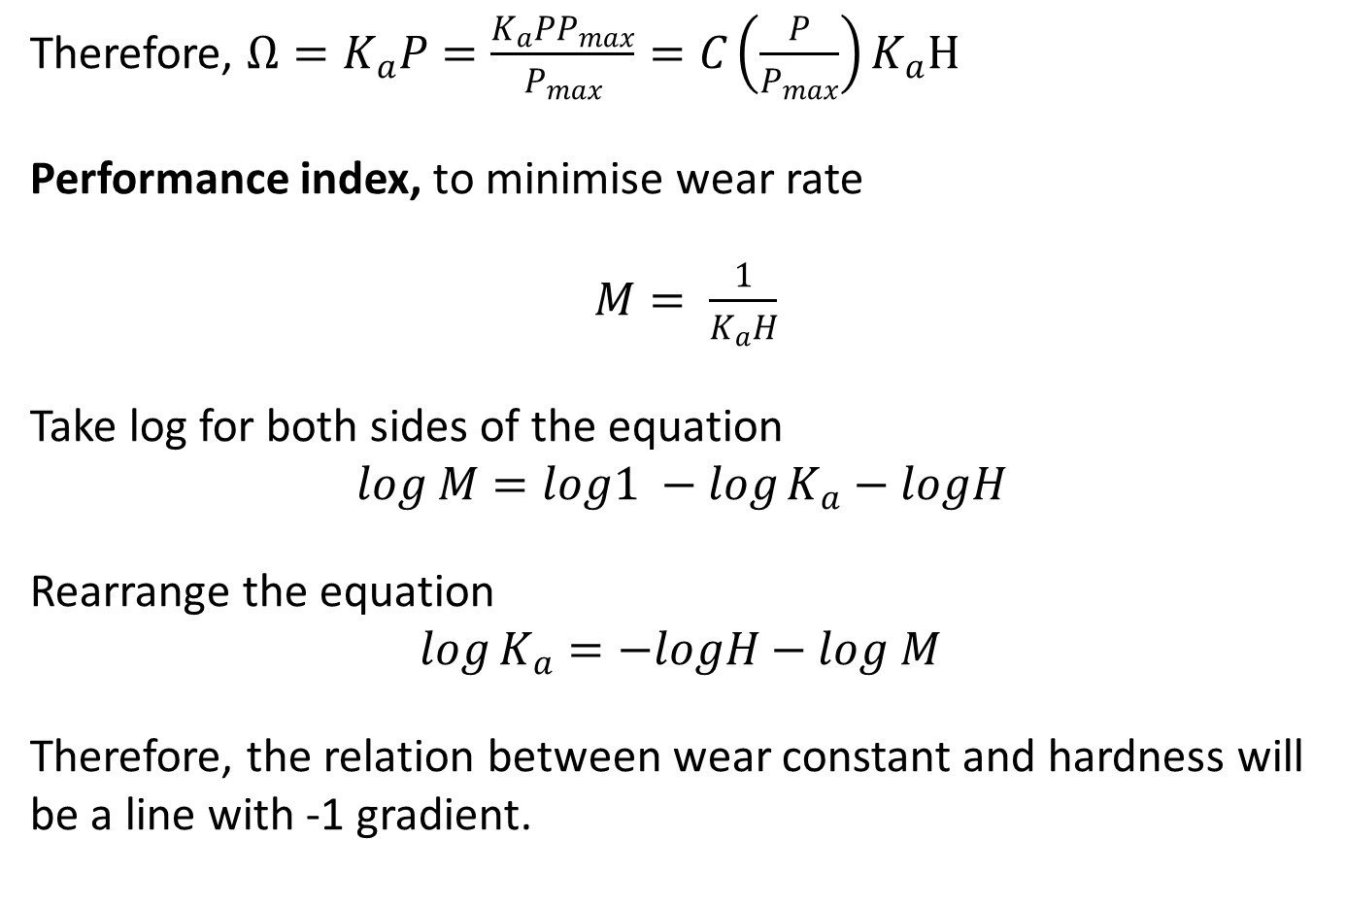
Low Wear rate materials
Therefore, $Ω=K_{a}P=\frac{K_{a}PP_{max}}{P_{max}}=C\left(\frac{P}{P_{max}}\right)K_{a}H$
Performance index, to minimise wear rate
$M= \frac{1}{K_{a}H}$
Take log for both sides of the equation
$$log M=log1 −\log{K_{a}}−logH$$
Rearrange the equation
$$\log{K_{a}}=−logH−log M$$
Therefore, the relation between wear constant and hardness will be a line with -1 gradient.

Slide 22
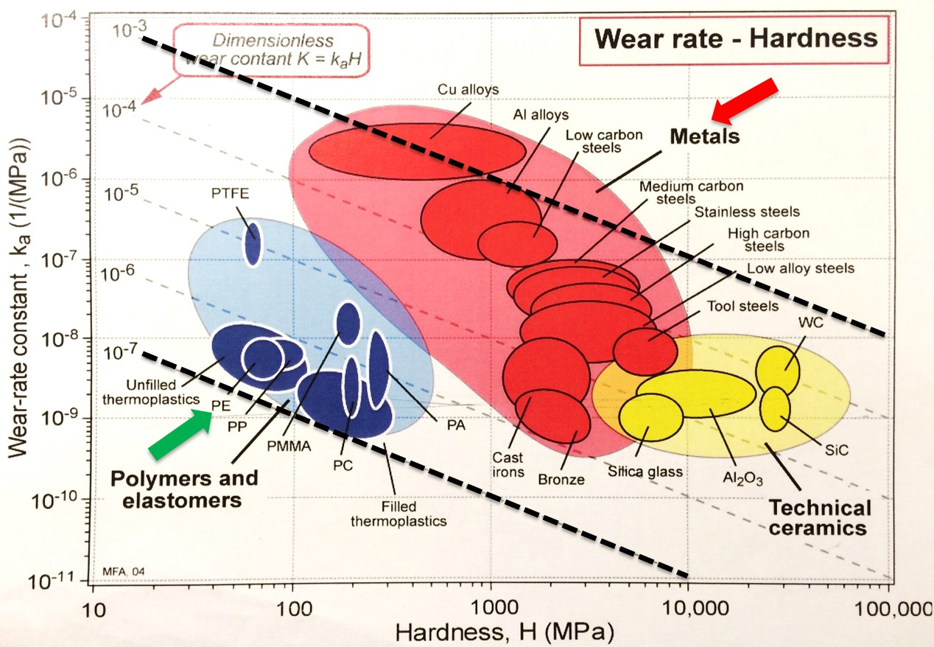
Wear rate – Material selection
Wear rate for metals is 4 orders of magnitude higher than PE

