Slide 1

Compressible flow
compressible fluid theory and maths
oblique shock prediction
expansion wave prediction
friction and heat transfer in pipe flow of compressible gases

Slide 2
2. Compressible flow introduction
Brief review of compressible flow
  isentropic compressible flow
  normal shock
  Mach wave and shock wave
Presentation of chart for normal shock
Oblique shock waves – indication of derivation, and introduction to use and meaning
Weak shock rarefaction – Prandtl-Meyer waves

Slide 3

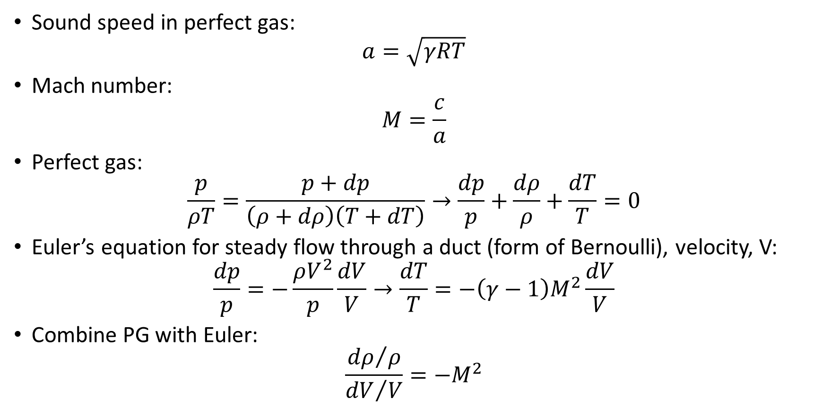
a) Review of compressible flow
$$dp=\dot{m}dV=ρAVdV$$
Sound speed in perfect gas:
$$a=\sqrt{γRT}$$
Mach number:
$$M=\frac{c}{a}$$
Perfect gas:
$$\frac{p}{ρT}=\frac{p+dp}{\left(ρ+dρ\right)\left(T+dT\right)}→\frac{dp}{p}+\frac{dρ}{ρ}+\frac{dT}{T}=0$$
Euler’s equation for steady flow through a duct (form of Bernoulli), velocity, V:
$$\frac{dp}{p}=−\frac{ρV^{2}}{p}\frac{dV}{V}→\frac{dT}{T}=−\left(γ−1\right)M^{2}\frac{dV}{V}$$
Combine PG with Euler:
$$\frac{{dρ}/ρ}{{dV}/V}=−M^{2}$$

Slide 4
Effect of M – determines importance of compressibility of the gas
From the equation, at M=0.1, the change in density will be 1% of the change in velocity
At M=0.33, it will be 10% of change in velocity
At M=0.4, it will be 16% of the change in velocity
Therefore, for M<0.1, incompressible assumption is valid
But for M>0.33, it is increasingly not valid

Slide 5
Isentropic flow in 1D (see TF2 formula sheet)
If the flow is considered to be isentropic, it means no heat transfer (relatively easy to achieve by quick changes in a short space with little exposed surface to external) and reversible (i.e. no friction – increasingly hard to achieve due to effects of viscosity)
Series of equations produced by this assumption can be used as a first approach to what happens when there is compressible flow
In particular, the stagnation temperature remains constant (due to adiabatic condition) and the stagnation pressure remains constant (due to the no loss by viscosity condition)
These can be very useful first approximation for accelerating flow

Slide 6
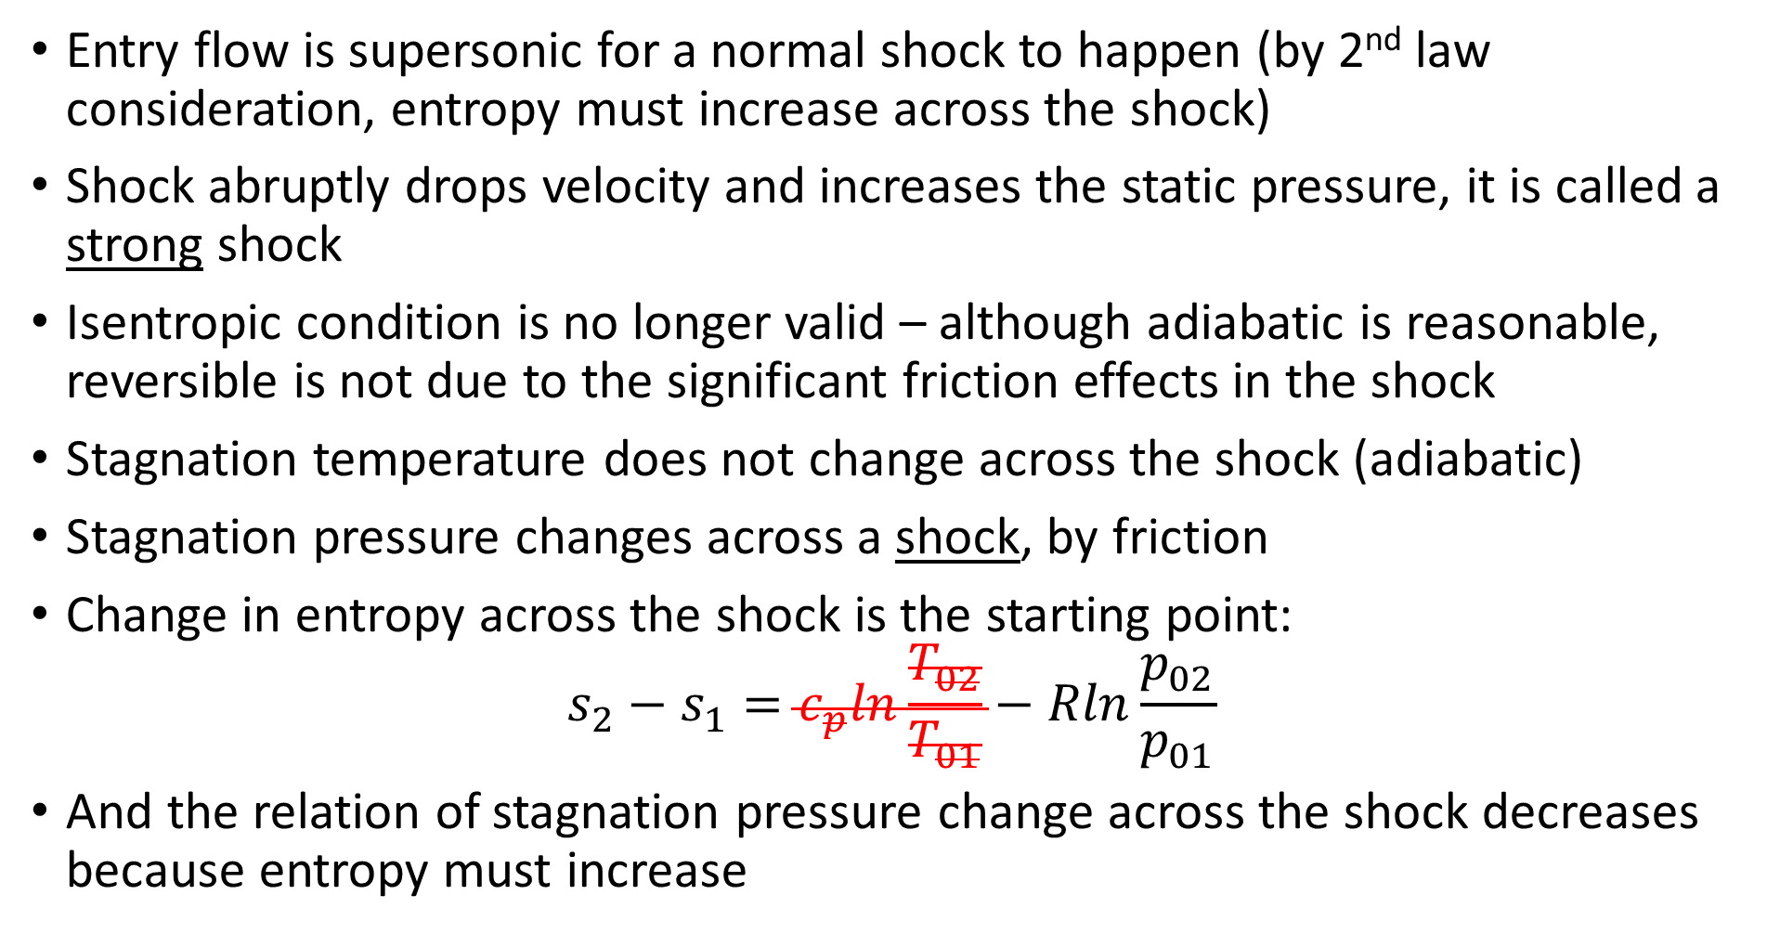
Normal shock (see TF2 formula sheet)
Entry flow is supersonic for a normal shock to happen (by 2nd law consideration, entropy must increase across the shock)
Shock abruptly drops velocity and increases the static pressure, it is called a strong shock
Isentropic condition is no longer valid – although adiabatic is reasonable, reversible is not due to the significant friction effects in the shock
Stagnation temperature does not change across the shock (adiabatic)
Stagnation pressure changes across a shock, by friction
Change in entropy across the shock is the starting point:
$$s_{2}−s_{1}=c_{p}ln\frac{T_{02}}{T_{01}}−Rln\frac{p_{02}}{p_{01}}$$
And the relation of stagnation pressure change across the shock decreases because entropy must increase

Slide 7
Consequences of shock
There are a series of formulae for shock waves and critical flow equations in the TF2 formula sheet
If there is supersonic flow which approaches a convergence, it will shock and produces a subsonic flow
If there is a subsonic flow which approaches a convergence it will accelerate until it reaches sonic velocity and no more, and no further reduction in downstream pressure or increase in upstream pressure can make the mass flow rate any higher
A moving normal shock (e.g. due to a sudden expansion or explosion) can be considered as a stationary normal shock by applying a relative velocity to the shock wave

Slide 8
Normal shock solutions in graphical form
Stagnation pressure ratio – decreases with M₁ and <1
M₂ decreases with increasing M₁, and <1
Velocity ratio decreases with M₁, and <1
Static pressure ratio increases with M₁, and >1
Density ratio increases with M₁ and >1
Temperature ratio increases with M₁ and >1
Remember, M₂ is based on T₂
p₂₀/p₁₀
M₂
u₂/u₁
ρ₂/ ρ₁
p₂/p₁
T₂/T₁

Slide 9
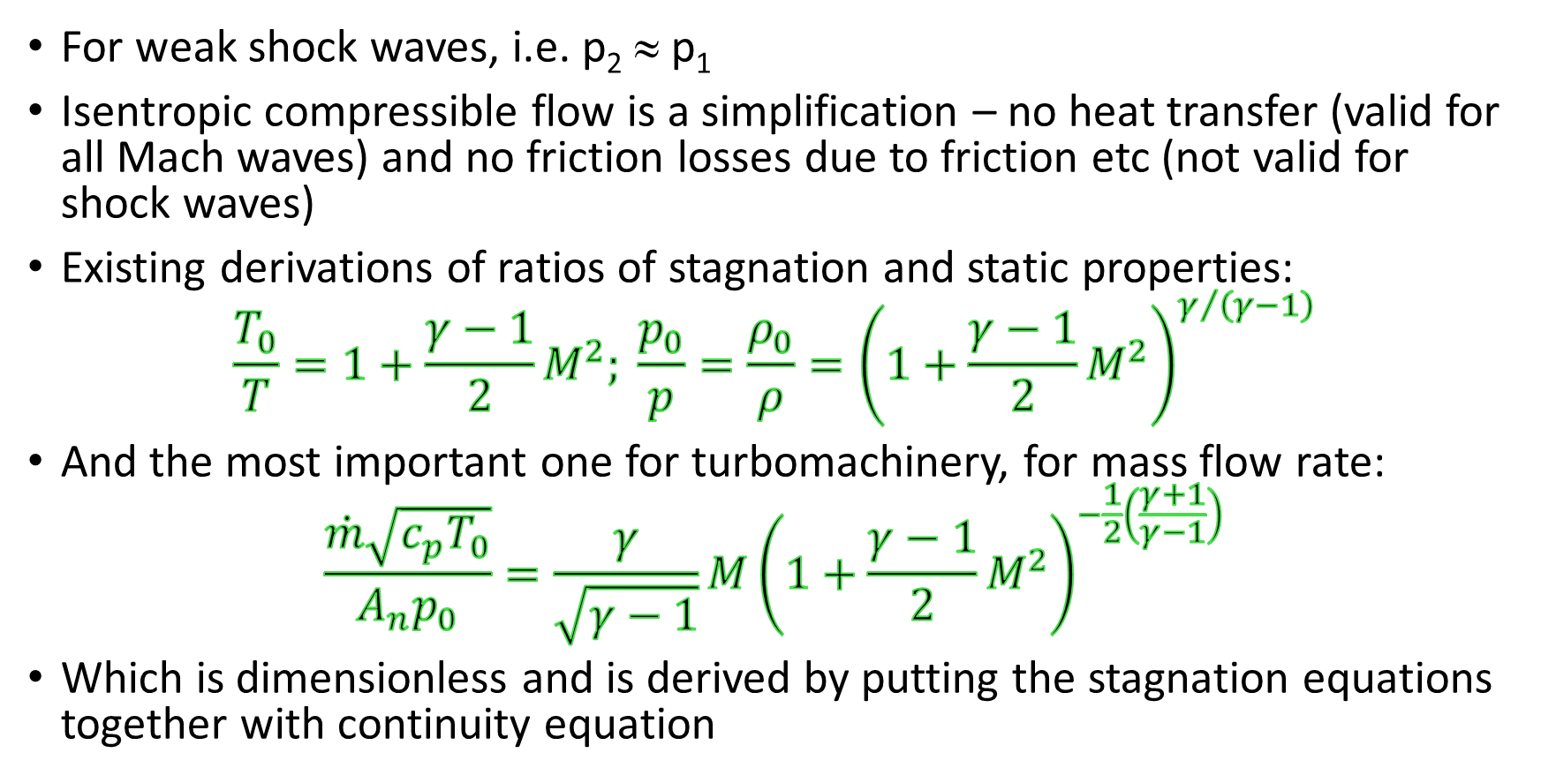
b) Compressible flow – assuming isentropic
Notes p.6
For weak shock waves, i.e. p₂ ≈ p₁
Isentropic compressible flow is a simplification – no heat transfer (valid for all Mach waves) and no friction losses due to friction etc (not valid for shock waves)
Existing derivations of ratios of stagnation and static properties:
$$\frac{T_{0}}{T}=1+\frac{γ−1}{2}M^{2}; {\frac{p_{0}}{p}=\frac{ρ_{0}}{ρ}=\left(1+\frac{γ−1}{2}M^{2}\right)}^{γ/{\left(γ−1\right)}}$$
And the most important one for turbomachinery, for mass flow rate:
$$\frac{\dot{m}\sqrt{c_{p}T_{0}}}{A_{n}p_{0}}=\frac{γ}{\sqrt{γ−1}}M{\left(1+\frac{γ−1}{2}M^{2}\right)}^{−\frac{1}{2}\left(\frac{γ+1}{γ−1}\right)}$$
Which is dimensionless and is derived by putting the stagnation equations together with continuity equation

Slide 10
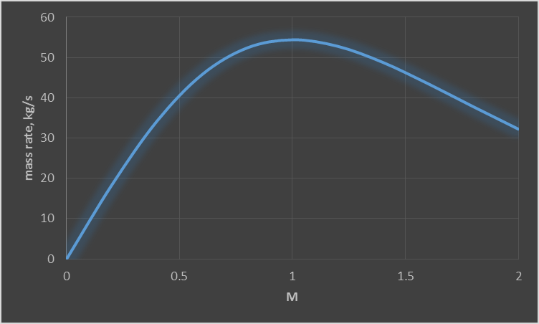
Notes p.6
Note the maximum flow rate is at Mach 1, and beyond that, if the velocity at the throat is further increased it means that for a fixed upstream pressure and temperature, the flow cannot produce a higher mass flux. Changes downstream do not affect the mass flux.
Example from Dixon and Hall, p.20, T₀ = 346K, p₀ = 250 kPa, A = 0.1m²

Slide 11
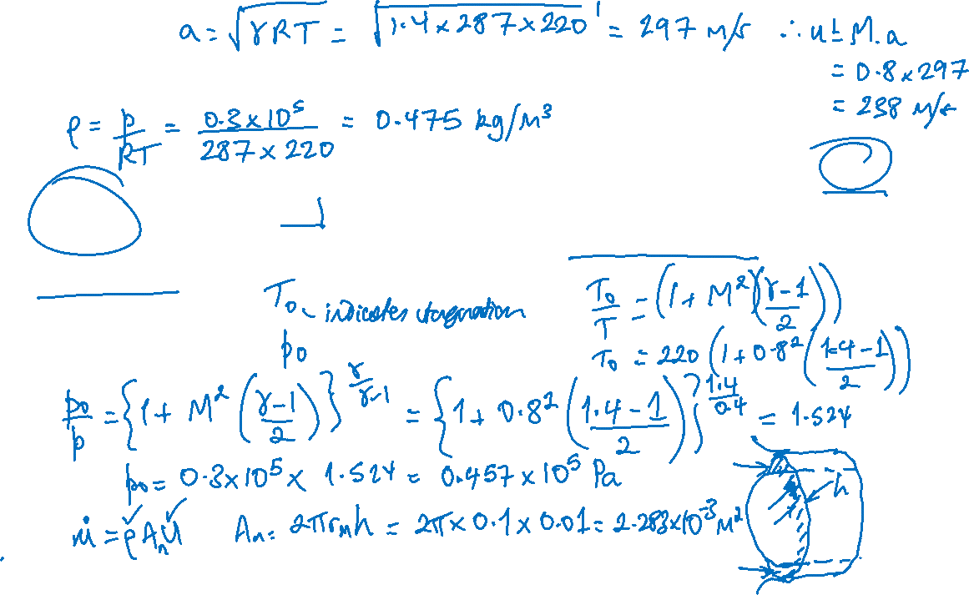
Example – isentropic compressible flow
Calculate the stagnation temperature and pressure for air at M = 0.8, p = 0.3 bar and T = 220 K. Calculate the mass flow rate given that this flow enters a compressor with annulus mean radius of 0.1 m and blade height 0.01 m

Slide 12
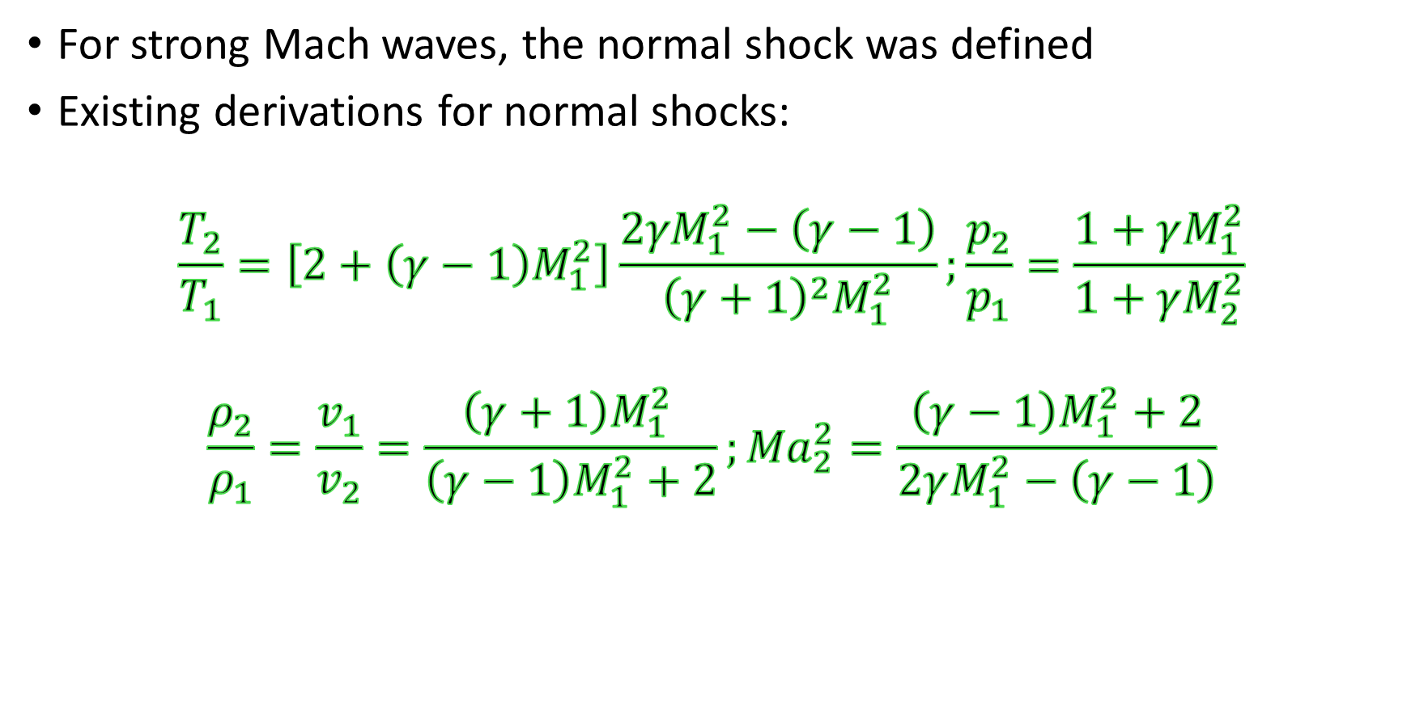
c) Normal shock, non-isentropic, p₂/p₁ >1, p₀₂/p₀₁< 1
For strong Mach waves, the normal shock was defined
Existing derivations for normal shocks:
$$\frac{T_{2}}{T_{1}}=\left[2+\left(γ−1\right)M_{1}^{2}\right]\frac{2{γM}_{1}^{2}−\left(γ−1\right)}{{\left(γ+1\right)}^{2}M_{1}^{2}};\frac{p_{2}}{p_{1}}=\frac{1+γM_{1}^{2}}{1+γM_{2}^{2}}$$
$$\frac{ρ_{2}}{ρ_{1}}=\frac{v_{1}}{v_{2}}=\frac{\left(γ+1\right)M_{1}^{2 }}{\left(γ−1\right)M_{1}^{2}+2};{Ma}_{2}^{2}=\frac{\left(γ−1\right)M_{1}^{2}+2}{2γM_{1}^{2}−\left(γ−1\right)}$$

Slide 13
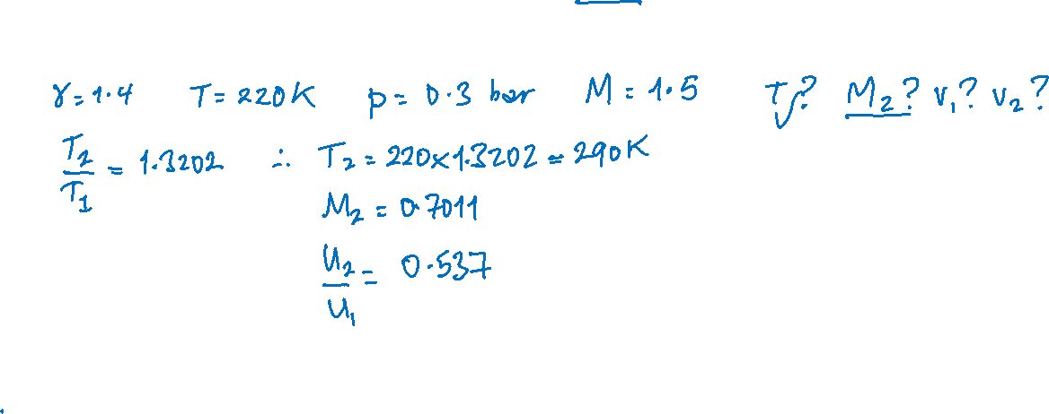
Example of normal shock
A shock occurs in a flow of air (γ = 1.4) at 220 K and 0.3 bar at M = 1.5. Calculate the static temperature and Mach number downstream of the shock and hence the velocity of the flow before and after the shock.

Slide 15


Oblique shock
When a supersonic flow is turned by a plane wall at an angle, δ, to the flow, a plane shock will occur, and the flow can be considered as resolved parallel and perpendicular to the plane shock wave, and it will proceed with resultant parallel to the wall
The oblique shock is then managed as a normal shock perpendicular to the shock wave, and the flow is unaffected parallel to the oblique shock wave, the angle of turning of the flow is equal to the angle of the wall, δ, and the shock wave is at angle θ
c_{1t}
Oblique shock
c_{1t}
c₂
c₁
δ
Plane wall
θ
c_{2n}
c_{1n}

Slide 16
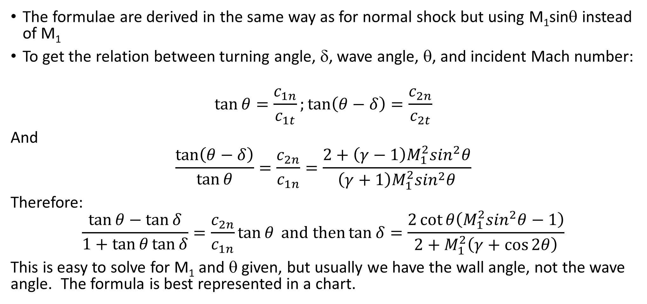
Formulae involved for oblique shock
The formulae are derived in the same way as for normal shock but using M₁sinθ instead of M₁
To get the relation between turning angle, δ, wave angle, θ, and incident Mach number:
$$\tan{θ=\frac{c_{1n}}{c_{1t}};\tan\left(θ−δ\right)=\frac{c_{2n}}{c_{2t}}}$$
And
$$\frac{\tan\left(θ−δ\right)}{\tan{θ}}=\frac{c_{2n}}{c_{1n}}=\frac{2+\left(γ−1\right)M_{1}^{2}\sin^{2}θ}{\left(γ+1\right)M_{1}^{2}\sin^{2}θ}$$
Therefore:
$$\frac{\tan{θ−\tan{δ}}}{1+\tan{θ\tan{δ}}}=\frac{c_{2n}}{c_{1n}}\tan{θ} and then\tan{δ}=\frac{2\cot{θ\left(M_{1}^{2}\sin^{2}θ−1\right)}}{2+M_{1}^{2}\left(γ+\cos{2θ}\right)}$$
This is easy to solve for M₁ and θ given, but usually we have the wall angle, not the wave angle. The formula is best represented in a chart.

Slide 17
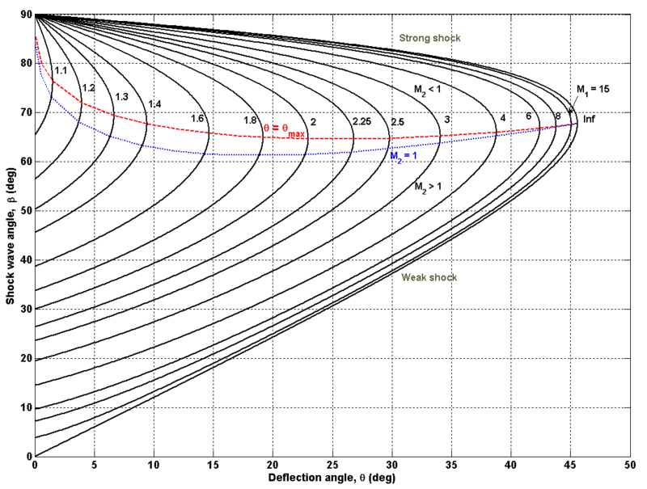

δ= δ_{max}
θ
Creative Commons – oblique shock chart, γ=1.4
https://en.wikipedia.org/wiki/Oblique_shock#/media/File:ObliqueShockAngleRelation.png
δ

Slide 18
Meaning of the chart
There are two solutions for θ for a given M₁ and δ
Usually, experimental evidence shows that the ‘weak shock’ solution is obtained, by which the Mach number of the flow is reduced, but still supersonic
Occasionally the ‘strong shock’ can occur which results in subsonic flow after the shock

Slide 19
Limits on the chart
Limits are interesting, δ = 0 has normal (90°) strong shock solution, same as normal shock
At this limit, the strong shock has the normal shock response
and a weak shock solution, where M₂ = M₁.
This is because of the normal shock requiring M₁sin θ>=1
e.g. for M₁ = 2, sin θ >= 0.5, i.e. minimum θ is 30°
There is a maximum angle through which the flow can be turned, beyond which the flow separates

Slide 20
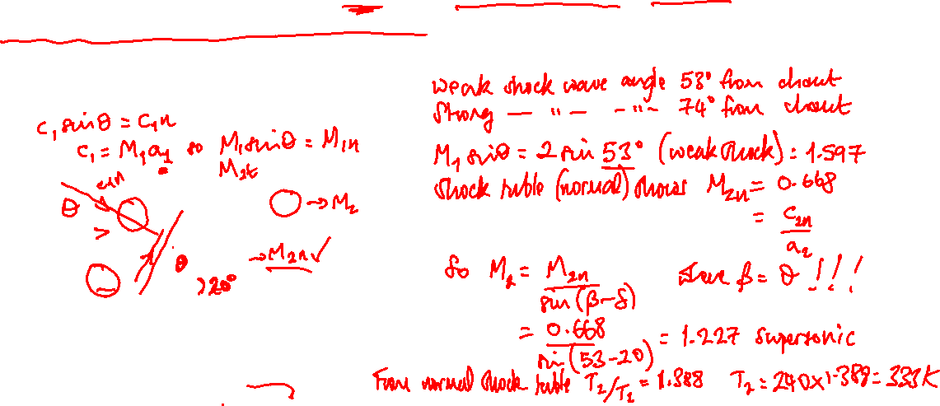
Example of oblique shock in air
Flow approaches a plane wall at an angle of 20° to the incoming flow, which has a Mach number of 2 and a temperature of 240 K. Find the angle of the weak and strong shocks and hence the resulting Mach number, and the temperature after the shock.
c_{1t}
c_{1t}
β-δ
c₂
β
c₁
δ
β
c_{2n}
c_{1n}

Slide 21

Example of oblique shock in air
Flow approaches a plane wall at an angle of 20° to the incoming flow, which has a Mach number of 2. Find the angle of the weak and strong shocks and hence the resulting Mach number, and the temperature after the shock.
Ans: from the chart, the weak shock is at 53° and the strong shock is at 74°. The corresponding Mach numbers are by trigonometry:
M_{n1} = M₁ sinβ, therefore M_{n1,weak} = 1.6, M_{n1,strong} = 1.92
From calculation (or quicker a spreadsheet calculation):
M_{2n,weak} = 0.668; M_{2n,strong} = 0.592
And M_{2n} = M₂ sin (β-δ) therefore M₂ = M_{2n} /sin (β-δ)
M_{2,weak} = 0.668/sin(53-20) = 1.84,
M_{2,strong} = 0.592/sin(74-20) = 0.73
Temperature ratio: 1.388 weak, 1.624 strong
Weak, T₂ = 333 K, strong, T₂ = 390 K
c_{1t}
c_{1t}
β-δ
c₂
β
c₁
δ
β
c_{2n}
c_{1n}

Slide 22

Supersonic flow expansion
Prandtl-Meyer flow occurs when supersonic flow turns to expand the flow area, i.e. flow around a convex corner, rather than the concave corner just considered for oblique shocks
By previous understanding that a shock wave must not produce an increase in entropy, the previous analysis for normal shock showed that an expansive shock is not possible since it would result in a decrease of entropy
Mach wave
α
dθ

Slide 23
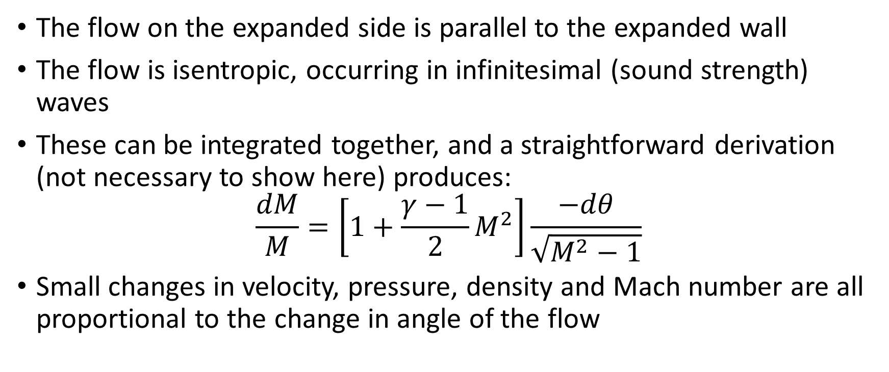

Formula relating Mach number to turned angle
The flow on the expanded side is parallel to the expanded wall
The flow is isentropic, occurring in infinitesimal (sound strength) waves
These can be integrated together, and a straightforward derivation (not necessary to show here) produces:
$$\frac{dM}{M}=\left[1+\frac{γ−1}{2}M^{2}\right]\frac{−dθ}{\sqrt{M^{2}−1}}$$
Small changes in velocity, pressure, density and Mach number are all proportional to the change in angle of the flow

Slide 24
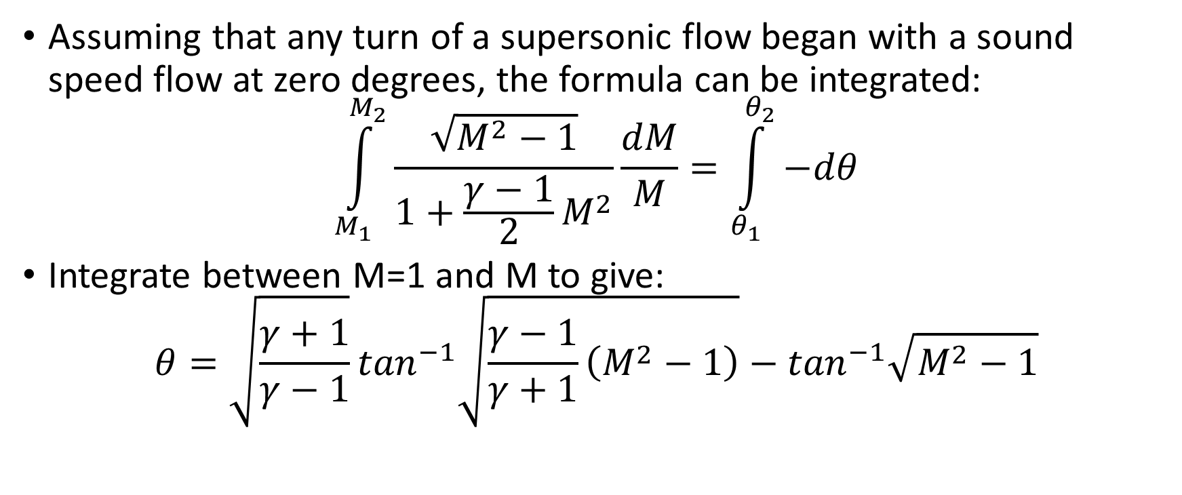
Integration produces Prandtl-Meyer
Assuming that any turn of a supersonic flow began with a sound speed flow at zero degrees, the formula can be integrated:
$$\int_{M_{1}}^{M_{2}}{\frac{\sqrt{M^{2}−1}}{1+\frac{γ−1}{2}M^{2}}}\frac{dM}{M}=\int_{θ_{1}}^{θ_{2}}{−dθ}$$
Integrate between M=1 and M to give:
$$θ=\sqrt{\frac{γ+1}{γ−1}}\tan^{−1}\sqrt{\frac{γ−1}{γ+1}\left(M^{2}−1\right)}−\tan^{−1}\sqrt{M^{2}−1}$$

Slide 25
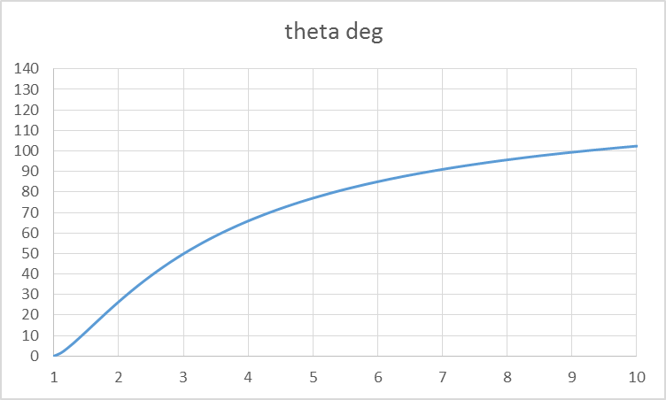
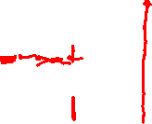
Prandtl-Meyer
To work out the Mach number change as a flow goes around a Prandtl-Meyer expansion fan, use the graph to find the Mach number at exit from a turn, which is the result of the integrated formula expressing the large number of infinitesimally small Mach waves at the corner.
The starting Mach number, say for example, 2, is the result of a turn starting from Mach 1, the angle being seen here to be approximately 25°. If this then turns by a further 10°, the exit Mach number will be at the point where the integral reaches the angle θ of 35°, i.e. approximately Mach 2.4. The expansion fan will appear under optical tests as shown approximately.
θ°, turned angle, starting from M=1
θ
Mach number corresponding to angle turned after starting at M=1
θ

Slide 26


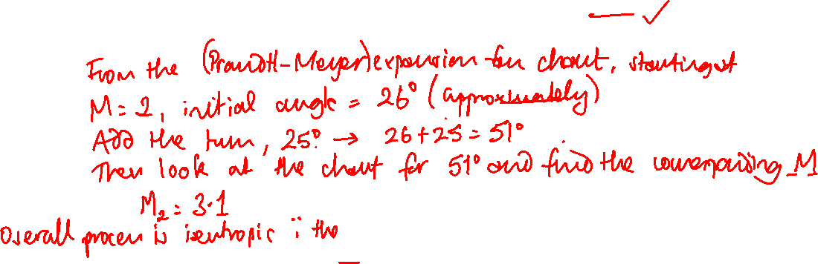



Prantdl-Meyer example
A flow of air with γ = 1.4 at 280 K and 85 kPa is expanded at a sharp corner by 25 degrees. The initial Mach number is 2; what is the final Mach number, pressure and temperature?

Slide 27













Slide 28
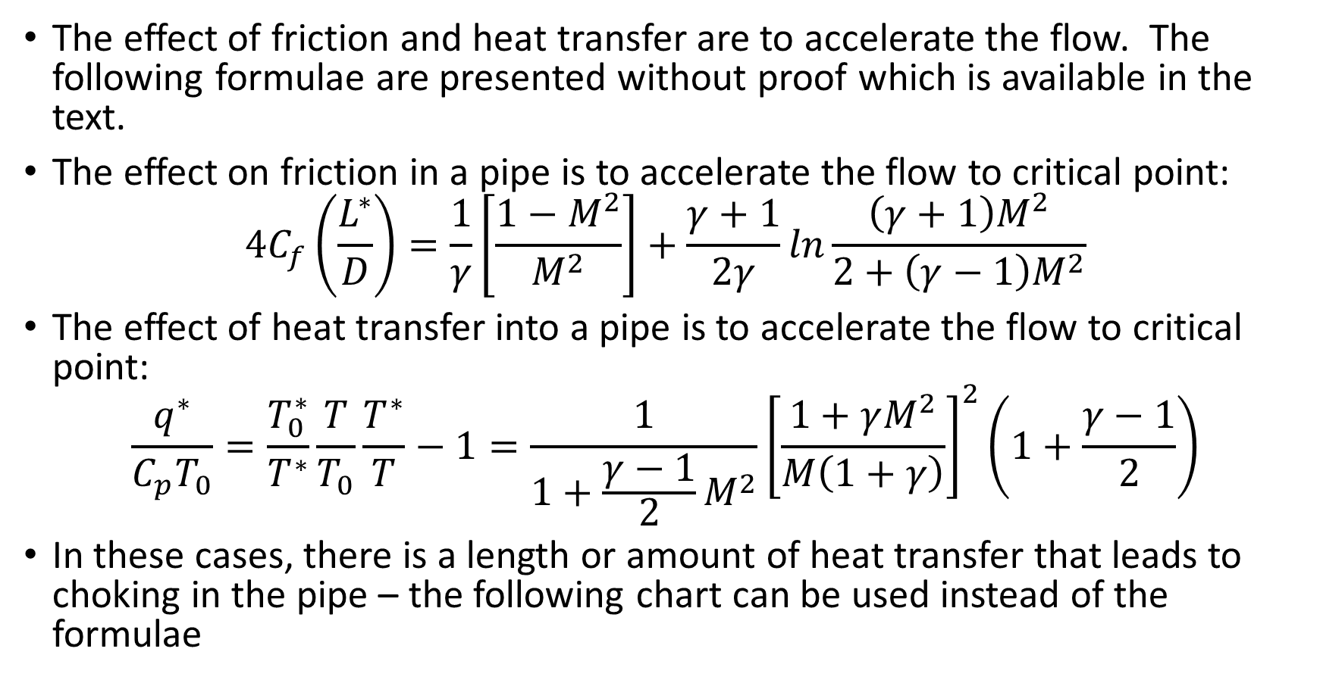
Pipe flow – heat transfer and friction effects
The effect of friction and heat transfer are to accelerate the flow. The following formulae are presented without proof which is available in the text.
The effect on friction in a pipe is to accelerate the flow to critical point:
$$4C_{f}\left(\frac{L^{∗}}{D}\right)=\frac{1}{γ}\left[\frac{1−M^{2}}{M^{2}}\right]+\frac{γ+1}{2γ}ln\frac{\left(γ+1\right)M^{2}}{2+\left(γ−1\right)M^{2}}$$
The effect of heat transfer into a pipe is to accelerate the flow to critical point:
$$\frac{q^{∗}}{C_{p}T_{0}}=\frac{T_{0}^{∗}}{T^{∗}}\frac{T}{T_{0}}\frac{T^{∗}}{T}−1=\frac{1}{1+\frac{γ−1}{2}M^{2}}{\left[\frac{1+γM^{2}}{M\left(1+γ\right)}\right]}^{2}\left(1+\frac{γ−1}{2}\right)$$
In these cases, there is a length or amount of heat transfer that leads to choking in the pipe – the following chart can be used instead of the formulae
p.273

Slide 29
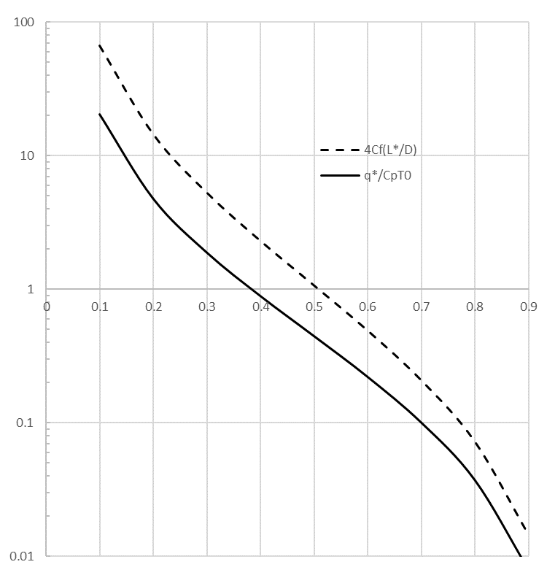
Inlet Mach number
Heat flux/pipe length to critical flow

Slide 30
































A 0.1 m diameter pipe has relative roughness of 0.002 and has flow at the inlet at Mach 0.1 with temperature 293 K. After what length will the flow become critical? The Re of this flow is 2.28×10⁵ and the Moody chart shows friction factor f of 0.025.

Slide 31
























A flow of air in a duct has a stagnation temperature of 450 K, c_{p} 1.005 kJ/kgK and Mach number at entry of 0.1. Calculate the specific heat addition to cause critical flow.

