Slide 1

Turbomachines – part 1 Introduction
Introduction to work in turbomachines from a flow perspective

Slide 2
Content of this section
flow through rotor and stator cascades in compressors and turbines
aspects of axial flow machines
cascade flow passage design methods introduction for axial flow machines

Slide 3
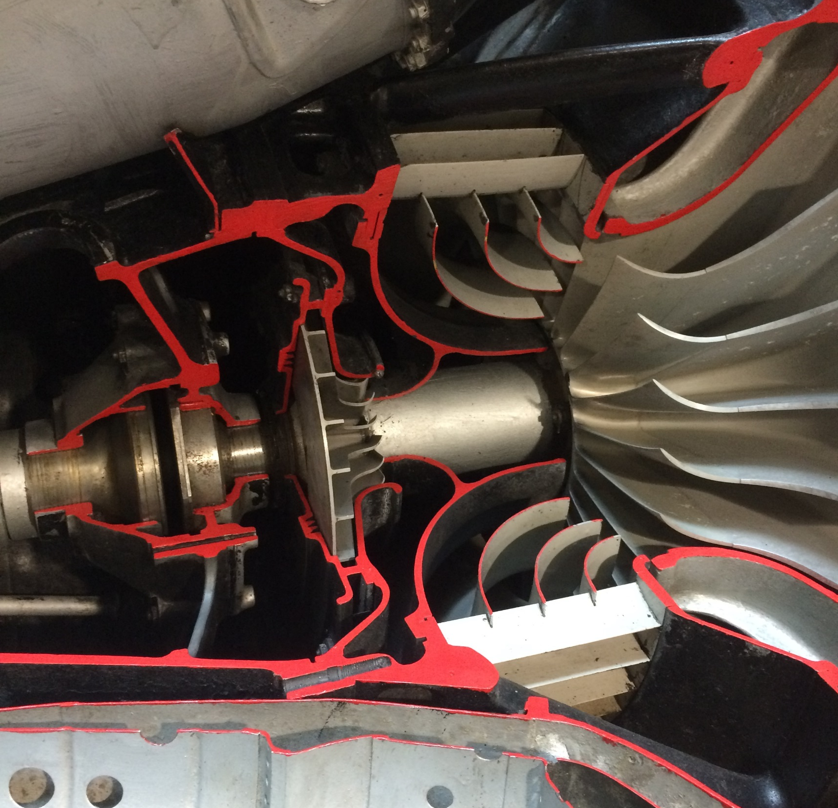
Turbomachines
c
Whittle’s jet engine, sectioned at University of Derby
c_{θ}
α
c_{m}
c_{θ} - absolute tangential velocity of the fluid
c_{x} – absolute axial velocity of the fluid
c_{r} – absolute radial velocity of the fluid
c – total absolute velocity of fluid
c_{m} – absolute meridional velocity of the fluid
c_{r}
c_{x}
r
ωr
Axis direction of the machine
U = ωr, the azimuthal velocity of the blade at radius r, i.e. circumferential component.

Slide 4
Turbomachines have a natural axis
Define the directions by cylindrical coordinates with respect to the axis of the machine
With the Z axis aligned with the machine axis, the distance z along the axis, the rotation angle, θ, around the axis and r the distance radially from the axis, are all well defined for a rotating machine in cylindrical coordinates – not so well in Cartesian and polar.
Y
θ
Y
y
θ
r
r
Z
Z
z
r
z
z
x
y
X
X
φ
x
Cylindrical, θ, r, z
θ is the angle around the z axis with the Y axis as the zero angle; r is the length of the resultant; z is the component on Z direction
Cartesian, x, y, z
x is the length of the resultant in the x-direction etc.
Polar, r, θ, φ
r is the length of the resultant, θ is the angle made by r around the Z direction, and φ is the angle made by r around the X direction.

Slide 5
Flow direction in turbomachines
Total velocity – the velocity of the fluid at any point in the passage through the blades
Meridional velocity – the velocity in the plane defined by radial and axial velocity, and represents volume rate through the machine
Tangential velocity contains the energy imparted to the fluid
Swirl angle, also known as the tangential angle, between the tangential direction and the meridional direction, represents the ratio of power to volume flow delivered by the machine
Now we take the thermodynamic-fluid hybrid notation for velocity, c
Why c? Because we need to think Roman, celeritas is the Latin for speed.

Slide 6

Velocities defining power and machine type
Meridional velocity, c_{m} , defining machine type, i.e. how axial vs. tangential
Tangential velocity, c_{θ} , defining power, i.e. how turned the flow is
Y
θ
Y
c
c_{m}
c_{θ}
Z, axis direction
Z, axis direction
r
α
r
$$tanα=\frac{c_{θ}}{c_{m}}$$
z
z
X
X
α is the swirl angle, i.e. how much turned the fluid is compared to its flow velocity through the machine.

Slide 7
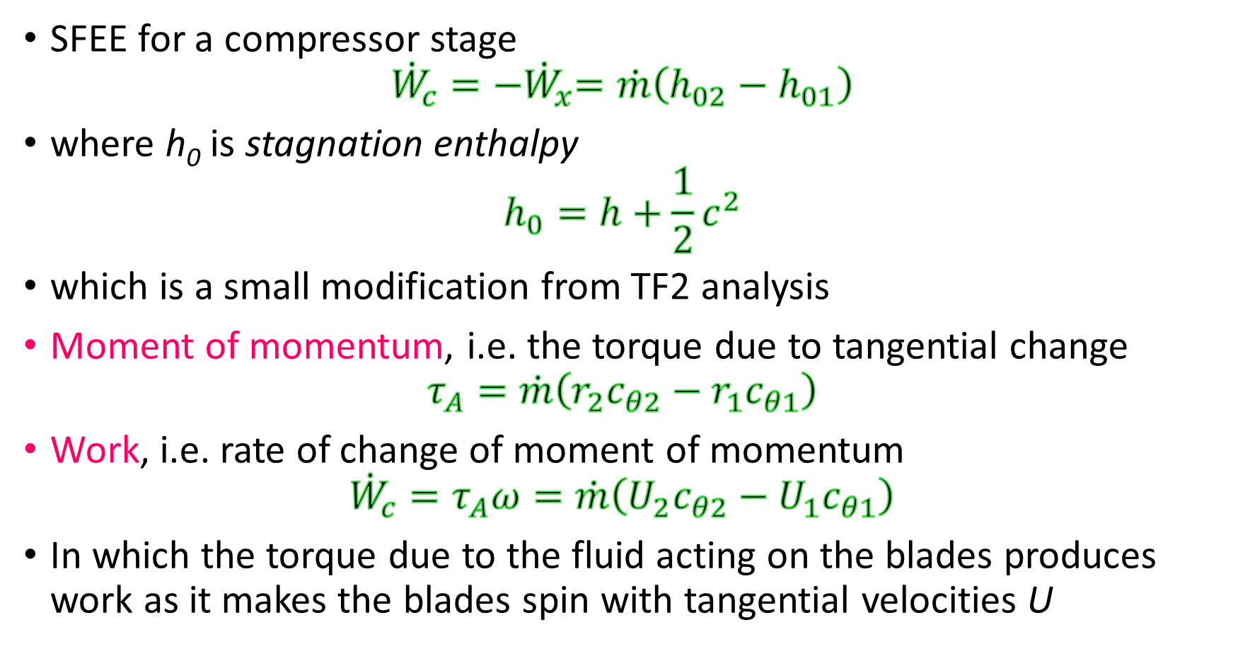
Relating thermodynamics to fluids in turbines and compressors
SFEE for a compressor stage
$${\dot{W}}_{c}={−\dot{W}}_{x}=\dot{m}\left(h_{02}−h_{01}\right)$$
where h₀ is stagnation enthalpy
$$h_{0}=h+\frac{1}{2}c^{2}$$
which is a small modification from TF2 analysis
Moment of momentum, i.e. the torque due to tangential change
$$τ_{A}=\dot{m}\left(r_{2}c_{θ2}−r_{1}c_{θ1}\right)$$
Work, i.e. rate of change of moment of momentum
$${\dot{W}}_{c}=τ_{A}ω=\dot{m}\left(U_{2}c_{θ2}−U_{1}c_{θ1}\right)$$
In which the torque due to the fluid acting on the blades produces work as it makes the blades spin with tangential velocities U

Slide 8
Inner peace…..the Euler work equation
From dynamics
$${\dot{W}}_{c}=−{\dot{W}}_{x}=\dot{m}\left(h_{02}−h_{01}\right)=τ_{A}ω=\dot{m}\left(U_{2}c_{θ2}−U_{1}c_{θ1}\right)$$
From thermodynamics
From fluid mechanics
Here we see the connection, at last, between fluid mechanics, dynamics, and thermodynamics. The energy principle matching the force movement principle, and the fluid driving the dynamic machine.

Slide 9
Example – Euler work
An axial turbine rotor speed is 12000 rpm, mean radius of the blade is 0.2 m, and the height of the blade is 0.01 m. Calculate the blade speed, U. Given the mass rate is 1 kg/s of air of density 0.8 kg/m³, calculate the axial velocity. Given tangential velocity changes from 200 m/s to 61 m/s, calculate the Euler work rate and hence, assuming air to be a perfect gas, with c_{p} = 1.005 kJ⋅kg⁻¹⋅K⁻¹, calculate the temperature change of the air.
[ans: 251 m/s, 99.5 m/s, 34.9 kW, -35°C]

Slide 10
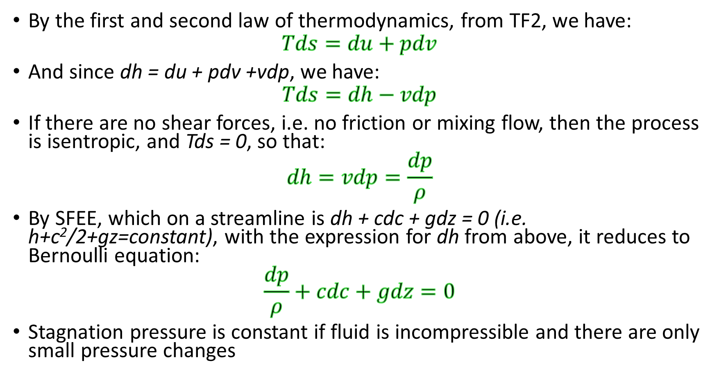
Entropy
By the first and second law of thermodynamics, from TF2, we have:
$$Tds=du+pdv$$
And since dh = du + pdv +vdp, we have:
$$Tds=dh−vdp$$
If there are no shear forces, i.e. no friction or mixing flow, then the process is isentropic, and Tds = 0, so that:
$$dh=vdp=\frac{dp}{ρ}$$
By SFEE, which on a streamline is dh + cdc + gdz = 0 (i.e. h+c²/2+gz=constant), with the expression for dh from above, it reduces to Bernoulli equation:
$$\frac{dp}{ρ}+cdc+gdz=0$$
Stagnation pressure is constant if fluid is incompressible and there are only small pressure changes

Slide 11
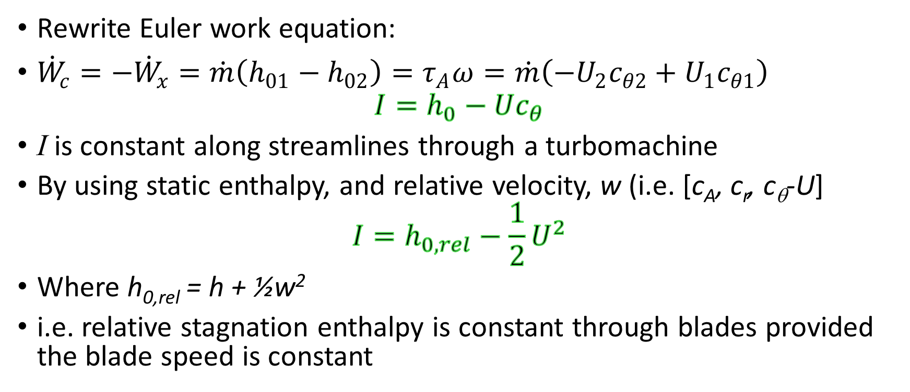
Rothalpy – ro(tational stagnation en)thalpy
Rewrite Euler work equation:
${\dot{W}}_{c}=−{\dot{W}}_{x}=\dot{m}\left(h_{01}−h_{02}\right)=τ_{A}ω=\dot{m}\left({−U}_{2}c_{θ2}+U_{1}c_{θ1}\right)$
$$I=h_{0}−Uc_{θ}$$
I is constant along streamlines through a turbomachine
By using static enthalpy, and relative velocity, w (i.e. [c_{A}, c_{r}, c_{θ}-U]
$$I=h_{0,rel}−\frac{1}{2}U^{2}$$
Where h_{0,rel} = h + ½w²
i.e. relative stagnation enthalpy is constant through blades provided the blade speed is constant

Slide 12
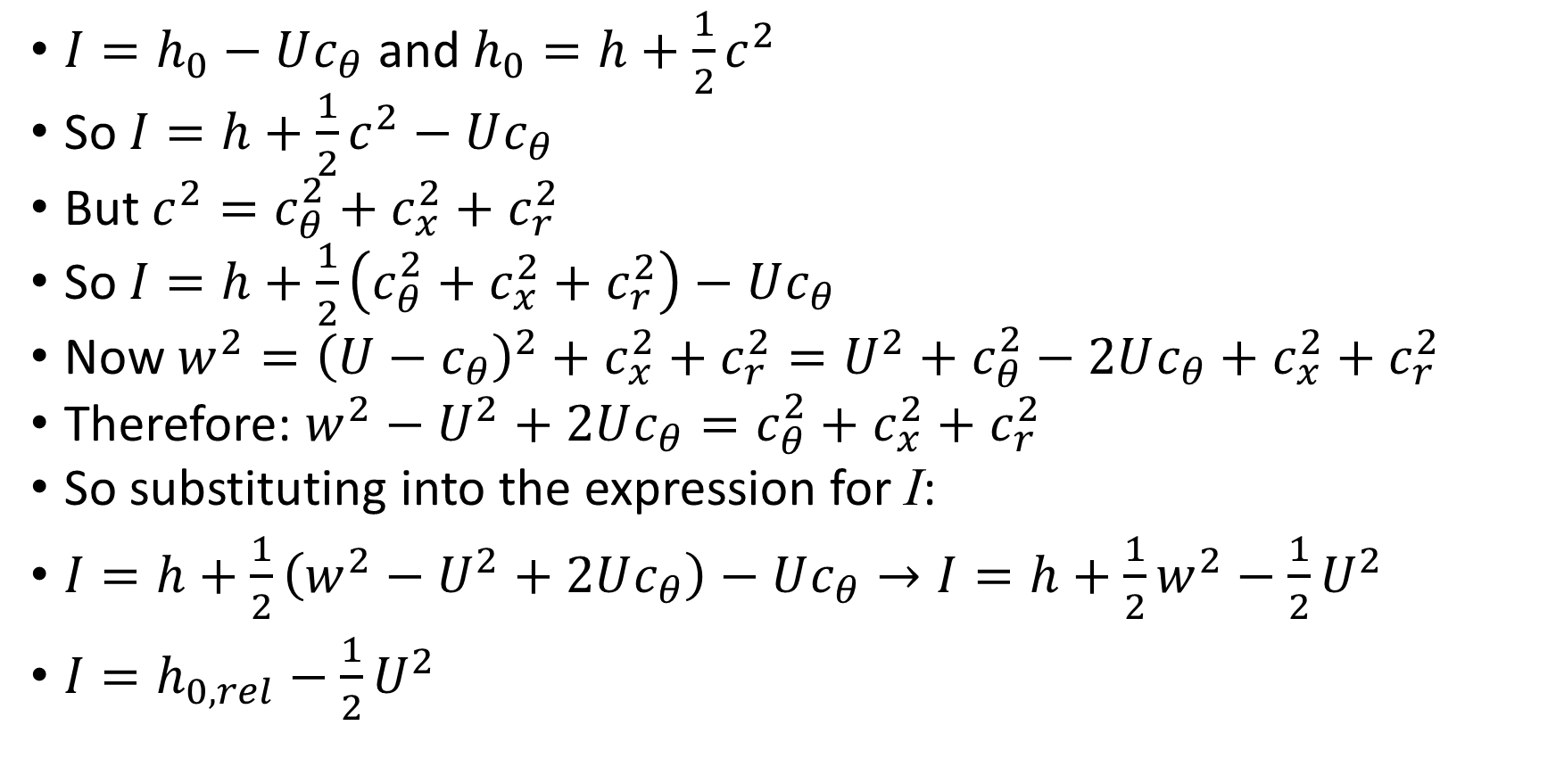
How to get the rothalpy in terms of w
$I=h_{0}−Uc_{θ}$ and $h_{0}=h+\frac{1}{2}c^{2}$
So $I=h+\frac{1}{2}c^{2}−Uc_{θ}$
But $c^{2}=c_{θ}^{2}+c_{x}^{2}+c_{r}^{2}$
So $I=h+\frac{1}{2}\left(c_{θ}^{2}+c_{x}^{2}+c_{r}^{2}\right)−Uc_{θ}$
Now $w^{2}={\left(U−c_{θ}\right)}^{2}+c_{x}^{2}+c_{r}^{2}=U^{2}+c_{θ}^{2}−2Uc_{θ}+c_{x}^{2}+c_{r}^{2}$
Therefore: $w^{2}−U^{2}+2Uc_{θ}=c_{θ}^{2}+c_{x}^{2}+c_{r}^{2}$
So substituting into the expression for I:
$I=h+\frac{1}{2}\left(w^{2}−U^{2}+2Uc_{θ}\right)−Uc_{θ}→I=h+\frac{1}{2}w^{2}−\frac{1}{2}U^{2}$
$I=h_{0,rel}−\frac{1}{2}U^{2}$

Slide 13
Fluids
Gases
Perfect gas obeys gas law and does not alter c_{p} and c_{v} when temperature changes.
Semi-perfect gas obeys gas law but c_{p} and c_{v} alter when temperature changes.
Steam
Turbomachines using steam operate close to the saturation line, or underneath it and so it is far from being a perfect gas.
Steam tables and charts are used to determine properties, according to the IAPWS, as detailed in the thermodynamic tables.

Slide 14
Turbomachine material to cover
flow through rotor and stator cascades in compressors and turbines
aspects of axial flow machines
cascade flow passage design methods introduction for axial flow machines
factors for consideration in radial and mixed flow machines

Slide 15
A flow in a turbine has c_{x} = 50 m/s, swirl angle α = 30° and c_{θ} = 97 m/s. Calculate c_{r} and c_{m} and c. [ans: 160 m/s, 168 m/s and 193 m/s]

Slide 16

Turbomachinery part 2
Analysis of axial turbomachines

Slide 17

Axial flow turbomachines
Description of blade profiles
Description of flow in cascades
general cascade flow characteristics
The flow through turbine cascades
The flow through compressor cascades
definition of important parameters for the design aspects of the flow and defining an initial design strategy for particular situations
A stage where the absolute velocity and direction at outlet and inlet are the same is called a normal stage

Slide 18
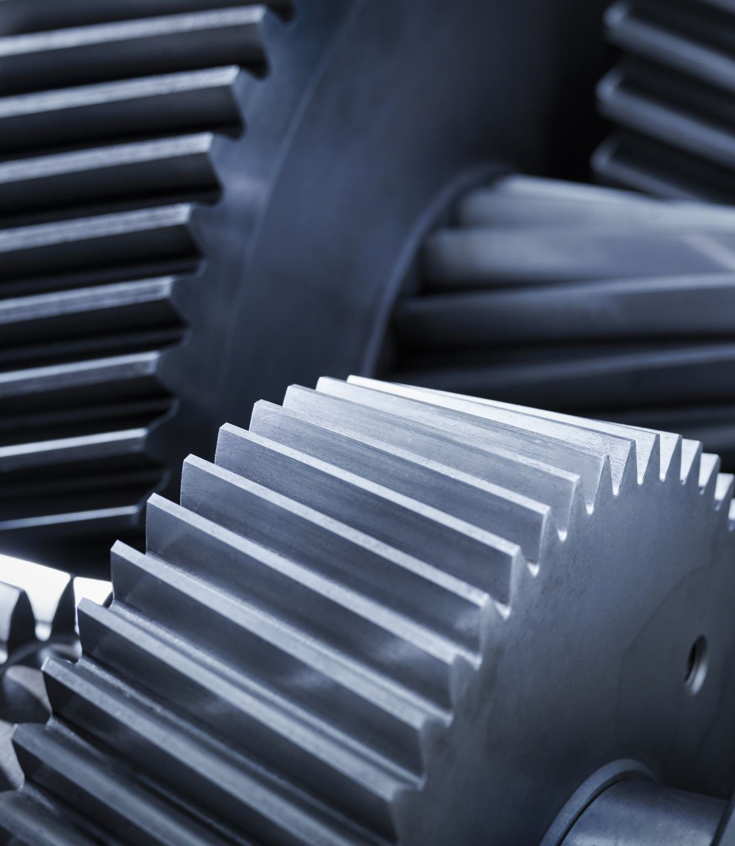
Definition of compressor and turbine stage
A stage consists of a rotor and a stator
The rotor is responsible for work transfer
The stator is responsible for guiding the flow to the next rotor row
It is useful to consider the absolute velocity angles and the relative velocity angles
The former defines the work and the latter defines the flow relative to the aerofoils of the row
In a turbine stage, the order is stator (commonly called nozzle) row followed by rotor
In a compressor stage, the order is rotor row followed by stator row

Slide 19
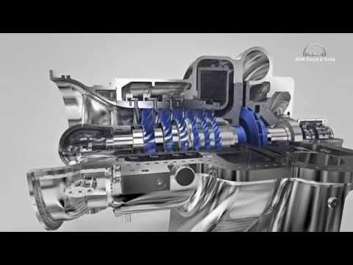
https://www.youtube.com/watch?v=Il27VvHu-s0

Slide 20
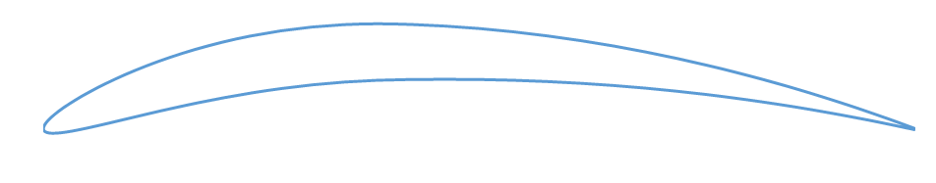
2D velocity analysis – axial flow simplification
This is a compressor stage – rotor in front of a stator
Meridional velocity is axial velocity since no radial velocity assumed i.e. c_{m} = c_{x};
α is the swirl angle (verify by inspection it is tan⁻¹(c_{θ}/c_{x}). It is the absolute velocity angle.
All velocities are resolved axially or circumferentially
Note: c indicates absolute velocity, w indicates relative to the blade speed velocity.
Therefore, w indicates the angle of attack of the flow approaching the blade, whereas c indicates how much the flow is turned by the stage which is related to work by the Euler work equation.
The azimuthal (circumferential) velocity can be divided into the component of the absolute and of the relative velocity vectors, which add up to the blade velocity.
c_{x1}
w₁
c₁
Reference direction
c_{θ1}
Swirl angle, α
c₁
w₁
Rotor
α₁
U
β₁
Relative velocity angle, β
β₂
c₂
α₂
w₂
Stator
U
There is no relative velocity on the stator – it is stationary, it sees c₂ absolute approaching it and c₃ absolute leaves it, note in this case the obvious slip of the c₃ velocity, i.e. the angle of the vector is not the same as the trailing edge angle
α₃
c₃

Slide 21
Blade profile
In this case, a compressor blade is shown, hence there are relative velocity (w) and velocity angles (β)
Stagger angle: ξ, between chord and reference direction
Space-chord ratio: s/l
Camber angle: θ
Blade inlet angle: α₁’, camber line to chord line
Blade outlet angle: α₂’, camber line to chord line
s
Reference direction
β₁
α₁’
ξ
w₁
θ
Chord line
l
Camber line
α₂’
β₂
w₂

Slide 22
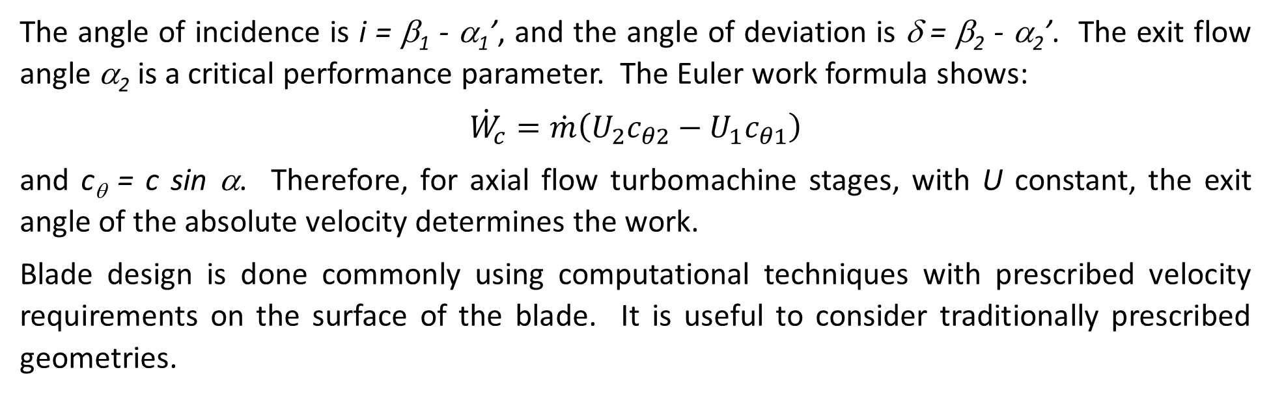
Work for the stage
The angle of incidence is i = β₁ - α₁’, and the angle of deviation is δ = β₂ - α₂’. The exit flow angle α₂ is a critical performance parameter. The Euler work formula shows:
$${\dot{W}}_{c}=\dot{m}\left(U_{2}c_{θ2}−U_{1}c_{θ1}\right)$$
and c_{θ} = c sin α. Therefore, for axial flow turbomachine stages, with U constant, the exit angle of the absolute velocity determines the work.
Blade design is done commonly using computational techniques with prescribed velocity requirements on the surface of the blade. It is useful to consider traditionally prescribed geometries.

Slide 23
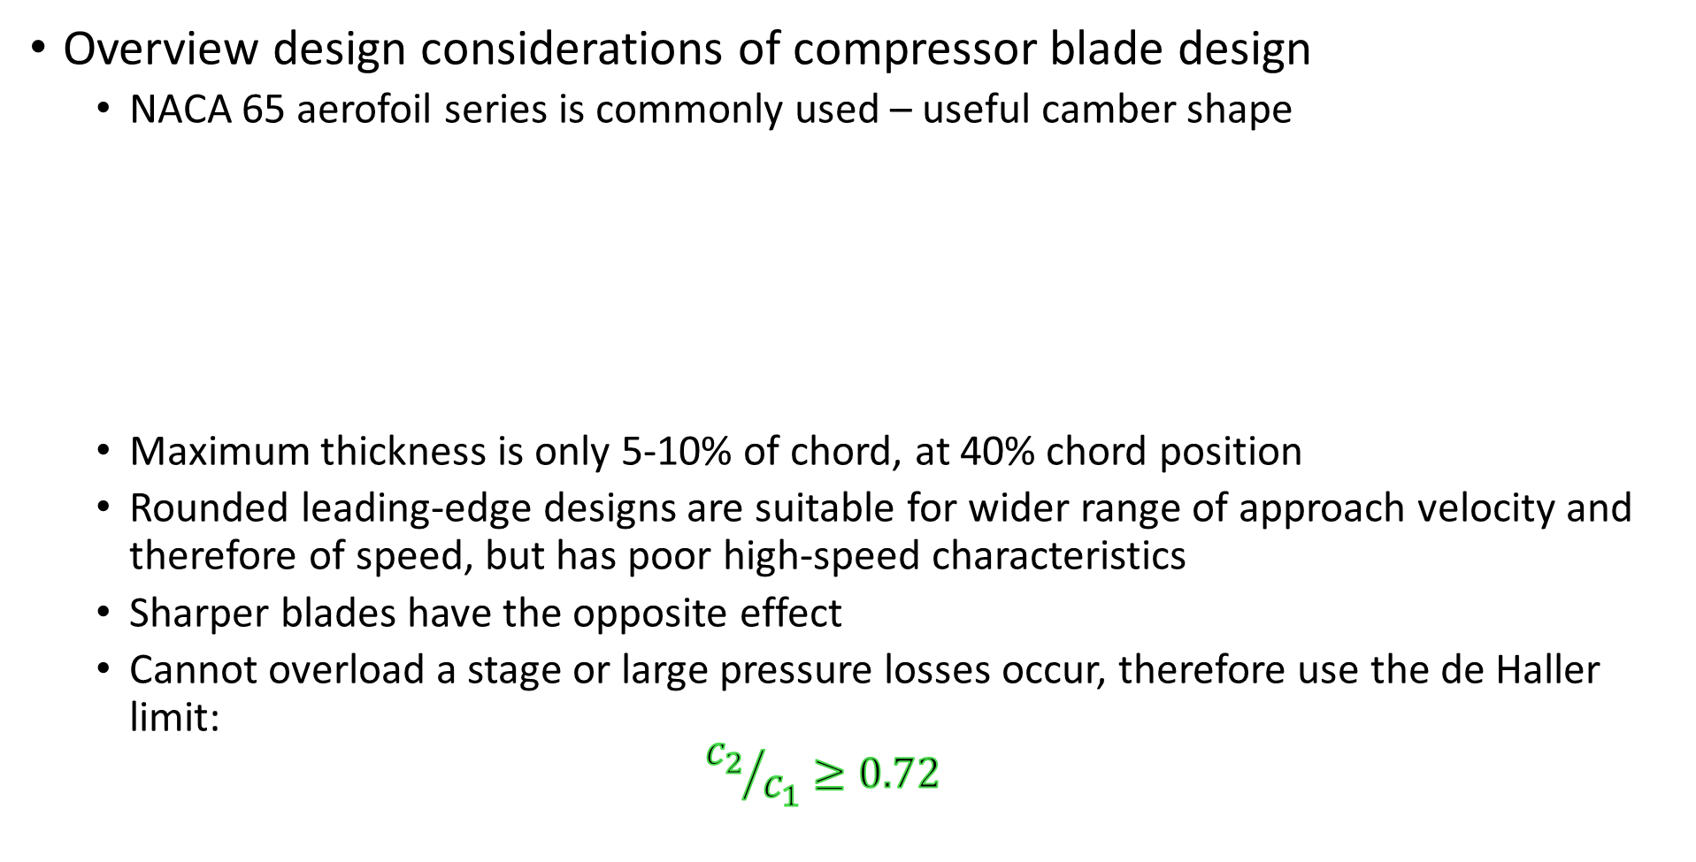
Compressor row design
Overview design considerations of compressor blade design
  NACA 65 aerofoil series is commonly used – useful camber shape
  Maximum thickness is only 5-10% of chord, at 40% chord position
  Rounded leading-edge designs are suitable for wider range of approach velocity and therefore of speed, but has poor high-speed characteristics
  Sharper blades have the opposite effect
  Cannot overload a stage or large pressure losses occur, therefore use the de Haller limit:
  $${c_{2}}/{c_{1}}≥0.72$$

Slide 24
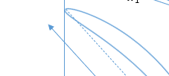
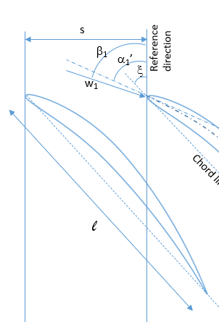

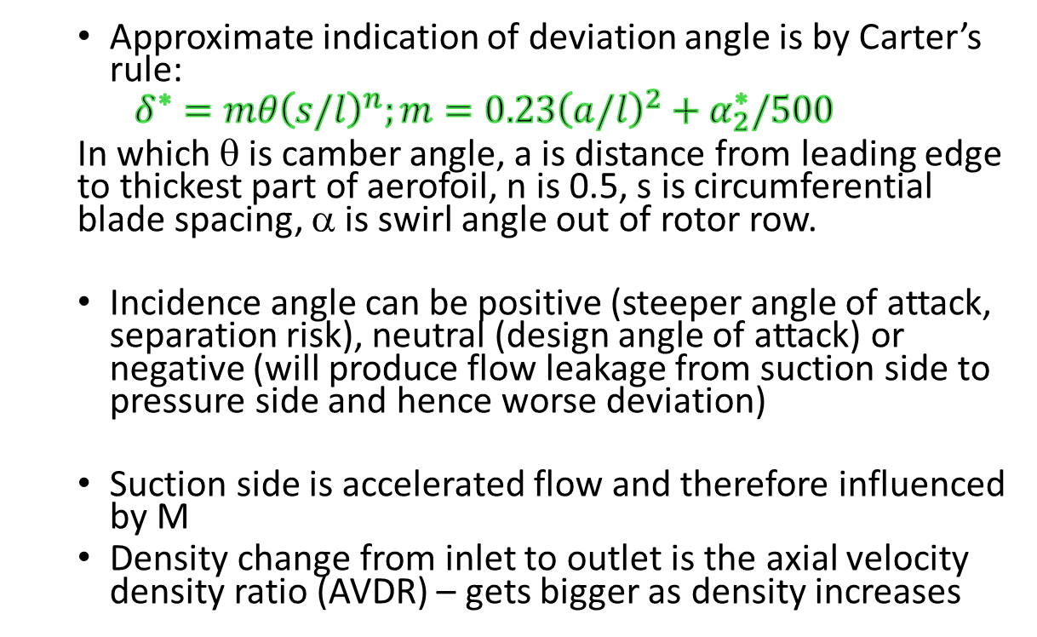
Compressor row design
  Approximate indication of deviation angle is by Carter’s rule:
  $$δ^{∗}=mθ{\left(s/l\right)}^{n};m=0.23{\left(a/l\right)}^{2}+α_{2}^{∗}/500$$
  In which θ is camber angle, a is distance from leading edge to thickest part of aerofoil, n is 0.5, s is circumferential blade spacing, α is swirl angle out of rotor row.
  Incidence angle can be positive (steeper angle of attack, separation risk), neutral (design angle of attack) or negative (will produce flow leakage from suction side to pressure side and hence worse deviation)
  Suction side is accelerated flow and therefore influenced by M
  Density change from inlet to outlet is the axial velocity density ratio (AVDR) – gets bigger as density increases
-ve
Pressure side
+ve
a
Max camber
$$\frac{ρ_{2}c_{x2}}{ρ_{1}c_{x1}}=\frac{H_{1}}{H_{2}}=\frac{{{\dot{m}}_{1}}/{A_{1}}}{{{\dot{m}}_{2}}/{A_{2}}}$$
Suction side

Slide 25

A compressor drags the flow
The paddle pulls on the water and leaves an unstable wake

Slide 26

Turbine row design
Overview design considerations of turbine blade design
  Boundary layer is much more stable than compressor because the flow is accelerating, and pressure is falling
  each stage can have a much higher loading without flow separation
  the flow deflection can be greater than 120°
  the ratio of c₂/c₁ can be between 2 and 4
  Losses rapidly rise as approaching and exceeding M=1 – trailing shock waves produce significant drag
  M=1 is the limiting load, since no higher flow rate can be achieved by increasing the Mach number

Slide 27
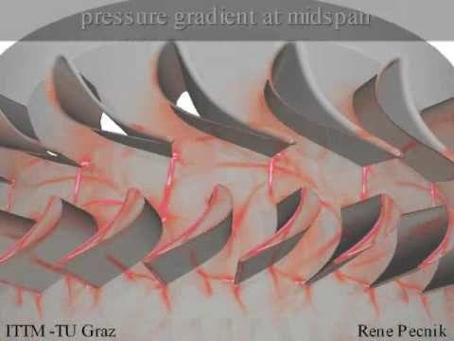
https://www.youtube.com/watch?v=sd7uHUxdoOw

Slide 28
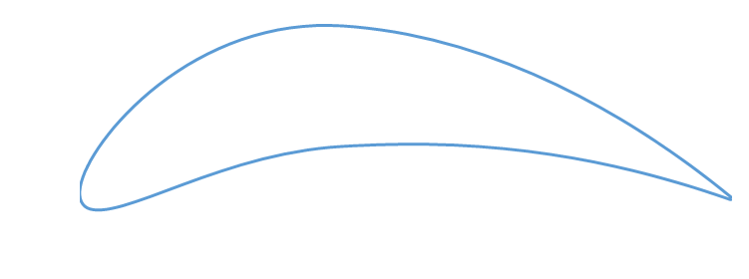
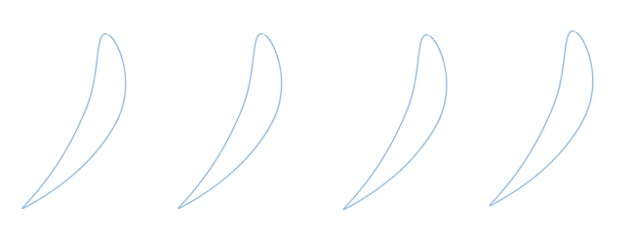
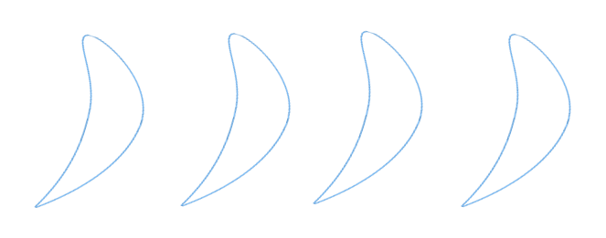
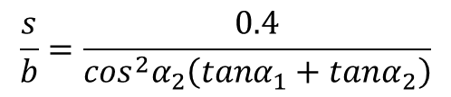
Axial turbine design - Zweifel criterion (for incompressible) interpretation – determines optimum s/l
c₁
s
Blade spacing
α₁
c₁
α₁
Nozzle row (stationary)
Axial chord
b
c₂
α₂
c₂
α₂
s
w₂
U
w₂
Rotor row (rotating)
b
α₃
α₃
c₃
w₃
c₃
w₃
U
$$\frac{s}{b}=\frac{0.4}{\cos^{2}α_{2}\left(tanα_{1}+tanα_{2}\right)}$$
As α increases, tan α tends to increase to infinity at 90° and cos α tends to decrease from 1 at zero to 0 at 90°, b is axial length of chord

Slide 29
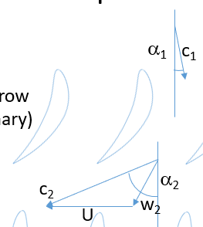
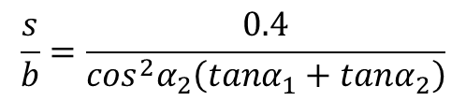
Example: For a turbine rotor row with inlet velocity c₁ at 70° and outlet c₂ at 20°, use the Zweifel criterion for the blade spacing and determine the blade spacing for turbine blades with chord 40 mm and stagger angle 25°.
[ans: 0.14, 6.2 mm]
$$\frac{s}{b}=\frac{0.4}{\cos^{2}α_{2}\left(tanα_{1}+tanα_{2}\right)}$$

Slide 30
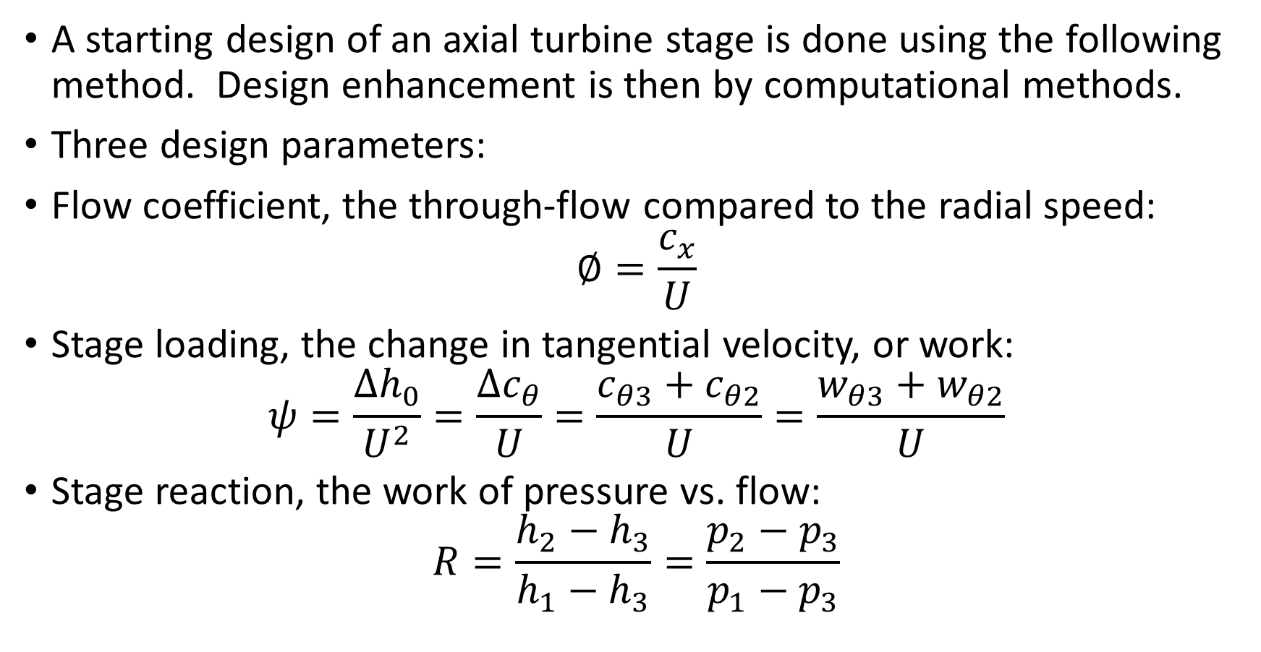
Mean line design of gas turbines – incompressible flow assumed
A starting design of an axial turbine stage is done using the following method. Design enhancement is then by computational methods.
Three design parameters:
Flow coefficient, the through-flow compared to the radial speed:
$$∅=\frac{c_{x}}{U}$$
Stage loading, the change in tangential velocity, or work:
$$ψ=\frac{{∆h}_{0}}{U^{2}}=\frac{Δc_{θ}}{U}=\frac{c_{θ3}+c_{θ2}}{U}=\frac{w_{θ3}+w_{θ2}}{U}$$
Stage reaction, the work of pressure vs. flow:
$$R=\frac{h_{2}−h_{3}}{h_{1}−h_{3}}=\frac{p_{2}−p_{3}}{p_{1}−p_{3}}$$

Slide 31
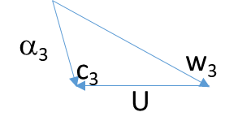
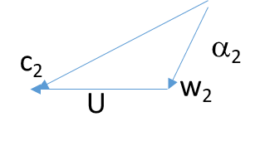
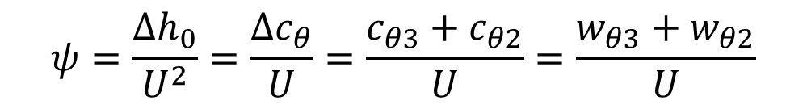
α₃
c₂
α₂
c₃
w₃
w₂
U
U
$$ψ=\frac{{∆h}_{0}}{U^{2}}=\frac{Δc_{θ}}{U}=\frac{c_{θ3}+c_{θ2}}{U}=\frac{w_{θ3}+w_{θ2}}{U}$$

Slide 32
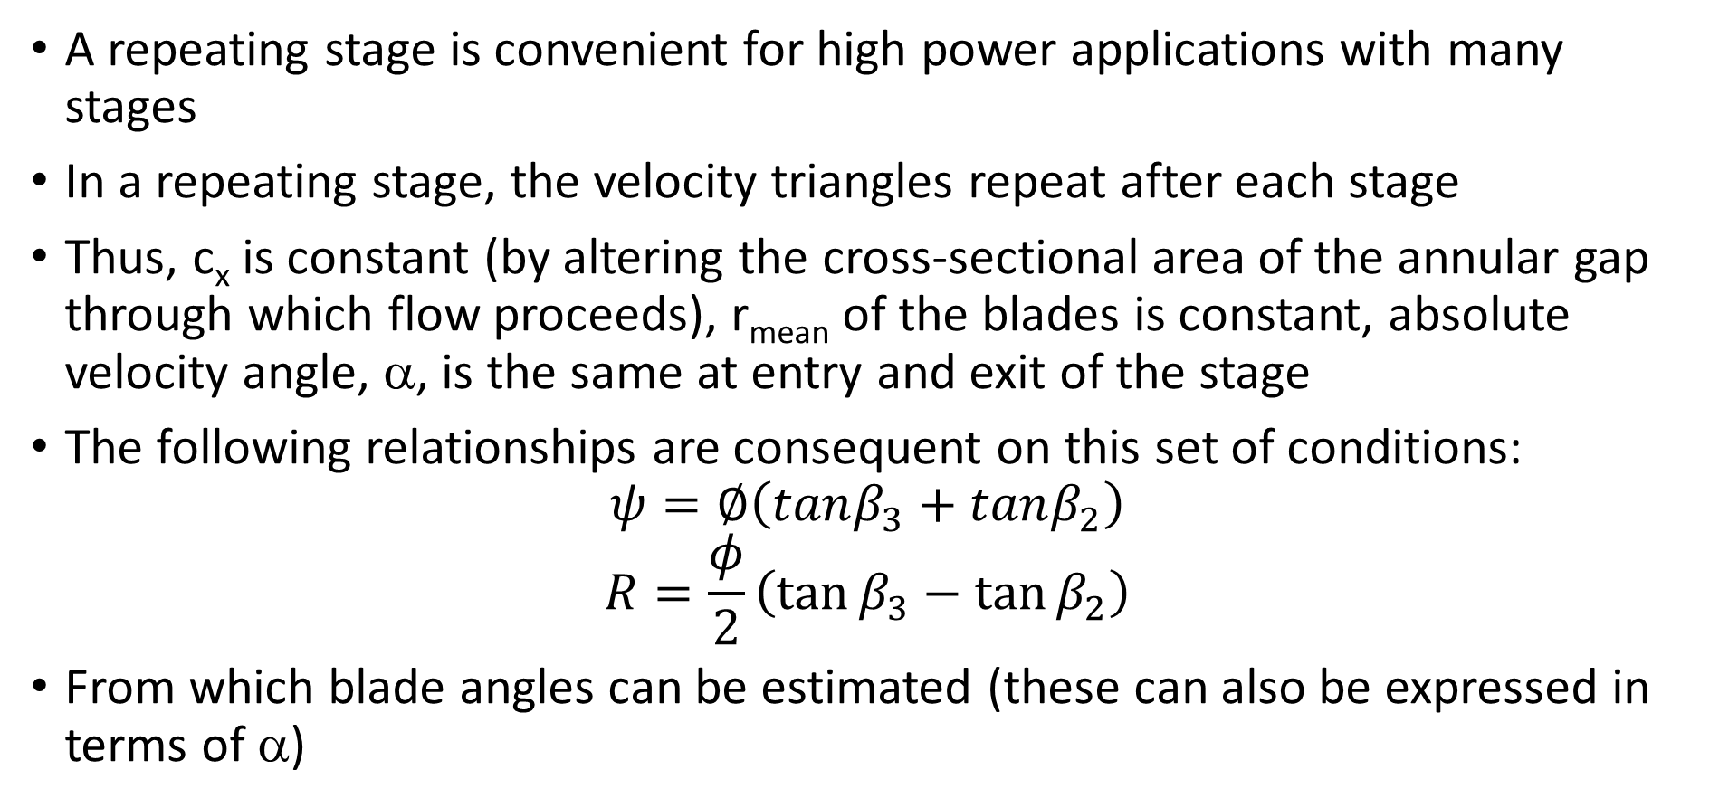
The repeating or normal stage
A repeating stage is convenient for high power applications with many stages
In a repeating stage, the velocity triangles repeat after each stage
Thus, c_{x} is constant (by altering the cross-sectional area of the annular gap through which flow proceeds), r_{mean} of the blades is constant, absolute velocity angle, α, is the same at entry and exit of the stage
The following relationships are consequent on this set of conditions:
$$ψ=∅\left(tanβ_{3}+tanβ_{2}\right)$$
$$R=\frac{φ}{2}\left(\tan{β_{3}−\tan{β_{2}}}\right)$$
From which blade angles can be estimated (these can also be expressed in terms of α)

Slide 33
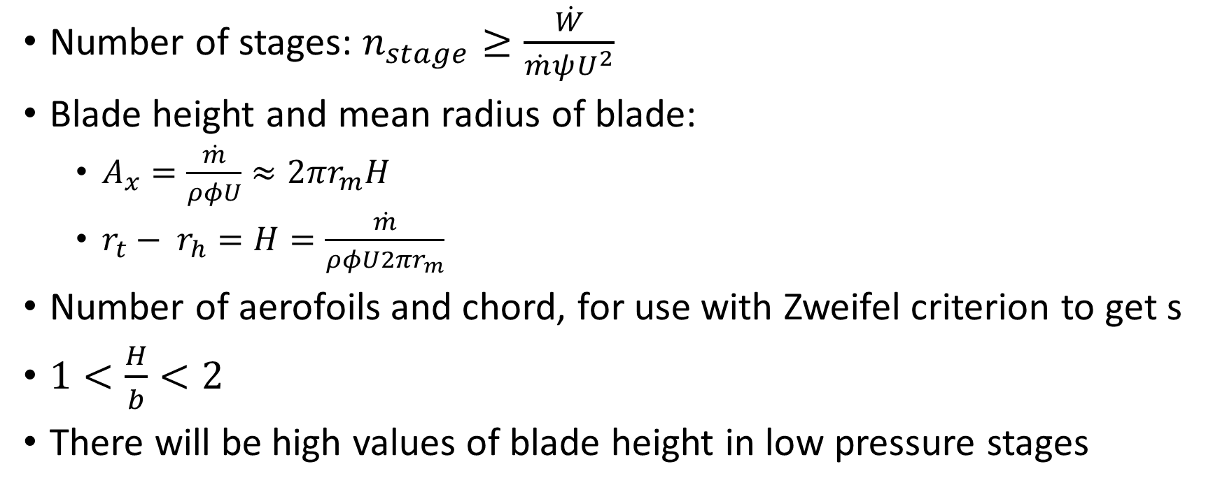
Mean line design of gas turbines
Number of stages: $n_{stage}≥\frac{\dot{W}}{\dot{m}ψU^{2}}$
Blade height and mean radius of blade:
  $A_{x}=\frac{\dot{m}}{ρφU}≈2πr_{m}H$
  $r_{t}− r_{h}=H=\frac{\dot{m}}{ρφU2πr_{m}}$
Number of aerofoils and chord, for use with Zweifel criterion to get s
$1<\frac{H}{b}<2$
There will be high values of blade height in low pressure stages

Slide 34
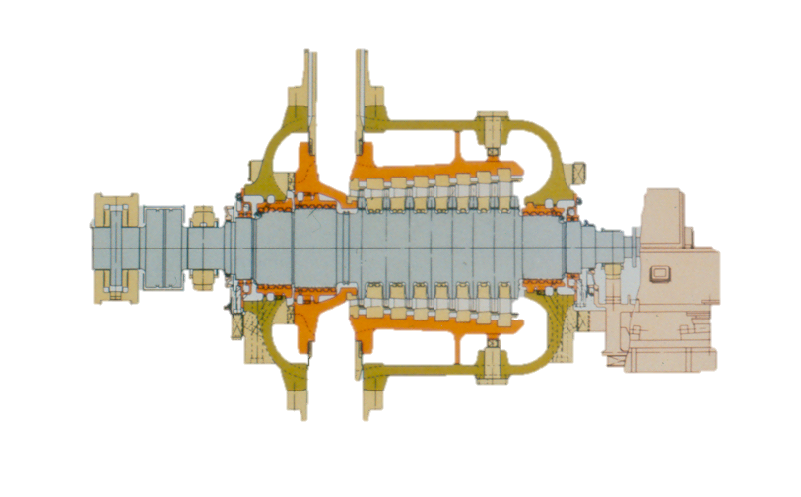
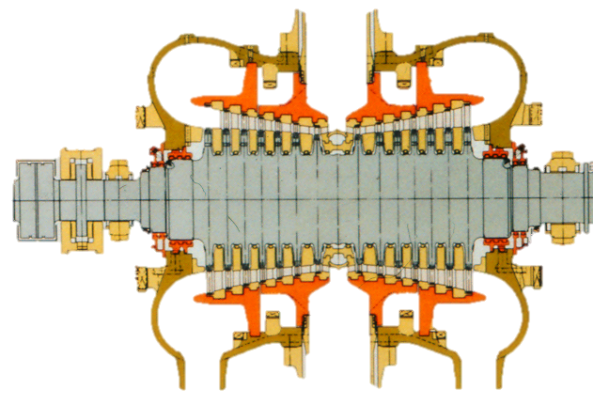
GEC Alstom IP steam turbine – blade height and mean radius changes

Slide 35
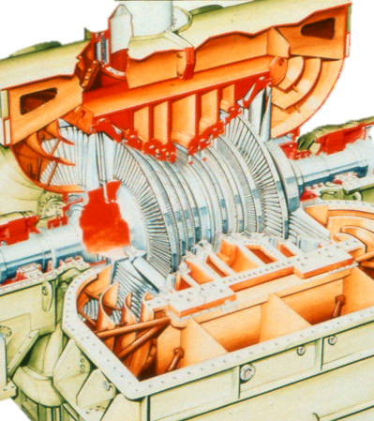
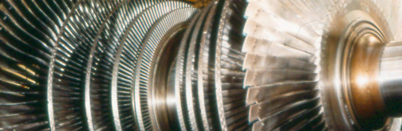
GEC Alstom LP steam turbine – large blade height

Slide 36
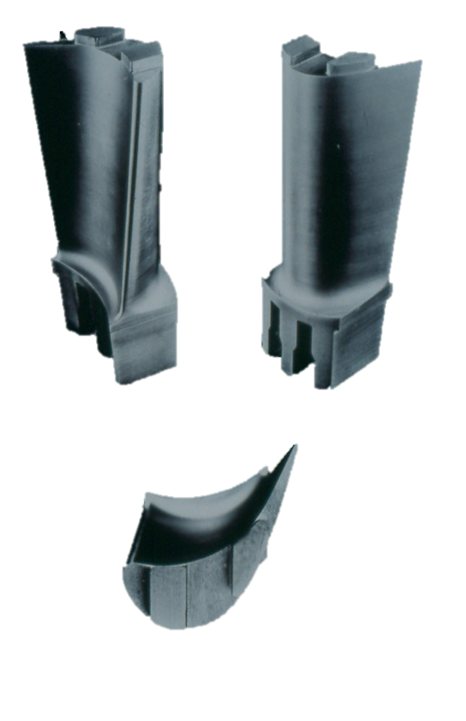
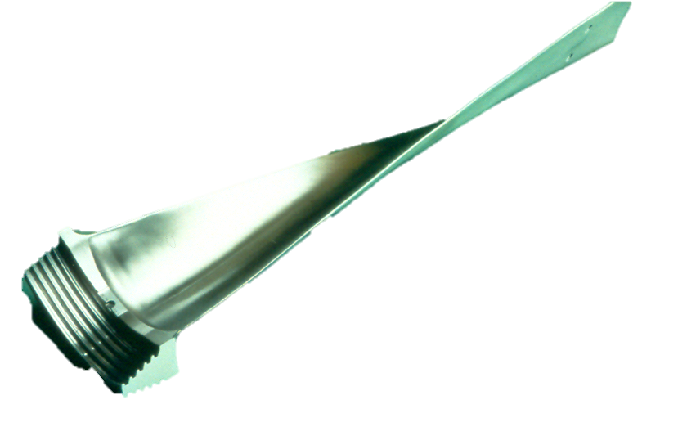
Turbine blades significant twist when radius change increases

Slide 37
Stage reaction combined velocity triangles
β₃
c₂
w₃
c₂
w₃
Entry
Exit
Entry
Exit
c₃
w₂ (= w₃)
c₃
w₂
c_{x}
β₃
β₂ = β₃
β₂
U
U
Zero reaction stage rotor:
no axial velocity change,
It can be shown that (relative velocity angles) β₂ = β₃
Therefore (relative velocities) w₂ = w₃
Advantage: high stage loading
Disadvantage: chance of separation – highly cambered blades
Use: some steam turbines
50% reaction stage rotor:
Symmetrical velocity triangles
Similar stator and rotor blade shapes, high acceleration and
lower turning and hence lower losses
Advantage: subsonic Mach numbers
Disadvantage: increased number of stages required
Use: gas turbines and some steam turbines

Slide 38
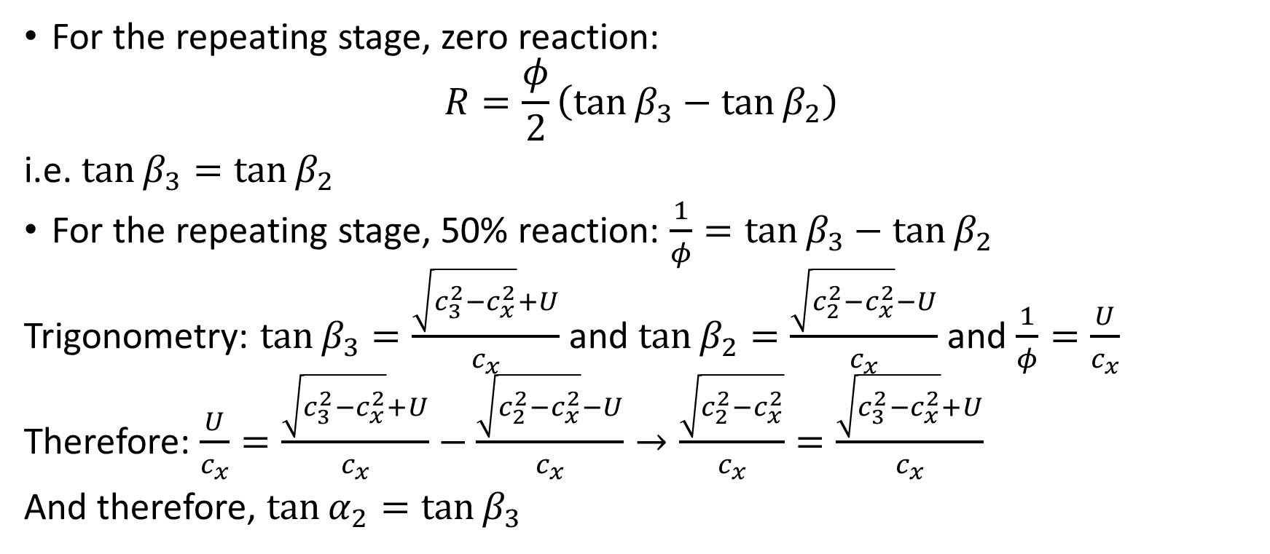
Proving the points
For the repeating stage, zero reaction:
$$R=\frac{φ}{2}\left(\tan{β_{3}−\tan{β_{2}}}\right)$$
i.e. $\tan{β_{3}=\tan{β_{2}}}$
For the repeating stage, 50% reaction: $\frac{1}{φ}=\tan{β_{3}−\tan{β_{2}}}$
Trigonometry: $\tan{β_{3}=\frac{\sqrt{c_{3}^{2}−c_{x}^{2}}+U}{c_{x}}}$ and $\tan{β_{2}=\frac{\sqrt{c_{2}^{2}−c_{x}^{2}}−U}{c_{x}}}$ and $\frac{1}{φ}=\frac{U}{c_{x}}$
Therefore: $\frac{U}{c_{x}}=\frac{\sqrt{c_{3}^{2}−c_{x}^{2}}+U}{c_{x}}−\frac{\sqrt{c_{2}^{2}−c_{x}^{2}}−U}{c_{x}}→\frac{\sqrt{c_{2}^{2}−c_{x}^{2}}}{c_{x}}=\frac{\sqrt{c_{3}^{2}−c_{x}^{2}}+U}{c_{x}}$
And therefore, $\tan{α_{2}=\tan{β_{3}}}$
(Inverted flow coefficient)

Slide 39

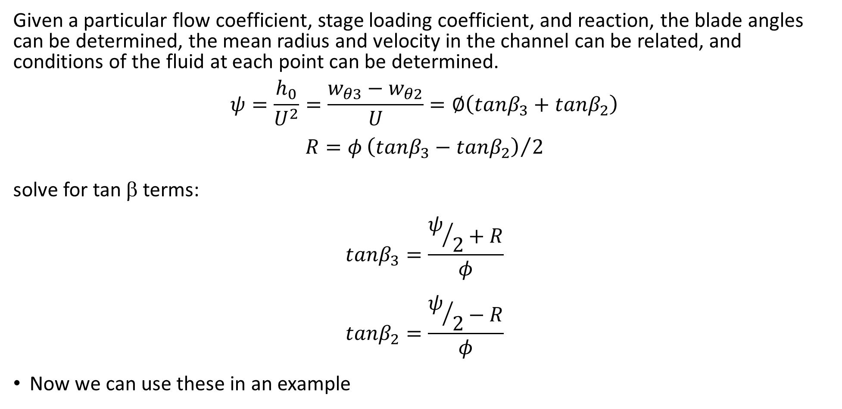
Design process
Given a particular flow coefficient, stage loading coefficient, and reaction, the blade angles can be determined, the mean radius and velocity in the channel can be related, and conditions of the fluid at each point can be determined.
$$ψ=\frac{h_{0}}{U^{2}}=\frac{w_{θ3}−w_{θ2}}{U}=∅\left(tanβ_{3}+tanβ_{2}\right)$$
$$R=φ{\left(tanβ_{3}−tanβ_{2}\right)}/2$$
solve for tan β terms:
$$tanβ_{3}=\frac{ψ/2+R}{φ}$$
$$tanβ_{2}=\frac{ψ/2−R}{φ}$$
Now we can use these in an example
Slide 30, $ψ=\frac{{∆h}_{0}}{U^{2}}=\frac{Δc_{θ}}{U}=\frac{c_{θ3}+c_{θ2}}{U}=\frac{w_{θ3}+w_{θ2}}{U}$

Slide 40
Design of turbine stage using parameters
Example: A turbine stage has a desired flow coefficient of 0.8, reaction of zero and stage loading of 5.1. Find the entry and exit relative flow angles and sketch the velocity triangles; calculate the axial velocity and given that the blade speed is 100 m/s, calculate the swirl angles, α. [ans: 72.6°, see next slide, 80 m/s, 62.5°, 77.3°]

Slide 41

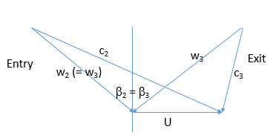

Slide 42
Example: Given the blades in the previous question are at a mean radius of 0.15m and that the blade height is 0.01m, and that the static pressure and temperature at nozzle exit are 8 bar and 1600K and the gas is air with R = 287 J/kgK, calculate the mass flow rate. [ans 1.313 kg/s]

